Slide 1
The History of the Holy Spirit in Adventism pt 9: Bad Bereans to Pitiful Parrots

Slide 2
Makes Decisions
Renews us
Spirit Speaks through David
HS forbids
Spirit reads man and God
Sanctifies us—3 mentioned
Spirit speaks/directs Peter
HS is omnipresent
Has Fellowship with us
Strengthens us
Spirit Speaks through Agabus
You can know the HS
Communion/relationship with us
You can grieve Him
Spirit spoke through Isaiah
No one directs the Spirit of the LORD
Lied to HS=Lied to God
Baptized in His Name
HS power is how we overcome
HS speaks via Paul
Wrote the Bible
HS is the Lord
Spirit gives eulogy
HS created the body of Jesus in the whom of Mary
Our Body is HS Temple
Jesus explains HS work
John 16:15
Rom. 8:26
Spirit says “Come”
HS taught Israel about the Sanctuary
Blasphemy not forgiven against HS
HS makes decisions
HS testified of Jesus’ sufferings and then powered the Gospel
HS is Intercessor/Groans
He testifies of Christ
HS bears witness
HS appoints positions
The Holy Spirit is the Creator
He is the Comforter/Person
Father sends in Jesus’ Name
HS is a witness
HS creates life
If they believe not on Jesus?
HS was vexed by ancient Israel
HS teaches
HS casts out Devils
Won’t speak of Himself
For the love the Spirit
Jesus directed by the HS
HS mentioned alongside the Son and the Father

Slide 3
The Kellogg Argument: Kellogg Brought in the Doctrine of the Trinity in his Book the Living Temple
“He [Kellogg] then stated that his former views regarding the trinity had stood in his way of making a clear and absolutely correct statement but that within a short time he had come to believe in the trinity and could now see pretty clearly where all the difficulty was and believed that he could clear up the matter satisfactorily. He told me that he now believed in God the Father, God the Son and God the Holy Ghost and his view was that it was God the Holy Ghost and not God the Father that filled all space and every living thing.” Letter, A. G. Daniells to W. C. White Oct 29th 1903

Slide 4
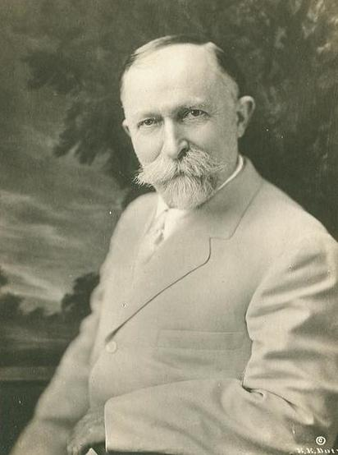
Ellen White: You Are Wrong About the Personality of God
“You are not definitely clear on the personality of God, which is everything to us as a people. You have virtually destroyed the Lord God Himself.” Ellen G. White to John Harvey Kellogg, Letter 300, March 16th 1903
Why is Ellen White Endorsing Trinitarians?
"Elder Haskell is a man of influence and has had an experience that goes back to the early days of the message. His interests were closely connected with those of the pioneers in this cause in their early labors and conflicts... Elder Haskell has had a knowledge of present truth from the beginning. He knows how to keep minds fresh, regarding the events of our history as a people, and to teach those points of faith that have been present truth to us from the rise of the message to this time... and (he) will work in harmony with the testimonies that God sends through His chosen agencies." Letter 56, 1908

Slide 5
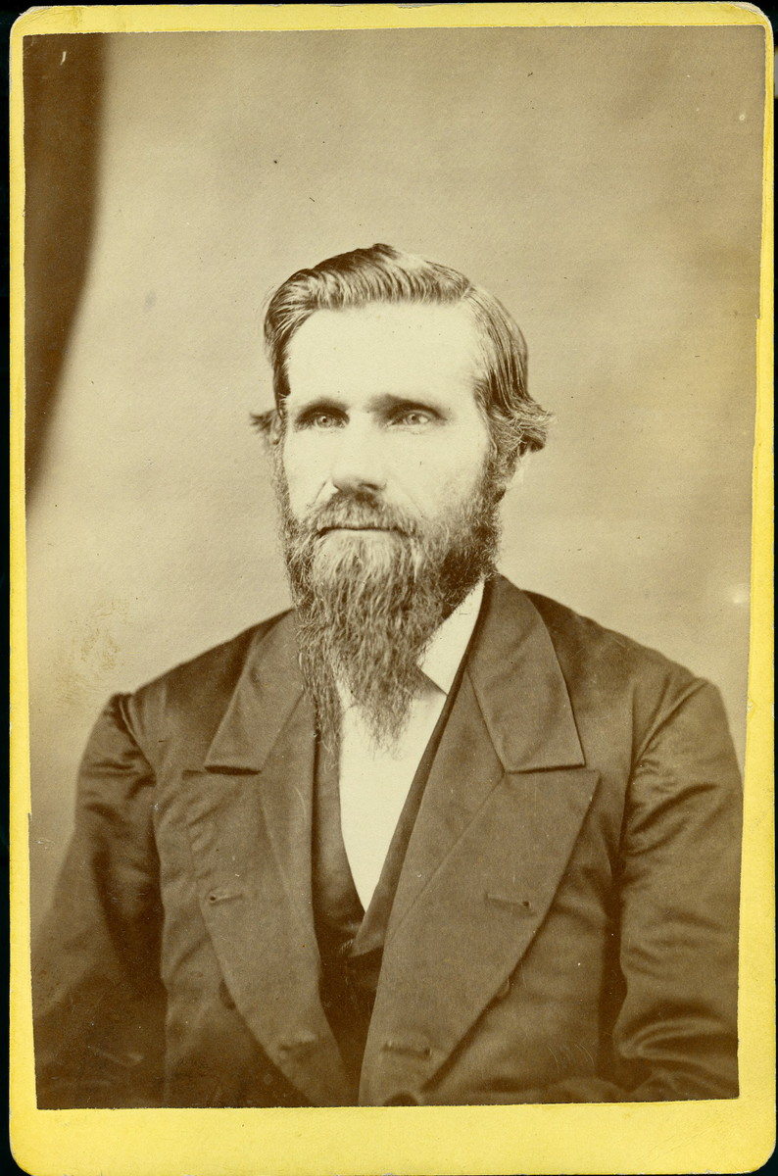
Haskell On the Trinity…. Again.
"The Father, the Son and the Holy Spirit are one and receive worship. Each one represents all the other members of the Trinity ... [but] Gabriel was only an angel bearing a message from the great Trinity of heaven, and could not receive worship [Rev. 19:10; Rev. 22:8-9]“ SN Haskell, The Bible Training School, Nov. 1907, No. 6, p. 94
“The doctrine of the Trinity is true when rightly understood” SN Haskell, Bible Training School, Feb. 1, 1906

Slide 6
Bad Bereans Didn’t Read the Full Quote!
“Dear Brother White: Ever since the council closed I have felt that I should write you confidentially regarding Dr. Kellog’s plans for revising and republishing “The Living Temple.” But I have allowed the pressure of work to prevent me from doing so. Last evening we received a letter from the Doctor which makes me feel that I must not delay any longer to write to you about this matter. In one of the Doctor’s statements made to the brethren while in council, he referred to “The Living Temple,” and gave us to understand that it would be entirely withdrawn from the market, and its career brought to an end; at least this was the idea I received from what he said. But the say the council closed, I had a long conversation with him about the book. He then told me that he did not think that after all there was a very great difference of opinion between us regarding the subject dealt with. He said that some days before coming to the council, he had been thinking the matter over, and began to see that he had made a slight mistake in expressing his views. He said that all the way along he had been troubled to know how to state the character of God and his relation to his created works. He felt sure that he believed just what the Testimonies teach, and what Dr. Waggoner and Elder Jones have taught for years” AG Daniells to WC White, Letter Oct. 29, 1903

Slide 7
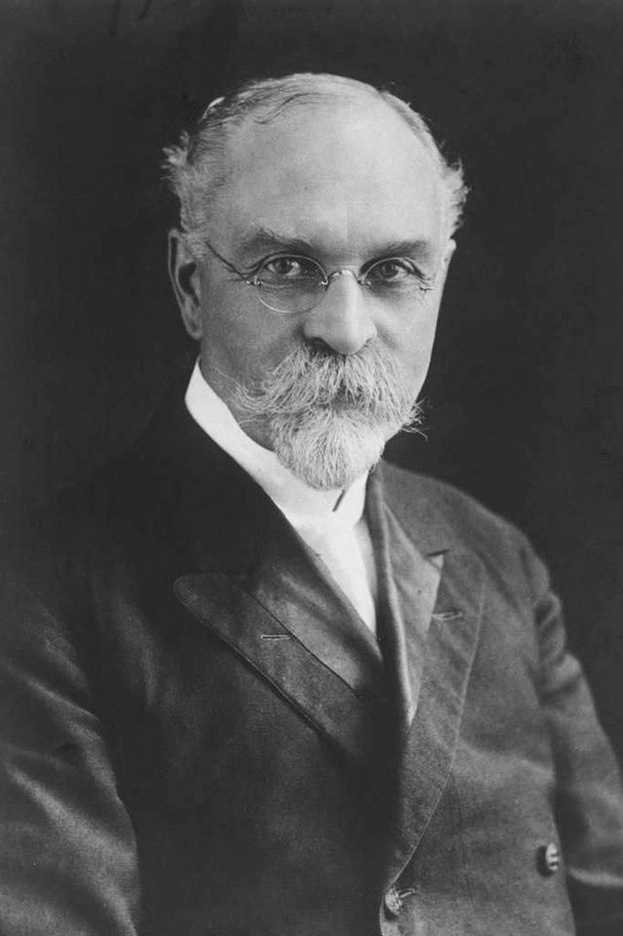
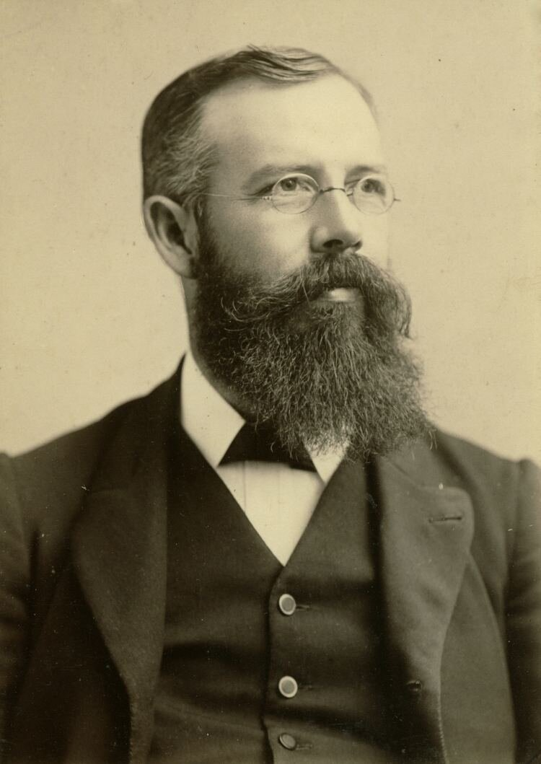
“but he had come to believe that none of them had expressed the matter in correct form. He then stated that his former views regarding the trinity had stood in his way of making a clear and absolutely correct statement; but that within a short time he had come to believe in the trinity, and could now see pretty clearly where all the difficulty was, and believed that he could clear the matter up satisfactorily. He told me that he now believed in God the Father, God the Son and God the Holy Ghost; that filled all space, and every living thing. He said that if he had believed this before writing the book, he could have expressed his views without giving the wrong impression the book now gives. I placed before him the objections I found in the teaching, and tried to show him that the teaching was so utterly contrary to the gospel that I did not see how it could be revised by changing a few expressions. We argued the matter ay some length in a friendly way; but I felt sure that when we parted, the Doctor did not understand himself, nor the character of his teaching. And I could not see how it would be possible for him to flop over, and in the course of a few days fix the book up so that it would be all right” AG Daniells to WC White, Oct. 29, 1903

Slide 8
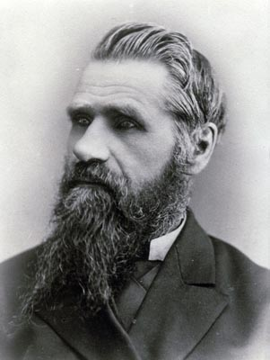
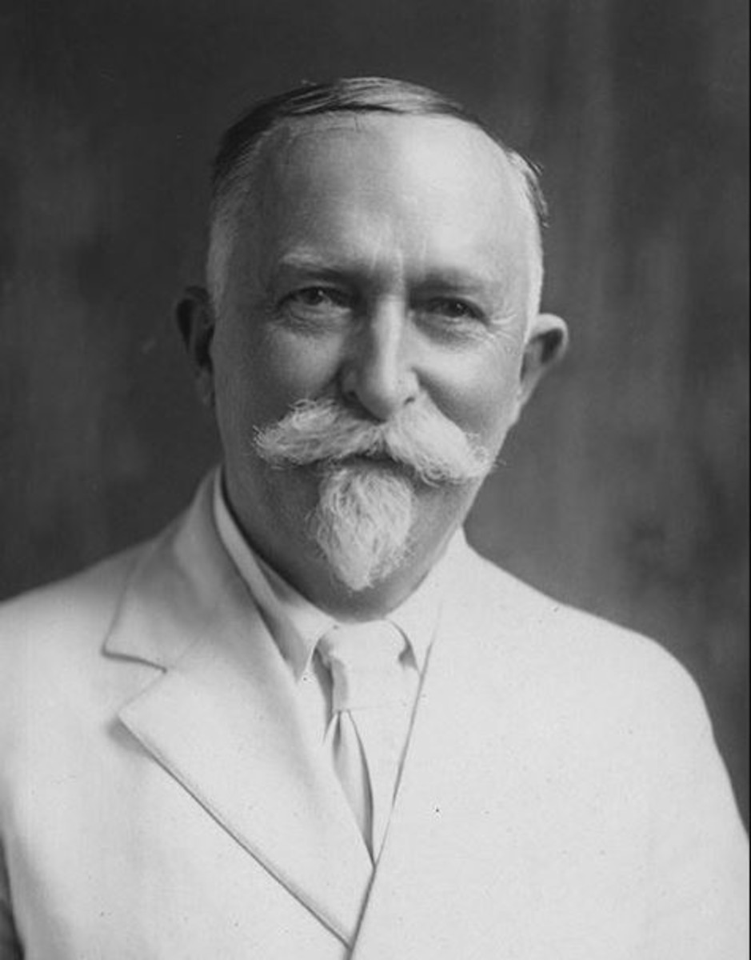
“After talking with me, he had a long interview with Prof. Prescott, in which he tried to get Brother Prescott to help him correct the statements that were misleading. But Brother Prescott would not consent to undertake the revision of that book in that manner. Then the doctor decided to leave a copy in his hands, with the request that he go through it, and cut out all that he believed misleading and erroneous. He stated that he would take a copy to Elder Haskell at South Lancaster, and ask him to do the same. Brother Prescott consented to give the book a careful examination, and write the Doctor his decision. After spending a whole day going through the book from the first part to the last, Brother Prescott became thoroughly convinced that it would be impossible to revise that part of the book dealing with theology, and he wrote to the Doctor to that effect.” AG Daniells to WC White Letter Oct. 29, 1903

Slide 9
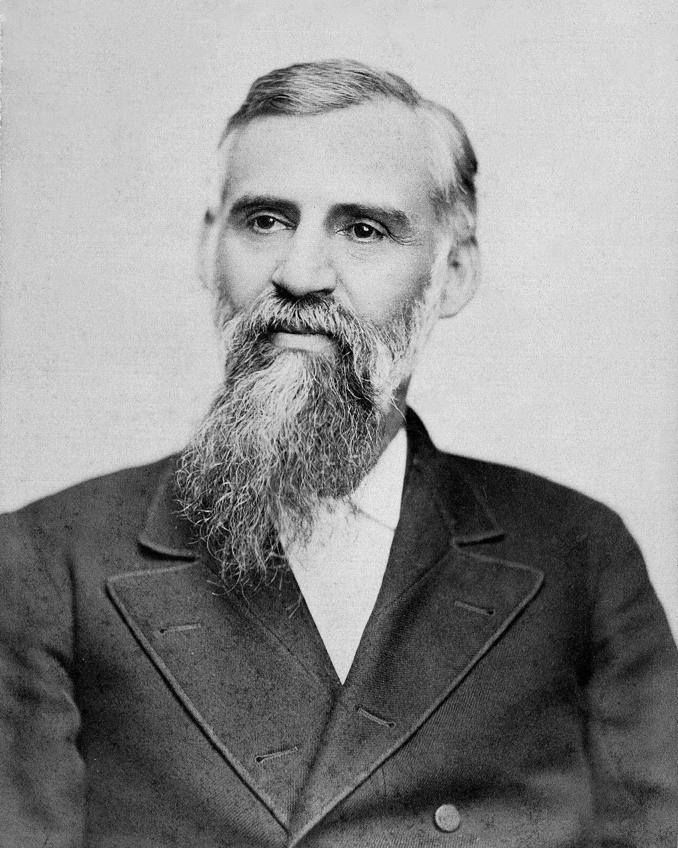
A Second Witness: Butler
"I have not by any means reached your conclusion, that the Holy Ghost and the Father are one", and probably never shall. The Scriptures say that God is a Sun; God is a light, etc. There is certainly a sense in which these statements are true. God and the Son of God MUST BE TWO DIFFERENT PERSONS. Christ says, "My Father is greater than I", and yet He says we should be one, even as the Father and He are one. It would be pretty hard to make fifteen or twenty of us, all children of God into ONE PERSON. BUT IT IS JUST AS DIFFICULT TO MAKE THE HOLY GHOST AND THE FATHER ONE PERSON.“ GI Butler to JH Kellogg Letter, Oct. 18, 1903

Slide 10
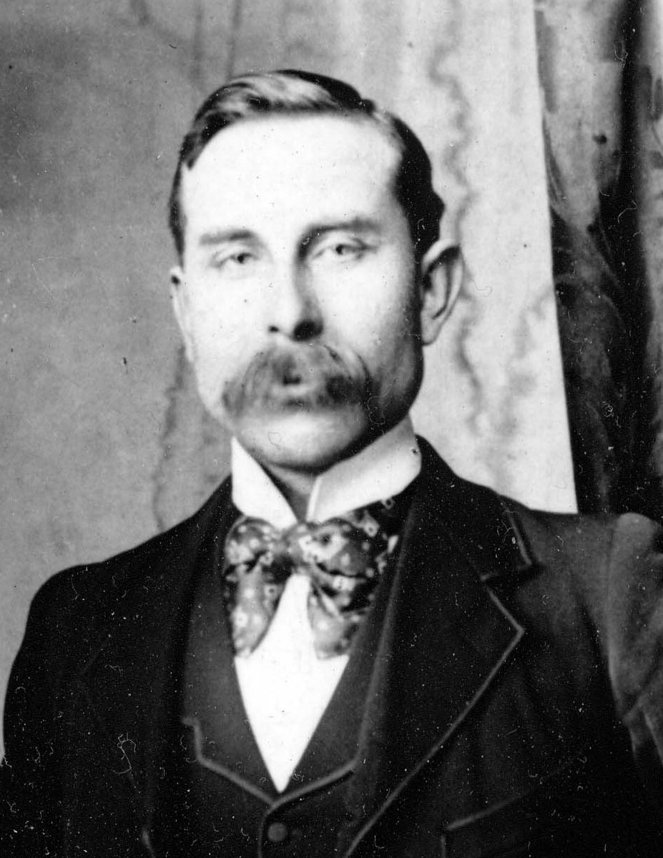
Next: The Washburn Quote “Against” the Trinity
“Because Christ being a part of the one person of the “Trinity” could not die unless the Father and Holy Ghost all died with Him, according to this false doctrine of the Trinity…” J.S. Washburn 1939 Letter “The Trinity”
Bad Bereans Did Not Read the Whole Quote: “Christ himself teaches in John 17:21, 22 that the three persons of the Godhead are three “separable beings.” For the disciples were “separable beings,” and Christ compares the unity of the Father and the Son with the unity of the disciples united in perfect unity of heart.” Ibid.

Slide 11
Antitrinitarian Teachers Agree Washburn Believes in the Biblical 3-Person Godhead:

Slide 12
The Parable of the Comforter?
Some Antitrinitarian false ministers twist the scriptures to teach that the sections on the Comforter from John 14-16 are merely a parable and not to be taken literally:
John 16:24-29 “Hitherto have ye asked nothing in my name: ask, and ye shall receive, that your joy may be full. These things have I spoken unto you in proverbs: but the time cometh, when I shall no more speak unto you in proverbs, but I shall shew you plainly of the Father. At that day ye shall ask in my name: and I say not unto you, that I will pray the Father for you: For the Father himself loveth you, because ye have loved me, and have believed that I came out from God. I came forth from the Father, and am come into the world: again, I leave the world, and go to the Father. His disciples said unto him, Lo, now speakest thou plainly, and speakest no proverb.”

Slide 13
Thus Saith the Lord
Wherever hearts are open to receive the truth, Christ is ready to instruct them. He reveals to them the Father, and the worship acceptable to Him who reads the heart. For such He uses no parables. To them, as to the woman at the well, He says, "I that speak unto thee am He.“– DA, 194
The disciples had been with Christ, and could understand Him; to them He need not talk in parables. He corrected their errors, and made plain to them the right way of approaching the people. He opened more fully to them the precious treasures of divine truth.– DA, 361
But the multitudes were slow of hearing, and in the home at Bethany Christ found rest from the weary conflict of public life. Here He opened to an appreciative audience the volume of Providence. In these private interviews He unfolded to His hearers that which He did not attempt to tell to the mixed multitude. He needed not to speak to His friends in parables.– DA, 524
If this is a parable, why is it not outlined and explained by Ellen White in any writing? Not the Desire of Ages, Not Christ’s Object Lessons???

Slide 14
Recap: Good or Bad Bereans???
Kellogg did not introduce the Trinity doctrine into Adventism, the Holy Spirit did. Kellogg was antitrinitarian when he wrote the book, then changed his understanding after the book was written to a Catholic Triune Pantheistic version of the Trinity. He requested others to “fix” his book but they wouldn’t so he published it anyway—the alpha of apostasy—Ellen White, Waggoner, Daniells, WC White, and Butler all rejected this false doctrine
Antitrinitarians who quote JS Washburn Letter on The Trinity quote it out of context and thus spread deception. Washburn’s issue with the Trinity is the same as Hislop’s, Wilkenson’s, the pioneers, and rational Christians: The 3-in-1 Trinity. In the very same text, JS Washburn makes the argument for a 3 Person Godhead…. Are you counting the lies told by Antitrinitarians?
Saying the Comforter chapters are parables goes against the Testimonies and obvious spiritual teaching. Many Antitrinitarians are just looking high and low for some method of proving their false doctrine. Like the Atheist, when their position is found to be false, they run to another false argument. You must defeat every single argument in the universe which they allege ‘proves’ the Holy Spirit is not a Person, but they need only provide 1 seemingly unanswerable argument to “win” the debate—that’s not honest!

Slide 15
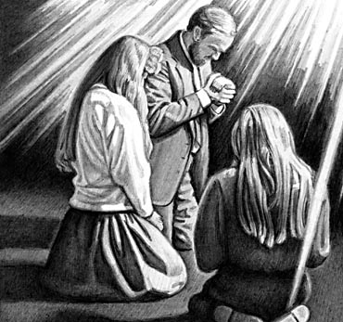
An Interesting Historical Warning
“If I had a vision in meeting, many would say that it was excitement and that someone mesmerized me. Then I would go away alone in the woods, where no eye or ear but God’s could see or hear, and pray to Him, and He would sometimes give me a vision there. I then rejoiced, and told them what God had revealed to me alone, where no mortal could influence me. But I was told by some that I mesmerized myself. Oh, thought I, has it come to this that those who honestly go to God alone to plead His promises and to claim His salvation, are to be charged with being under the foul and soul-damning influence of mesmerism? Do we ask our kind Father in heaven for “bread,” only to receive a “stone” or a “scorpion”” EW, p. 21

Slide 16
Accuse Others of What You Yourself Are Doing
“These things wounded my spirit, and wrung my soul in keen anguish, well-nigh to despair, while many would have me believe that there was no Holy Ghost and that all the exercises that holy men of God have experienced were only mesmerism or the deceptions of Satan. At this time there was fanaticism in Maine. Some refrained wholly from labor and disfellowshiped all those who would not receive their views on this point, and some other things which they held to be religious duties. God revealed these errors to me in vision and sent me to His erring children to declare them; but many of them wholly rejected the message, and charged me with conforming to the world. On the other hand, the nominal Adventists charged me with fanaticism, and I was falsely, and by some wickedly, represented as being the leader of the fanaticism that I was actually laboring to correct.” EW, p. 22

Slide 17
Catholicism/Jesuitism
General Conference
3rd Angel’s
Message
Fanaticism
Atheism/Politics

Slide 18
Don’t Forget Your ONLY Mission!
We are now living in the closing scenes of this world's history. Let men tremble with the sense of the responsibility of knowing the truth. The ends of the world are come. Proper consideration of these things will lead all to make an entire consecration of all that they have and are to their God. . . . The weighty obligation of warning a world of its coming doom is upon us. From every direction, far and near, calls are coming to us for help. The church, devotedly consecrated to the work, is to carry the message to the world: Come to the gospel feast; the supper is prepared, come. . . . Crowns, immortal crowns, are to be won. The kingdom of heaven is to be gained. A world, perishing in sin, is to be enlightened. The lost pearl is to be found. The lost sheep is to be brought back in safety to the fold. Who will join in the search? Who will bear the light to those who are wandering in the darkness of error? We should now feel the responsibility of laboring with intense earnestness to impart to others the truths that God has given for this time. We cannot be too much in earnest. . . . Now is the time for the last warning to be given. There is a special power in the presentation of the truth at the present time; but how long will it continue?--Only a little while. If there was ever a crisis, it is now. All are now deciding their eternal destiny. Men need to be aroused to realize the solemnity of the time, the nearness of the day when human probation shall be ended. Decided efforts should be made to bring the message for this time prominently before the people. The third angel is to go forth with great power. . . Evangelistic work, opening the Scriptures to others, warning men and women of what is coming upon the world, is to occupy more and still more of the time of God's servants. – Evangelism, p. 16,17

Slide 19
Other Arguments Coming
-Washburn quotex
-Kellogg quotex
-EGW Quotes
-Butchered Quote from Ellen White about the vision of the Sanctuary satan breathed on them

Slide 20
Persecution: Over the Trinity or Sabbath?
“A spurious sabbath is presented to be legislated into power, compelling the observance of a sabbath which God has not enjoined upon man. The persecutions of Protestants by Romanism, by which the religion of Jesus Christ was almost annihilated, will be more than rivalled, when Protestantism and popery are combined.” 3SM 387
“The same masterful mind that plotted against the faithful in ages past is still seeking to rid the earth of those who fear God and obey His law. Satan will excite indignation against the humble minority who conscientiously refuse to accept popular customs and traditions. Men of position and reputation will join with the lawless and the vile to take counsel against the people of God. Wealth, genius, education, will combine to cover them with contempt. Persecuting rulers, ministers, and church members will conspire against them. With voice and pen, by boasts, threats, and ridicule, they will seek to overthrow their faith. By false representations and angry appeals they will stir up the passions of the people. Not having a "Thus saith the Scriptures" to bring against the advocates of the Bible Sabbath, they will resort to oppressive enactments to supply the lack. To secure popularity and patronage, legislators will yield to the demand for a Sunday law. Those who fear God cannot accept an institution that violates a precept of the Decalogue. On this battlefield comes the last great conflict of the controversy between truth and error. And we are not left in doubt as to the issue. Now, as in the days of Mordecai, the Lord will vindicate His truth and His people. 5T 450

Slide 21
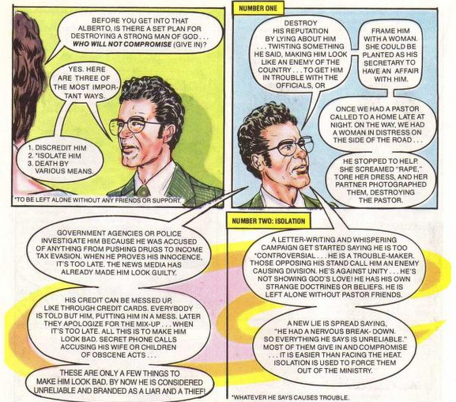
Jack Chick, Alberto Series: Alberto pt 1, p. 22

Slide 22
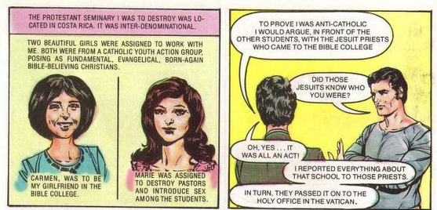
Jack Chick, Alberto Series: Alberto pt 1, p. 23

Slide 23
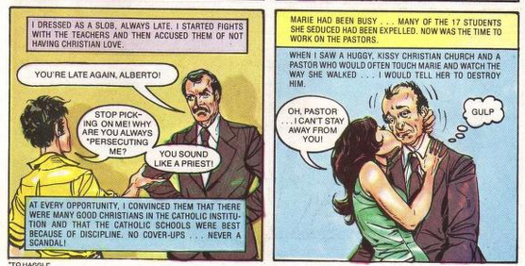
Jack Chick, Alberto Series: Alberto pt 1, p. 23

Slide 24
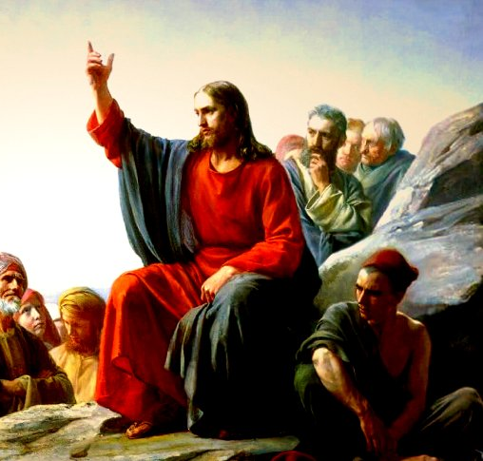
The Parable of the Comforter?
John 16:25-proverbs
John 14:16-18-Wanted to reveal the Father, he=Father
Rich man and Lazarus Parable-Abraham’s Bosom
John 14:22-Disciples say Jesus is coming
John 15:26-proceeds from the Father-Who is in the Sanctuary?

Slide 25
6. Spirit of truth, testify of Christ, therefore is Christ—If 3 are 1, then all symbols can apply to each
7. John 16:7-”I will send him unto you”—Christ could not send Spirit until he was glorified—Why then was He anointed with the Spirit at His baptism—was Christ’s ministry a farce? Stones into bread, come off the cross, legions
8. Spirit of a person and the person are the same thing right?
9. Holy Spirit as a person is a tradition, namely one from Rome—counterfeits of Satan
10. John 16:12-14-Not a new teacher—Christ is “truth” the “Spirit of truth” is the same Jesus Christ—NO TEACHER besides Christ—Son is glorified by the Father whose Spirit proceedeth from Him
11. John 16:26-27-All about the Father and Son of God-Sanctuary context
12. John 16:29-disciples said he speaks plain speech that He is the Son of God
13. This issue is NOT Christianity, not biblical-Become the 3rd Angel’s Message- Gal. 4:6—Is Christ omnipresent?
14. 1 John 2:1 “Comforter”—parakletos—is Jesus

Slide 26
The Gaslighters Outline:
Lenin accuse others of what you yourself are doing… + Hitler quote on Lenin being trained by Jesuits
Recap: They quote Canright—he’s a liar, Hislop—he believes in the Trinity, & Kellogg issue—when it proves the opposite, You believe in the Catholic Trinity when they actually do
Nadar Mansour—the parable of the Comfortor + Jesus did not speak in parables directly to his disciples—they glory in their unbelief (see my own quote to Chris Chung)
Fanaticism leads to darkness and strong delusion (EGW vision about Satan breathing on people---this is about the Sanctuary)
The stenographer issue: They reject every quote proving the Trinity from stenographers but then use them when it serves to bolster their arguments
1 John 5:7 doesn’t belong in the Bible—it was added to create the Trinity doctrine (NIV, RSV, ESV comparison) + Ellen White doesn’t quote it directly (there are other Bible passages she does not touch—does that make them false also?) + Gail Riplinger quotes
3rd Angel’s Message is to engross our whole work compared to stats of false ministries that dedicate themselves to this false message

Slide 27
Holy Spirit Vindicated Outline:
The Bible Evidence Recap
The SOP Evidence Recap
The Pioneer Evidence Recap
Their Best Arguments Defeated Recap (Parable of the Comforter, You’re Catholic Argument, The Father and Jesus are the Holy Spirit—Catholic spiritualism, Pioneers—fail… which ones?, Hislop liars, Kellogg liars, stenographer liars, Froom liars, Ellen White did not write that—with her own hand ML Andreason, the One True God is a false god doctrine)
The Parrots: Jesuit quote on how they would control minds—apes and parrots
Naming Names + Get back to the 3rd Angel’s Message—it’s salvational!

