Slide 1
Amazing Grace, pt. 11
‘Maiden of Maon’

Slide 2
The Chiseler!
So often, the home is used as the place of chiseling! Maybe because this is where we spend so much of our time, or maybe because it is here that we come into such close proximity to others that the Lord uses the home as the place to refine the character!

Slide 3
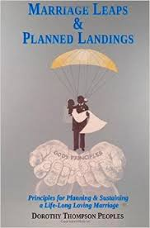
Planned Marriages
In Bible times, marriages were planned between the father and the suitor, like Laban and Jacob. Often, if the suitor had money, he could just about contract with anyone for their daughter because this was a sign that the daughter would be well cared for in her new home! Sometimes, character did not go along with the pocket book and unhappy marriages resulted!

Slide 4
A Fitting Example!
“And there was a man in Maon, whose possessions were in Carmel; and the man was very great, and he had three thousand sheep, and a thousand goats: and he was shearing his sheep in Carmel. Now the name of the man was Nabal; and the name of his wife Abigail: and she was a woman of good understanding, and of a beautiful countenance: but the man was churlish and evil in his doings; and he was of the house of Caleb.” 1 Sam. 25:2,3

Slide 5
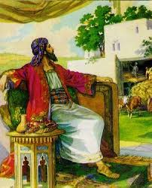
Wealthy Nabal
As far as his pocketbook was concerned, Nabal was a great man. He was extremely wealthy. He had several thousand animals and that translated into a nice big house, many servants, and plenty of everything! Tragically, all but happiness!

Slide 6
Rude, cheap, and mean!
Nabal was ‘’churlish and evil in his doings; and he was of the house of Caleb.” verse 3 SOP says, “ Nabal was a descendant of Caleb, but his character was churlish and niggardly.” PP, pg. 664
Churlish means ‘rude in a mean-spirited and surly way…rude, ill-mannered, ill-bred, discourteous, impolite, unmannerly, uncivil, unchivalrous;”
Niggardly means “not generous; stingy.
"serving out the rations with a niggardly hand"
synonyms: cheap, mean, miserly, parsimonious, close-fisted, penny-pinching,”

Slide 7
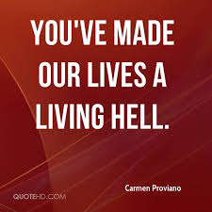
Hell to be Around!
Nabal was mean spirited. He let everyone know how much he despised their weaknesses! He had everything money could buy, but wouldn’t share it with anyone! This particular trait almost got him killed!

Slide 8
Nabal the Nightmare
Living with a man like that could easily have led Abigail to drink or drugs. At the least, Nabal could have made her just as cruel and nasty as he was. But, she didn’t; she choose to turn the lemon into lemonade…” My brethren, count it all joy when ye fall into divers temptations; Knowing this, that the trying of your faith worketh patience. But let patience have her perfect work, that ye may be perfect and entire, wanting nothing.” James 1:2-4

Slide 9
Abigail- The Opposite!
Abigail was everything Nabal was not. She was wise, God fearing, and ready to pitch in and help. She was understanding and quick on her feet to discern situations and how others were feeling! She was kind and generous.

Slide 10
The Jewel of Maon
In the crisis of her life, Abigail was, “These words could have come only from the lips of one who had partaken of the wisdom from above. The piety of Abigail, like the fragrance of a flower, breathed out all unconsciously in face and word and action. The Spirit of the Son of God was abiding in her soul. Her speech, seasoned with grace, and full of kindness and peace, shed a heavenly influence. Better impulses came to David, and he trembled as he thought what might have been the consequences of his rash purpose. "Blessed are the peacemakers: for they shall be called the children of God." Matthew 5:9. Would that there were many more like this woman of Israel, who would soothe the irritated feelings, prevent rash impulses, and quell great evils by words of calm and well-directed wisdom. A consecrated Christian life is ever shedding light and comfort and peace. It is characterized by purity, tact, simplicity, and usefulness. It is controlled by that unselfish love that sanctifies the influence. It is full of Christ, and leaves a track of light wherever its possessor may go. Abigail was a wise reprover and counselor.” PP, pg. 667

Slide 11
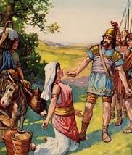
The sweetness of Christ in Her soul!
The amazing traits of character of Abigail that abode in her life were the result of choices she made as she faced trials. Such a character is not ours at birth, but is gained from the furnace of affliction! Probably, many of those trials came from being married to Nabal! The Spirit of God was abiding in her soul!

Slide 12
Nabal and Abigail and David!
“And David heard in the wilderness that Nabal did shear his sheep. And David sent out ten young men, and David said unto the young men, Get you up to Carmel, and go to Nabal, and greet him in my name: And thus shall ye say to him that liveth in prosperity, Peace be both to thee, and peace be to thine house, and peace be unto all that thou hast. And now I have heard that thou hast shearers: now thy shepherds which were with us, we hurt them not, neither was there ought missing unto them, all the while they were in Carmel. Ask thy young men, and they will shew thee. Wherefore let the young men find favour in thine eyes: for we come in a good day: give, I pray thee, whatsoever cometh to thine hand unto thy servants, and to thy son David. And when David's young men came, they spake to Nabal according to all those words in the name of David, and ceased. And Nabal answered David's servants, and said, Who is David? and who is the son of Jesse? there be many servants now a days that break away every man from his master. Shall I then take my bread, and my water, and my flesh that I have killed for my shearers, and give it unto men, whom I know not whence they be? So David's young men turned their way, and went again, and came and told him all those sayings.” 1 Sam. 25:4-12

Slide 13
For months, David’s men had protected Nabal’s shepherd’s from marauders and thieves. At shearing time, David expected some kind of show of appreciation. This was right, reasonable, and custom at that time! Nabal let David’s men have it. Forget it!! No way, pal!

Slide 14
David Responds
“And David said unto his men, Gird ye on every man his sword. And they girded on every man his sword; and David also girded on his sword: and there went up after David about four hundred men; and two hundred abode by the stuff. But one of the young men told Abigail, Nabal's wife, saying, Behold, David sent messengers out of the wilderness to salute our master; and he railed on them. But the men were very good unto us, and we were not hurt, neither missed we any thing, as long as we were conversant with them, when we were in the fields: They were a wall unto us both by night and day, all the while we were with them keeping the sheep. Now therefore know and consider what thou wilt do; for evil is determined against our master, and against all his household: for he is such a son of Belial, that a man cannot speak to him.” 1 Samuel 25:13-17

Slide 15
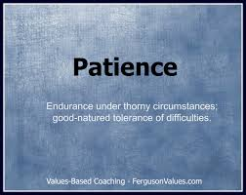
Murder on his Mind!
“When the young men returned empty-handed and related the affair to David, he was filled with indignation. He commanded his men to equip themselves for an encounter; for he had determined to punish the man who had denied him what was his right, and had added insult to injury. This impulsive movement was more in harmony with the character of Saul than with that of David, but the son of Jesse had yet to learn of patience in the school of affliction.
One of Nabal's servants hastened to Abigail, the wife of Nabal, after he had dismissed David's young men, and told her what had happened.” PP, pg. 665

Slide 16
Abigail Intervenes
And when Abigail saw David, she hasted, and lighted off the ass, and fell before David on her face, and bowed herself to the ground, And fell at his feet, and said, Upon me, my lord, upon me let this iniquity be: and let thine handmaid, I pray thee, speak in thine audience, and hear the words of thine handmaid. Let not my lord, I pray thee, regard this man of Belial, even Nabal: for as his name is, so is he; Nabal is his name, and folly is with him: but I thine handmaid saw not the young men of my lord, whom thou didst send. Now therefore, my lord, as the LORD liveth, and as thy soul liveth, seeing the LORD hath withholden thee from coming to shed blood, and from avenging thyself with thine own hand, now let thine enemies, and they that seek evil to my lord, be as Nabal. And now this blessing which thine handmaid hath brought unto my lord, let it even be given unto the young men that follow my lord. I pray thee, forgive the trespass of thine handmaid: for the LORD will certainly make my lord a sure house; because my lord fighteth the battles of the LORD, and evil hath not been found in thee all thy days. Yet a man is risen to pursue thee, and to seek thy soul: but the soul of my lord shall be bound in the bundle of life with the LORD thy God; and the souls of thine enemies, them shall he sling out, as out of the middle of a sling. And it shall come to pass, when the LORD shall have done to my lord according to all the good that he hath spoken concerning thee, and shall have appointed thee ruler over Israel; That this shall be no grief unto thee, nor offence of heart unto my lord, either that thou hast shed blood causeless, or that my lord hath avenged himself: but when the LORD shall have dealt well with my lord, then remember thine handmaid.” 1 Samuel 25:23-31

Slide 17
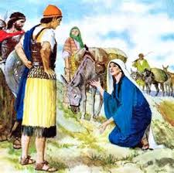
Intercessor!
“Without consulting her husband or telling him of her intention, Abigail made up an ample supply of provisions… The piety of Abigail, like the fragrance of a flower, breathed out all unconsciously in face and word and action. The Spirit of the Son of God was abiding in her soul. Her speech, seasoned with grace, and full of kindness and peace, shed a heavenly influence. Better impulses came to David, and he trembled as he thought what might have been the consequences of his rash purpose.” PP, pg. 667

Slide 18
Fruits in her Life!
Abigail’s intervention:
1. Saved David from murder and guilt.
2. Provided necessary provisions for David and his men.
3. Nabal could not handle the truth of what could have happened and he died.
4. Abigail became David’s wife.

