Slide 1
Prophetic Update ‘Activist for Christ’

Slide 2
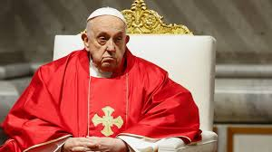
Francis’ Two-Pronged Attack!
Francis’ two pronged attack centers around complete political and religious power. He is advocating this with great force today. Listen to him speak, “a need for all nations of the world to submit their governmental powers to a reformed and more powerful United Nations in the hope of leading to one world government to benefit all mankind. He noted that the time is now right to make this move, since globalized economic conditions in the twenty-first century have weakened the political power of nation states. A single, global authority, he wrote, “ought at least to promote more effective world organizations, equipped with the power to provide for the global common good, the elimination of hunger and poverty and the sure defense of fundamental human rights.”
Tomorrows World, Oct. 30, 2020

Slide 3
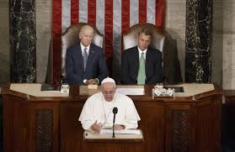
Who Might that Authority Be?
“With whom the kings of the earth have committed fornication, and the inhabitants of the earth have been made drunk with the wine of her fornication. So he carried me away in the spirit into the wilderness: and I saw a woman sit upon a scarlet colored beast, full of names of blasphemy, having seven heads and ten horns.” Revelation 17:2-3
We see a power here that is the combination of a beast (political power) and a woman (church power).

Slide 4
In the Religious Realm TOO!
“I extend my heartfelt greetings to all present at the Fourth World Gathering of the Global Christian Forum. Your assembly has participants from all over the world, which reflects a beautiful mosaic of contemporary Christianity with its rich diversity while still founded on our shared identity as followers of Jesus Christ…Unity is an indispensable element for embracing the vision of the Kingdom of God. As such, there is an intrinsic bond between ecumenism and Christian mission. Throughout its history, the Global Christian Forum has contributed significantly to the promotion of this bond by providing a space in which members, especially those from different historical expressions of the Christian faith, grow in mutual respect and fraternity by encountering one another in Christ. May this gathering, on the forum’s silver anniversary, deepen your faith and revitalize your fraternal love as you pray together, exchange your personal stories and address the challenges facing the global Christian community. To all of you, I invoke the blessings of Almighty God, and pray that the gathering will advance the visible unity among all Christians.” Dicastery for Promoting Christian Unity Via della Conciliazione, 5 - 00193 Rome

Slide 5
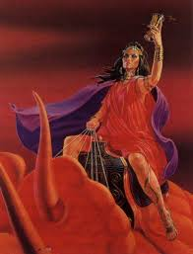
Revelation 17 Depicts a Religious power too!!
“And the woman was arrayed in purple and scarlet colour, and decked with gold and precious stones and pearls, having a golden cup in her hand full of abominations and filthiness of her fornication: And upon her forehead was a name written, MYSTERY, BABYLON THE GREAT, THE MOTHER OF HARLOTS AND ABOMINATIONS OF THE EARTH.” Revelation 17:4,5

Slide 6
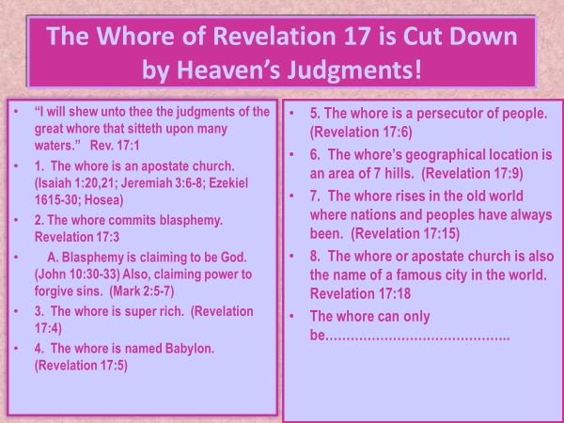
Characteristics of this Religious/Political Power

Slide 7
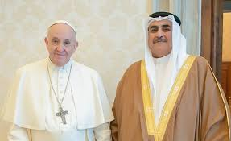
The Papacy-Religious and Political
Today, we are seeing Revelation 17 right before our eyes. The papacy is in command, wielding both political and religious power and this will culminate in her regaining the lost political power she had during the Dark Ages. However, this time, the Lord will not allow her to rule for very long. ““And the ten horns which thou sawest are ten kings, which have received no kingdom as yet; but receive power as kings one hour with the beast. These have one mind, and shall give their power and strength unto the beast.” Revelation 17:12,13

Slide 8
A Warning to the Political Powers of Earth
“The Roman Church now presents a fair front to the world, covering with apologies her record of horrible cruelties. She has clothed herself in Christlike garments; but she is unchanged. Every principle of the papacy that existed in past ages exists today. The doctrines devised in the darkest ages are still held. Let none deceive themselves. The papacy that Protestants are now so ready to honor is the same that ruled the world in the days of the Reformation, when men of God stood up, at the peril of their lives, to expose her iniquity. She possesses the same pride and arrogant assumption that lorded it over kings and princes, and claimed the prerogatives of God. Her spirit is no less cruel and despotic now than when she crushed out human liberty and slew the saints of the Most High. The papacy is just what prophecy declared that she would be, the apostasy of the latter times. 2 Thessalonians 2:3, 4. It is a part of her policy to assume the character which will best accomplish her purpose; but beneath the variable appearance of the chameleon she conceals the invariable venom of the serpent. “Faith ought not to be kept with heretics, nor persons suspected of heresy” (Lenfant, volume 1, page 516), she declares. Shall this power, whose record for a thousand years is written in the blood of the saints, be now acknowledged as a part of the church of Christ?” GC, pg. 571

Slide 9
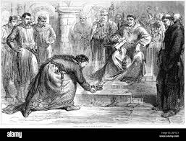
Nothing Good Will Ever Come from Rome!!
Tyranny, destruction of liberty, enslavement of mankind, the horrors of the Dark Ages revived , will be the fruits of Rome's ascendancy. Nothing good will ever come from Romanism. They are the epitome of despotic rule!! Have we forgotten the history of King John and Henry the 4th? Rome seeks to destroy us all!!

Slide 10
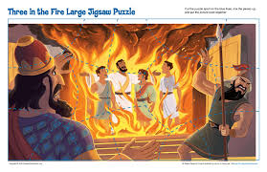
Babylon the Great Tried it Before
Then Nebuchadnezzar the king sent to gather together the princes, the governors, and the captains, the judges, the treasurers, the counsellors, the sheriffs, and all the rulers of the provinces, to come to the dedication of the image which Nebuchadnezzar the king had set up…Then Nebuchadnezzar the king was astonied, and rose up in haste, and spake, and said unto his counsellors, Did not we cast three men bound into the midst of the fire? They answered and said unto the king, True, O king. He answered and said, Lo, I see four men loose, walking in the midst of the fire, and they have no hurt; and the form of the fourth is like the Son of God.” Daniel 3:2,24,25

Slide 11
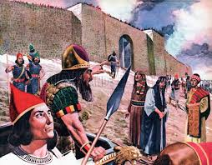
World Empire in the Long Ago!
The Assyrian barbarians surrounded the people of God, threatening them, and wanting to make them utterly subservient to their rule. The ASSYRIANS had a massive empire and felt their victory over all was assured!
Hezekiah felt otherwise. “Be strong and courageous, be not afraid nor dismayed for the king of Assyria, nor for all the multitude that is with him: for there be more with us than with him: With him is an arm of flesh; but with us is the LORD our God to help us, and to fight our battles. And the people rested themselves upon the words of Hezekiah king of Judah.” 2 Chronicles 32:7,8

Slide 12
The Results: God vs. Earthly Monsters
“Therefore thus saith the LORD concerning the king of Assyria, He shall not come into this city, nor shoot an arrow there, nor come before it with shields, nor cast a bank against it. By the way that he came, by the same shall he return, and shall not come into this city, saith the LORD. For I will defend this city to save it for mine own sake, and for my servant David's sake. Then the angel of the LORD went forth, and smote in the camp of the Assyrians a hundred and fourscore and five thousand: and when they arose early in the morning, behold, they were all dead corpses. So Sennacherib king of Assyria departed, and went and returned, and dwelt at Nineveh.” Isaiah 37:33-37

Slide 13
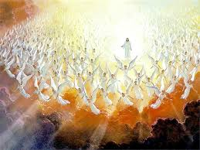
Nebuchadnezzar, Sennacharib, and Francis
“These have one mind, and shall give their power and strength unto the beast. These shall make war with the Lamb, and the Lamb shall overcome them: for he is Lord of lords, and King of kings: and they that are with him are called, and chosen, and faithful.” Rev. 17:13,14
The ecumenical movement and the powers of earth are warring against Christ and His little ones. The Lord Jesus will win this battle. To all, Francis and friends-slaves, turn to Jesus before it is forever too late!!!

Slide 14
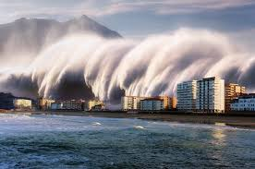
“And after these things I saw another angel come down from heaven, having great power; and the earth was lightened with his glory. And he cried mightily with a strong voice, saying, Babylon the great is fallen, is fallen, and is become the habitation of devils, and the hold of every foul spirit, and a cage of every unclean and hateful bird. For all nations have drunk of the wine of the wrath of her fornication, and the kings of the earth have committed fornication with her, and the merchants of the earth are waxed rich through the abundance of her delicacies. And I heard another voice from heaven, saying, Come out of her, my people, that ye be not partakers of her sins, and that ye receive not of her plagues.” Rev. 18:1-4

