Slide 1
The Right Arm, pt. 9
Trust in Divine Power

Slide 2
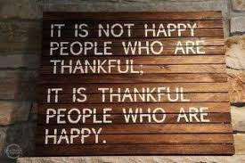
“Sickness of the mind prevails everywhere. Nine tenths of the diseases from which men suffer have their foundation here. Perhaps some living home trouble is, like a canker, eating to the very soul and weakening the life-forces. Remorse for sin sometimes undermines the constitution and unbalances the mind. There are erroneous doctrines also, as that of an eternally burning hell and the endless torment of the wicked that, by giving exaggerated and distorted views of the character of God, have produced the same result upon sensitive minds.—Testimonies for the Church 5, pg.444

Slide 3
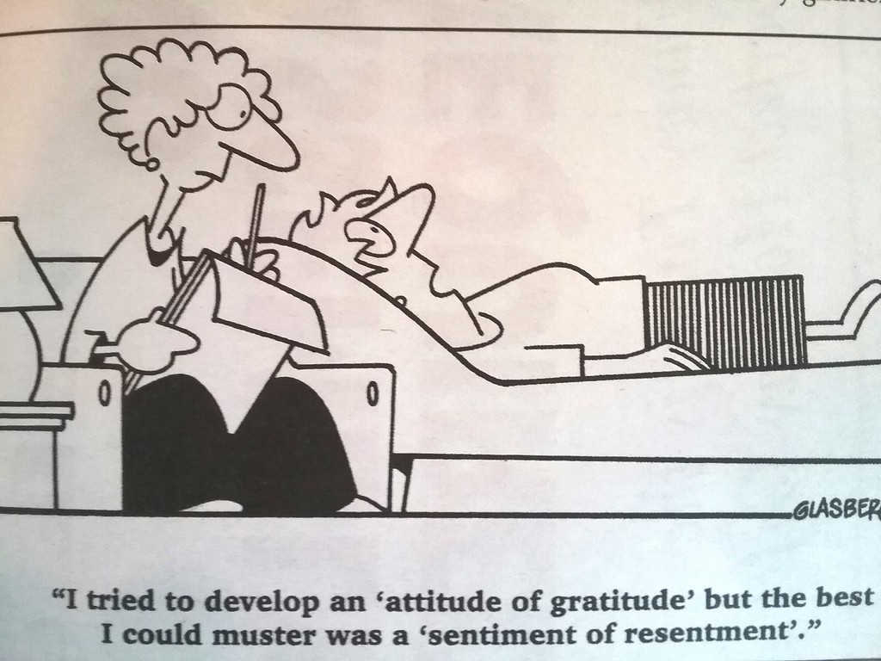
Final Law of Health-Trust in Divine Power
The last law of health that we will look at is Trusting in Divine Power. This is the most important law of health, far surpassing the other 7. Since 90% of all disease begins in the mind; obviously, keeping our thoughts on heavenly things, living in submission to God’s authority, and keeping an attitude of gratitude will help to keep us free from disease.

Slide 4
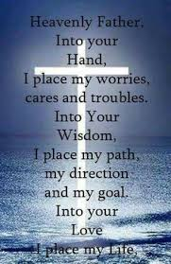
“Pure air, sunlight, abstemiousness, rest, exercise, proper diet, the use of water, trust in Divine power—these are the true remedies.”—Ellen G. White, Ministry of Healing, p. 127

Slide 5
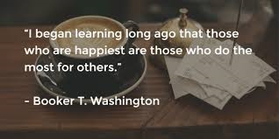
Serving Others!
Research has shown that spirituality helps to control stress, strengthen the immune system, and protect against heart disease and cancer. Beyond these benefits, God promises eternal life to those who trust Him—a life of perfect health and freedom from pain, fear, and death. Persevere in learning of Him and talking to Him; you will come to experience His great unfailing love, His power and wisdom, the kindness, beauty, and compassion of His character, and the joy of doing His will. You will learn to trust Him and know that He loves you and will never harm you.
There are two more principles of health beyond the eight laws mentioned thus far that deserve special mention. They are gratitude and serving others.

Slide 6
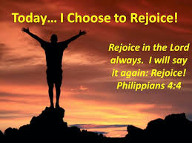
Rejoicing in the Lord
"Gratitude, rejoicing, benevolence, trust in God 's love and care -- these are health's greatest safeguards." My Life Today, pg. 151.
Science has proven now, that people who trust in God , and have faith, come through illnesses and surgeries better than those who do not trust in God.

Slide 7
Leaning on Jesus!
Remember, worry, stress, and depression bring decay, disease, and death. The immune system is strengthened by trusting God. The foundation of all health is in the acceptance of the blessings which the Creator has provided for us. Foremost of these is the privilege we have of choosing our Saviour to be our Guide as well as our Great Physician. In fact, the divine purpose of our physical healing is to make us more inclined to accept the spiritual healing Christ longs to perform upon our hearts. There is an inexpressible peace that comes to one who has learned to trust in God and to lay all things in His hands. In Matthew 11:28 Jesus says, “Come unto Me…and I will give your rest.” Rest from sorrow, rest from fear, and rest from insecurity. But first we must come to Him as our Great Physician. We must trust Him before we can understand and practice His profession or reveal His wisdom and love. The let us resign ourselves to do His will, and endeavor faithfully to follow every instruction He gives for when we come to God, we must be willing to acknowledge and accept His ways as best for us, and follow them, regardless of our own personal preference and prejudices.

Slide 8
Reducing Anxiety!
Dr. Andrew Newberg wrote a book entitled How God Changes Your Brain’ Through extensive research and brain scans, he shows that spiritual practices are inherently good for our bodies—especially our brains. According to Newberg, both meditation and prayer play significant roles in strengthening important circuits in our brains, which make us more socially aware and alert, while reducing anxiety, depression, and neurological stress.

Slide 9
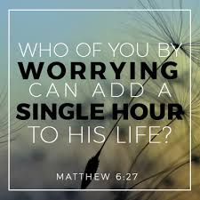
Crushing the Life Force
“The love which Christ diffuses through the whole being is a vitalizing power. Every vital part—the brain, the heart, the nerves—it touches with healing. By it the highest energies of the being are aroused to activity. It frees the soul from the guilt and sorrow, the anxiety and care, that crush the life-forces. With it come serenity and composure. It implants in the soul, joy that nothing earthly can destroy—joy in the Holy Spirit—health-giving, life-giving joy.—The Ministry of Healing, 115 (1905).

Slide 10
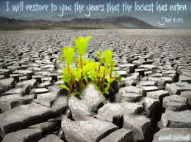
Christ Restores Broken Mind!
“God’s healing power runs all through nature. If a tree is cut, if a human being is wounded or breaks a bone, nature begins at once to repair the injury. Even before the need exists, the healing agencies are in readiness; and as soon as a part is wounded, every energy is bent to the work of restoration. So it is in the spiritual realm. Before sin created the need, God had provided the remedy. Every soul that yields to temptation is wounded, bruised, by the adversary; but wherever there is sin, there is the
Savior. It is Christ’s work “to heal the brokenhearted, to preach deliverance to the captives, ... To set at liberty them that are bruised” (Luke 4:18).—Education, 113

Slide 11

Evil Destroys the Mind
“Evil thoughts destroy the soul. The converting power of God changes the heart, refining and purifying the thoughts. Unless a determined effort is made to keep the thoughts centered on Christ, grace cannot reveal itself in the life. The mind must engage in the spiritual warfare. Every thought must be brought into captivity to the obedience of Christ. All the habits must be brought under God’s control.—Letter 123, 1904.

Slide 12
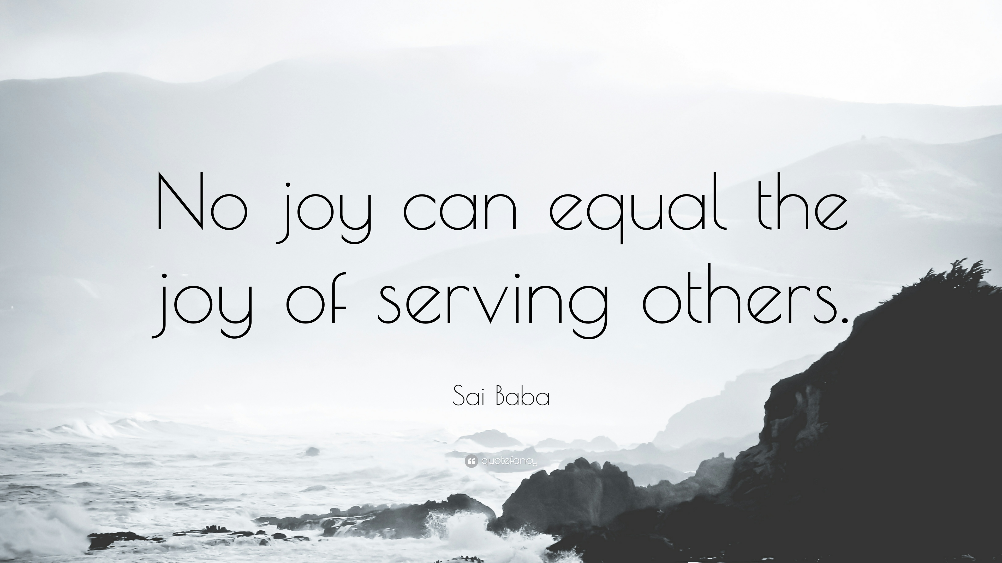
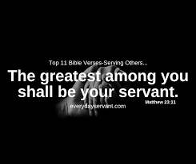
Being Grateful and Serving Others keys to Health

Slide 13
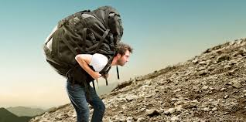
When you are feeling crushed
Sometimes, everything seems against us and the temptation to believe God doesn’t love us anymore is almost overwhelming. Then is the time to go to a quiet place and begin to thank God for all His blessings. They may be very small things, but as we thank Him for blessings received, the discouragement and despondency will disappear and you will be at peace again!

Slide 14
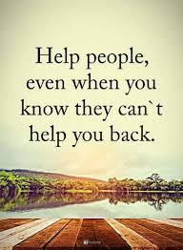
Serve Those Who Can’t Serve you
Service to others in itself is a good thing! The greatest kind of service is serving those who can NEVER return the favor. Serving those who can not possibly repay your kindness to them gives a special sense of joy for you have the sense of giving to one who can never give back to you. This leads one to depend upon the Lord for his needs and to health of mind and body!

Slide 15
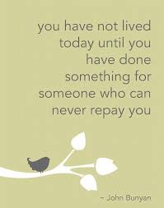
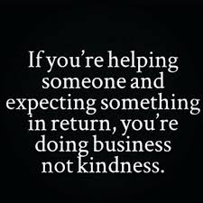

Slide 16
“Many are in obscurity. They have lost their bearings. They know not what course to pursue. Let the perplexed ones search out others who are in perplexity and speak to them words of hope and encouragement. When they begin to do this work, the light of heaven will reveal to them the path that they should follow. By their words of consolation to the afflicted they themselves will be consoled. By helping others, they themselves will be helped out of their difficulties. Joy takes the place of sadness and gloom. The heart, filled with the Spirit of God, glows with warmth toward every fellow being. Every such a one is no longer in darkness; for his "darkness" is "as the noon day."--MS 116, 1902. (4BC 1151.)

Slide 17
Unselfish Work!
“Unselfish work for others helps make our characters like Christ’s. It brings peace and happiness. It gives us a strong desire to be more helpful. There will be no room in our lives for laziness and selfishness. If we exercise our faith and other Christian graces, we will become strong in our work for God. We shall see the truth clearly. Our faith will keep growing, and we will pray with greater power. God’s Spirit will move upon our hearts, helping us develop characters that will honor Him. If we give ourselves in unselfish service for others, we are most surely working out our own salvation. The only way to grow in grace is to do the work Christ has asked us to do. We need to help others as much as we can, for helping others is spiritual exercise. Exercising the body makes a person strong. If we want to keep our Christian life strong, we must work. If we receive God’s blessings and do nothing, our Christian lives will not be healthy and strong. Receiving without giving is like trying to live by eating and not working. A person who does not use his arms and legs soon loses his power to move them. The Christian who will not use the powers that God gives him no longer grows in Christ. He even loses the power he already has.

Slide 18

Trusting in Divine Power
“How excellent is thy lovingkindness, O God! therefore the children of men put their trust under the shadow of thy wings.” Ps. 36: 8 Trusting in the goodness of God, knowing He loves us and wants our best good will lead us to a merry heart of thanksgiving/gratitude and praise. This attitude of gratitude will find its highest joy in serving those who could never repay us for our efforts toward them!

