Slide 1
‘I Hear the Sound’

Slide 2
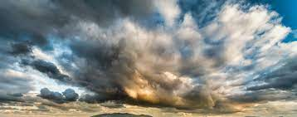
I HEAR THE SOUND
OF A MIGHTY RUSHING WIND
AND IT’S CLOSER NOW
THAN IT’S EVER BEEN
I CAN ALMOST HEAR THE TRUMPET
AND GABRIEL SOUND THE CHORD
AT THE MIDNIGHT CRY WE’LL BE GOING HOME.

Slide 3
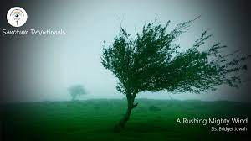
“And when the day of Pentecost was fully come, they were all with one accord in one place. And suddenly there came a sound from heaven as of a rushing mighty wind, and it filled all the house where they were sitting. And there appeared unto them cloven tongues like as of fire, and it sat upon each of them. And they were all filled with the Holy Ghost, and began to speak with other tongues, as the Spirit gave them utterance. And there were dwelling at Jerusalem Jews, devout men, out of every nation under heaven. Now when this was noised abroad, the multitude came together, and were confounded, because that every man heard them speak in his own language.” Acts 2:1-6

Slide 4
The Early Rain!
“It is true that in the time of the end, when God's work in the earth is closing, the earnest efforts put forth by consecrated believers under the guidance of the Holy Spirit are to be accompanied by special tokens of divine favor. Under the figure of the early and the latter rain, that falls in Eastern lands at seedtime and harvest, the Hebrew prophets foretold the bestowal of spiritual grace in extraordinary measure upon God's church. The outpouring of the Spirit in the days of the apostles was the beginning of the early, or former, rain, and glorious was the result. To the end of time the presence of the Spirit is to abide with the true church.” Acts of the Apostles, pgs. 54,55

Slide 5
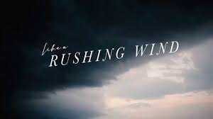
It’s Purpose
“I was shown that if God's people make no efforts on their part, but wait for the refreshing to come upon them and remove their wrongs and correct their errors; if they depend upon that to cleanse them from filthiness of the flesh and spirit, and fit them to engage in the loud cry of the third angel, they will be found wanting. The refreshing or power of God comes only on those who have prepared themselves for it by doing the work which God bids them, namely, cleansing themselves from all filthiness of the flesh and spirit, perfecting holiness in the fear of God.” (1T 619)

Slide 6
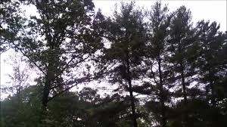
“A new heart also will I give you, and a new spirit will I put within you: and I will take away the stony heart out of your flesh, and I will give you an heart of flesh. And I will put my spirit within you, and cause you to walk in my statutes, and ye shall keep my judgments, and do them.” Ezekiel 36:26,27
“Seeing ye have purified your souls in obeying the truth through the Spirit unto unfeigned love of the brethren, see that ye love one another with a pure heart fervently:” 1 Peter 1:23
“In all who submit to His power the Spirit of God will consume sin. But if men cling to sin, they become identified with it.” DA, pg. 107

Slide 7
Someone ELSE is Coming
“And after these things I saw another angel come down from heaven, having great power; and the earth was lightened with his glory.” Rev. 18:1
“I saw the latter rain is coming suddenly, as the midnight cry and with ten times the power.” Ellen White letter, Spalding-Megan Collection, pages 3,4
“In the parable of Matthew 25 the time of waiting and slumber is followed by the coming of the bridegroom. This was in accordance with the arguments just presented, both from prophecy and from the types. They carried strong conviction of their truthfulness; and the "midnight cry" was heralded by thousands of believers.
Like a tidal wave the movement swept over the land. From city to city, from village to village, and into remote country places it went, until the waiting people of God were fully aroused.” GC, pg. 400

Slide 8
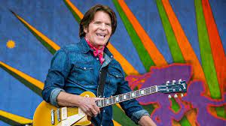
The Devil Has Tried So Hard to Stop Him
Under the control of demon spirits, John Fogerty and Credence Clearwater Revival sang in the 70’s
“Long as I remember
The rain been coming' down.
Clouds of mystery pouring'
Confusion on the ground.
Good men through the ages,
Trying' to find the sun;
And I wonder,
Still I wonder,
Who'll stop the rain?

Slide 9
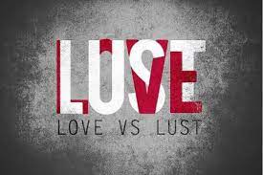
Trying to Stop the Rain thru Adventist Spiritualism
“It is true that spiritualism is now changing its form and, veiling some of its more objectionable features, is assuming a Christian guise…. Even in its present form, so far from being more worthy of toleration than formerly, it is really a more dangerous, because a more subtle, deception. While it formerly denounced Christ and the Bible, it now professes to accept both. But the Bible is interpreted in a manner that is pleasing to the unrenewed heart, while its solemn and vital truths are made of no effect. Love is dwelt upon as the chief attribute of God, but it is degraded to a weak sentimentalism, making little distinction between good and evil. God's justice, His denunciations of sin, the requirements of His holy law, are all kept out of sight. The people are taught to regard the Decalogue as a dead letter.” GC, pgs. 557,558

Slide 10
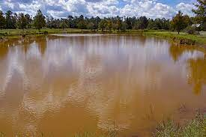
Adventist Spiritualism Defined
Adventist spiritualism wants love and sin together. It only wants Jesus without law, justice. It wants Jesus 2,000 years ago, but nothing in the life!
It doesn’t want Rev. 14 anymore. It wants to be with the other churches, apostate Protestantism and Roman Catholicism. It wants ecumenism! It doesn’t want the sanctuary and the investigative judgment; it wants atonement finished at the cross! Welcome to conference Adventism today!!

Slide 11
Spiritualism’s Other Face in Adventism
Churches of Galatia under satanic delusion. Notice: “O foolish Galatians, who hath bewitched you, that ye should not obey the truth, before whose eyes Jesus Christ hath been evidently set forth, crucified among you? This only would I learn of you, Received ye the Spirit by the works of the law, or by the hearing of faith? Are ye so foolish? having begun in the Spirit, are ye now made perfect by the flesh?” Galatians 3:1-3
The problem was they had rejected the power of Christ in their lives and had embraced religious ideas as their salvation. They had one string on their violin! Notice: “And certain men which came down from Judaea taught the brethren, and said, Except ye be circumcised after the manner of Moses, ye cannot be saved. When therefore Paul and Barnabas had no small dissension and disputation with them, they determined that Paul and Barnabas, and certain other of them, should go up to Jerusalem unto the apostles and elders about this question.” Acts 15:1,2
Galatians 4:9,10 “But now, after that ye have known God, or rather are known of God, how turn ye again to the weak and beggarly elements, whereunto ye desire again to be in bondage? Ye observe days, and months, and times, and years.”

Slide 12
Galatia’s Other Gospel
Galatia had accepted false ideas, their new gospel. Their new gospel was circumcision and keeping the feast days and Paul said they were under satanic power; they were bewitched! Do we have any spiritualistic teachings in self supporting Adventism today that are being pawned off as salvational issues wherein Christ has been rejected? Have you run into anyone with 1 string on their violin?

Slide 13
Look Familiar

Slide 14
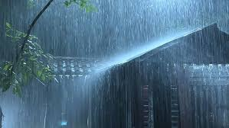
Rain is STILL Coming!
“Now the Spirit speaketh expressly, that in the latter times some shall depart from the faith, giving heed to seducing spirits, and doctrines of devils; Speaking lies in hypocrisy; having their conscience seared with a hot iron;” 1 Tim. 4:1,2
It has happened and is happening today! Spiritualism’s other face in self supporting Adventism has tried to stop the Latter Rain. “And after these things I saw another angel come down from heaven, having great power; and the earth was lightened with his glory. And he cried mightily with a strong voice, saying, Babylon the great is fallen, is fallen, and is become the habitation of devils, and the hold of every foul spirit, and a cage of every unclean and hateful bird.” Rev. 18:1,2

Slide 15
Touch Your People Once Again
We need wisdom-- we need power-- And true love for each other-- We have had so many big but empty words-- So we come before Your face-- Asking for Your grace--- Bring Your people to a state of kingdom life-- Restore Your church again
[Chorus]
Touch Your people once again-- With Your precious holy hand, we pray-- Let Your kingdom shine upon this earth-- Through a living glorious church-- Not for temporary deeds-- But to restore authority and power--- Let a mighty rushing wind blow in-- Touch Your people once again
Lord, You see Your tired servants-- And the broken wounded soldiers--- Oh, how much we need Your precious healing hand-- We need the power of the cross--- As the only source for us-- When we stand up facing final battle cry---- Restore your church again
[Chorus]
Touch Your people once again
With Your precious holy hand, we pray
Let Your kingdom shine upon this earth
Through a living glorious church
Not for temporary deeds
But to restore authority and power
Let a mighty rushing wind blow in
Touch Your people once again
Let a mighty rushing wind blow in
Touch Your people once again

