Slide 1
The History of the Holy Spirit in Adventism pt 4: The Godhead Vs the Pagan-Catholic Trinity

Slide 2
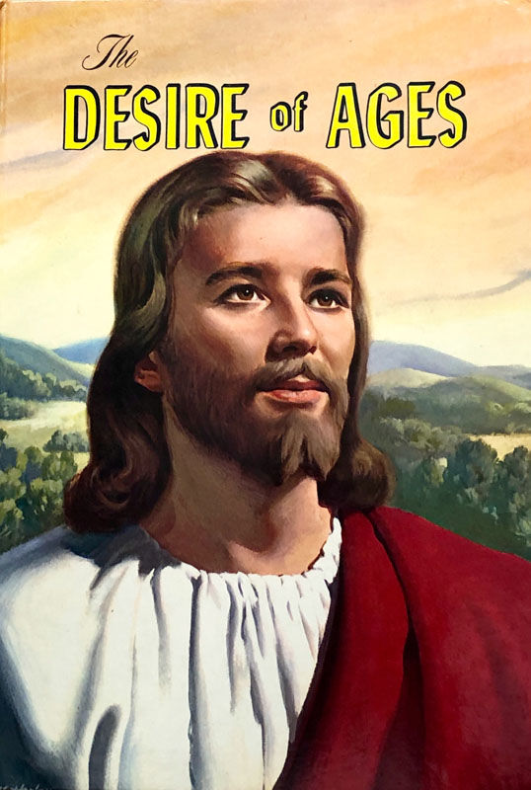
The Quote…
“The power of evil had been strengthening for centuries, and the submission of men to this satanic captivity was amazing. Sin could be resisted and overcome only through the mighty agency of the Third Person of the Godhead, who would come with no modified energy, but in the fullness of divine power.“ DA, 671

Slide 3
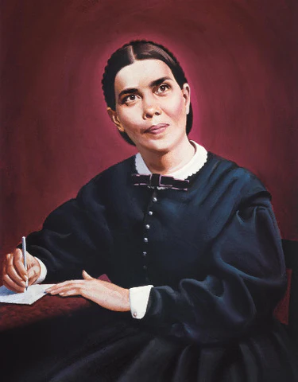
Ellen White: Silence is Golden
“The nature of the Holy Spirit is a mystery. Men cannot explain it, because the Lord has not revealed it to them. Men having fanciful views may bring together passages of Scripture and put a human construction on them, but the acceptance of these views will not strengthen the church. Regarding such mysteries, which are too deep for human understanding, silence is golden.” AA, 52

Slide 4
What Does the Bible Say?
1 John 5:7,8 “For there are three that bear record in heaven, the Father, the Word, and the Holy Ghost: and these three are one. And there are three that bear witness in earth, the Spirit, and the water, and the blood: and these three agree in one.”
Ephesians 4:4-6 “There is one body, and one Spirit, even as ye are called in one hope of your calling; One Lord, one faith, one baptism, One God and Father of all, who is above all, and through all, and in you all.”

Slide 5
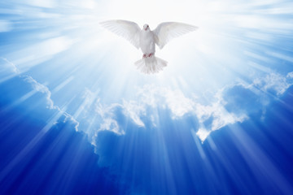
Only God Receives Worship!
“As the saints in the kingdom of God are accepted in the beloved, they hear: “Come, ye blessed of My Father, inherit the kingdom prepared for you from the foundation of the world.” And then the golden harps are touched, and the music flows all through the heavenly host, and they fall down and worship the Father and the Son and the Holy Spirit.” Ms139, 1906 para 32.

Slide 6
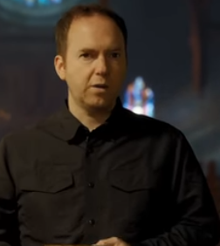
Alexander Hislop Calls Out the Trinity as Pagan?
In the Judgment Hour YouTube Channel, the video entitled “Established by Force: The DARK History of Christian Nationalism or Church and State” the speaker seeks to prove that the 2 doctrines which reveal true Christians are 1) the Sabbath and the 2) Antitrinitarianism
The video uses excellent cgi, visuals, and music—some comments praised these aspects specifically. At approximately 1:13:20 the speaker misquotes Alexander Hislop’s Two Babylons book, p. 240-252 using it to “prove” that the Trinity is a pagan creation

Slide 7
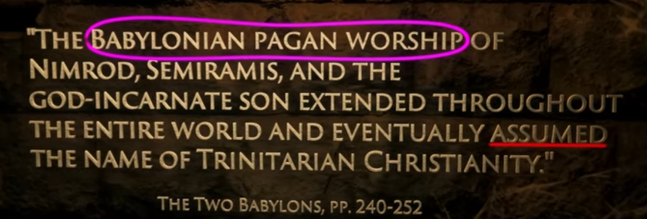
It is an easily-verifiable fact that Alexander Hislop believed in the 3-Person Godhead, the criticizism of the Trinity found in his book is about the idea that God has 3 heads, shares 1 body, or clones or spirates Himself as taught by the pagan counterfeits. Moreover, Hislop uses the many examples of pagan trinities throughout history as proof that the knowledge of the true Trinity (3-Person) Godhead was corrupted after the flood. In other words, Judgment Hour is misquoting Hislop personal beliefs AND the point he trying to make in the book which is the opposite of what the Judgment Hour is portraying---Jehovah’s Witnesses do this often.

Slide 8
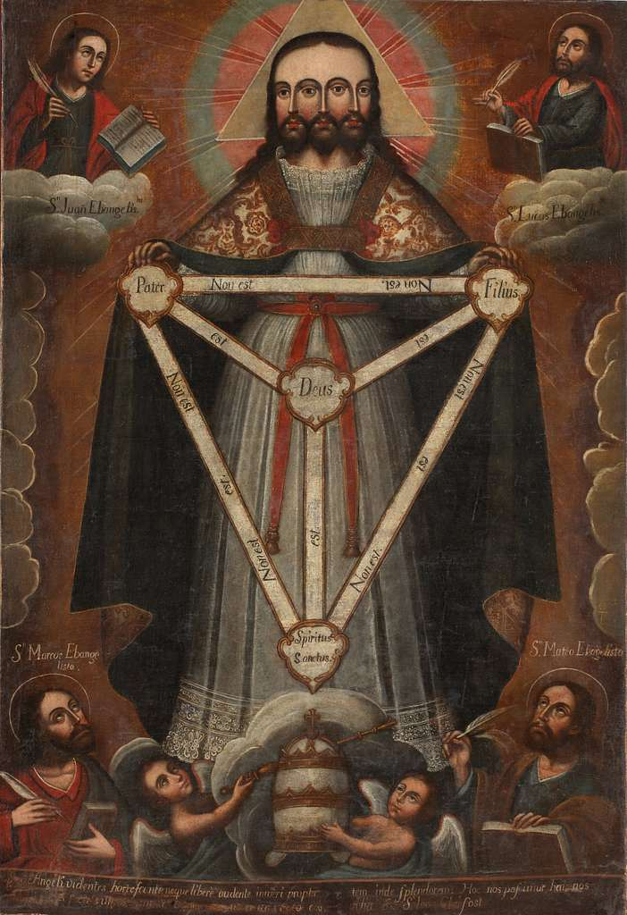
Hislop Explains the Pagan/Catholic Trinity
“PARKHURST'S Hebrew Lexicon, "Cherubim." From the following extract from the Dublin Catholic Layman, a very able Protestant paper, describing a Popish picture of the Trinity, recently published in that city, it will be seen that something akin to this mode of representing the Godhead is appearing nearer home: "At the top of the picture is a representation of the Holy Trinity. We beg to speak of it with due reverence. God the Father and God the Son are represented as a MAN with two heads, one body, and two arms. One of the heads is like the ordinary pictures of our Saviour. The other is the head of an old man, surmounted by a triangle. Out of the middle of this figure is proceeding the Holy Ghost in the form of a dove. We think it must be painful to any Christian mind, and repugnant to Christian feeling, to look at this figure." (17th July, 1856)” Alexander Hislop, The Two Babylons, Ch. 2: Objects of Worship, I. The Trinity in Unity

Slide 9
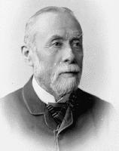
What Alexander Hislop Believes/Teaches
“In Japan, the Buddhists worship their great divinity, Buddha, with three heads, in the very same form, under the name of "San Pao Fuh." All these have existed from ancient times. While overlaid with idolatry, the recognition of a Trinity was universal in all the ancient nations of the world, proving how deep-rooted in the human race was the primeval doctrine on this subject, which comes out so distinctly in Genesis. * * The threefold invocation of the sacred name in the blessing of Jacob bestowed on the sons of Joseph is very striking: "And he blessed Joseph, and said, God, before whom my fathers Abraham and Isaac did walk the God which fed me all my life long unto this day, the Angel which redeemed me from all evil, bless the lads" (Gen 48:15,16). If the angel here referred to had not been God, Jacob could never have invoked him as on an equality with God.” Alexander Hislop, The Two Babylons, Ch. 2: Objects of Worship, I. The Trinity in Unity

Slide 10
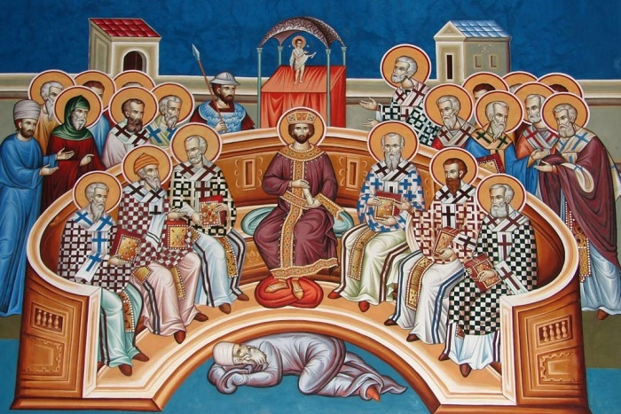
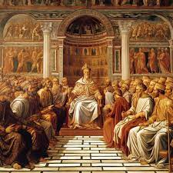
Catholic Nicean Creed
“I believe in one God, the Father almighty, maker of heaven and earth, of all things visible and invisible. I believe in one Lord Jesus Christ, the Only Begotten Son of God, born of the Father before all ages. God from God, Light from Light, true God from true God, begotten, not made, consubstantial with the Father; through him all things were made. For us men and for our salvation he came down from heaven, and by the Holy Spirit was incarnate of the Virgin Mary, and became man. For our sake he was crucified under Pontius Pilate, he suffered death and was buried, and rose again on the third day in accordance with the Scriptures. He ascended into heaven and is seated at the right hand of the Father. He will come again in glory to judge the living and the dead and his kingdom will have no end. I believe in the Holy Spirit, the Lord, the giver of life, who proceeds from the Father and the Son, who with the Father and the Son is adored and glorified, who has spoken through the prophets. I believe in one, holy, catholic and apostolic Church. I confess one Baptism for the forgiveness of sins and I look forward to the resurrection of the dead and the life of the world to come. Amen.” Council of Nicea 325AD

Slide 11
Truth Triumphant On the Council of Nicea
“The burning question of the decades succeeding the Council of Nicaea was how to state the relations of the Three Persons of the Godhead: Father, Son, and Holy Ghost. The council had decided, and the Papacy had appropriated the decision as its own. The personalities of the Trinity were not confounded, and the substance was not divided. The Roman clergy claimed that Christianity had found in the Greek word homoousios (in English, “consubstantiality”) an appropriate term to express this relationship.⁴⁰ Then the papal party proceeded to call those who would not subscribe to this teaching, Arians, while they took to themselves the title of Trinitarians. An erroneous charge was circulated that all who were called Arians believed that Christ was a created being.⁴¹ This stirred up the indignation of those who were not guilty of the charge.” B.G. Wilkinson, Truth Triumphant, Ch. 7: Patrick, p. 85

Slide 12
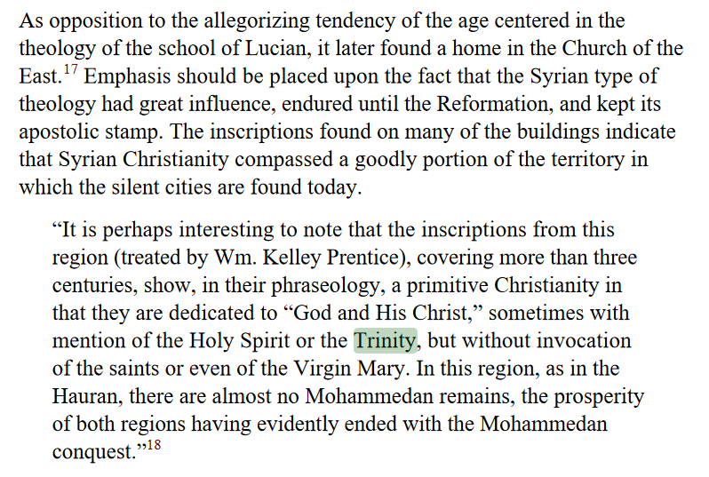
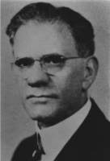
B.G. Wilkinson Trinity is Apostolic Christianity?
B.G. Wilkinson, Truth Triumphant, Ch. 4: Silent Cities in Syria, p. 35

Slide 13
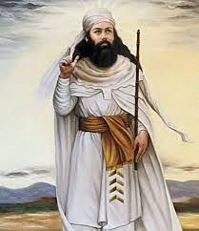
The OT Taught the Trinity?
“On these occasions libations were poured on the ground, sacred hymns were sung, and portions of the sacred writings of Zoroaster were read. For financial support they received offerings, and also possessed considerable endowments.³³ The revelations of the Old Testament had disclosed the Trinity. “In a disfigured and uncouth semblance” Zoroaster proclaimed his species of a trinity.³⁴ He placed at the head of his celestial hierarchy Ormazd (or Ahura-Mazda), the great wise spirit, and Ahriman, the supreme evil spirit, who was the coeval and rival god of darkness dwelling in the bottomless pit of night. With them he associated in a marked way, Mithra, the god of light, who was the sun and an embodiment of sun worship” B.G. Wilkinson, Truth Triumphant, Ch. 9: Papas, p. 121

Slide 14
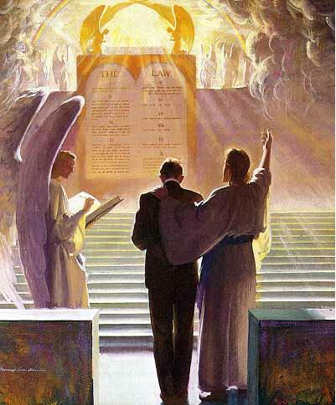
A Co-Intercessor
Romans 8:16, 26-27 “ The Spirit itself beareth witness with our spirit, that we are the children of God . . . Likewise the Spirit also helpeth our infirmities: for we know not what we should pray for as we ought: but the Spirit itself maketh intercession for us with groanings which cannot be uttered. And he that searcheth the hearts knoweth what is the mind of the Spirit, because he maketh intercession for the saints according to the will of God.

Slide 15
How is the Holy Spirit a Mediator???
2 Tim. 2:5-6 “For there is one God, and one mediator between God and men, the man Christ Jesus; who gave himself a ransom for all, to be testified in due time.”
John 14:8-9 “Philip saith unto him, Lord, show us the Father, and it sufficeth us. Jesus saith unto him, Have I been so long time with you, and yet hast thou not known me, Philip? he that hath seen me hath seen the Father; and how sayest thou then, Show us the Father?”
John 10:29-30 “My Father, which gave them me, is greater than all; and no man is able to pluck them out of my Father's hand. I and my Father are one.”
Is Jesus the Father???
Is. 9:6 “For unto us a child is born, unto us a son is given: and the government shall be upon his shoulder: and his name shall be called Wonderful, Counsellor, The mighty God, The everlasting Father, The Prince of Peace.”

Slide 16
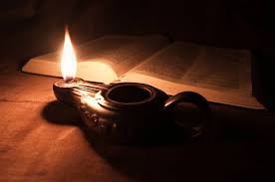
The Holy Spirit is Our Advocate?
“The Spirit is freely given us of God if we will appreciate and accept it. And what is it? The representative of Jesus Christ. It is to be our constant helper. It is through the Spirit that Christ fulfills the promise, “I will never leave thee nor forsake thee.” “Verily, verily, I say unto you, He that believeth on me hath everlasting life”. (The bell is sounding for morning worship, I must stop here) (1888 Materials, pp. 1538, 1539, Letter to S. N. Haskell, May 30, 1896).
“And Jesus said He would give us the Comforter. What is the Comforter? It is the Holy Spirit of God. What is the Holy Spirit? It is the representative of Jesus Christ, it is our Advocate that stands by our side and places our petitions before the Father all fragrant with His merits” (Reflecting Christ, p. 285).

Slide 17
The Spirit Sent Christ!
Isaiah 48:16 “Come ye near unto me, hear ye this; I have not spoken in secret from the beginning; from the time that it was, there am I: and now the Lord GOD, and his Spirit, hath sent me.

Slide 18
The Holy Spirit Speaks
Acts 8:29 “Then the Spirit said unto Philip, Go near, and join thyself to this chariot.
Acts 13:2 “ As they ministered to the Lord, and fasted, the Holy Ghost said, Separate me Barnabas and Saul for the work whereunto I have called them.”
Acts 11:12 “And the Spirit bade me go with them, nothing doubting.”
1 Timothy 4:1 “Now the Spirit speaketh expressly, that in the latter times some shall depart from the faith, giving heed to seducing spirits, and doctrines of devils;

Slide 20
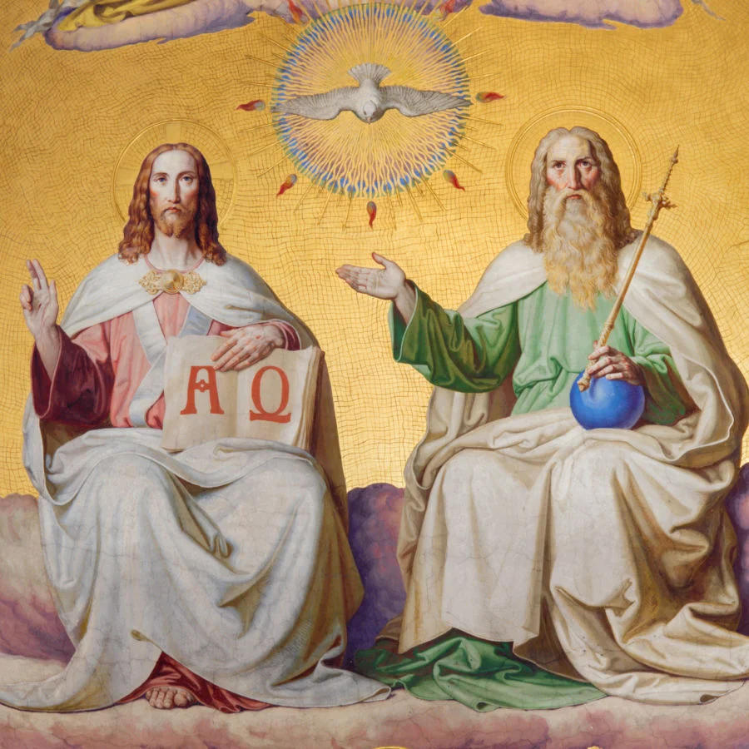
Where then? Does this Doctrine Come From?
In order to understand the concept of person in God, we have to understand its foundation in the processions and relations within the inner life of God. And the Council of Florence, AD 1338-1445, can help us in this regard. . . The Son “proceeds” from the Father, and the Holy Spirit “proceeds from the Father and the Son.” These are the two processions in God. And these are foundational to the four relations that constitute the three persons in God. These are those four eternal relations in God:
1. The Father actively and eternally generates the Son, constituting the person of God, the Father.
2. The Son is passively generated of the Father, which constitutes the person of the Son.
3. The Father and the Son actively spirate the Holy Spirit in the one relation within the inner life of God that does not constitute a person. It does not do so because the Father and Son are already constituted as persons in relation to each other in the first two relations. This is why CCC 240 teaches, “[The Second Person of the Blessed Trinity] is Son only in relation to his Father.”
4. The Holy Spirit is passively spirated of the Father and the Son, constituting the person of the Holy Spirit. – Catholic Answers, June 20, 2014 (https://www.catholic.com/magazine/online-edition/explaining-the-trinity)

Slide 21
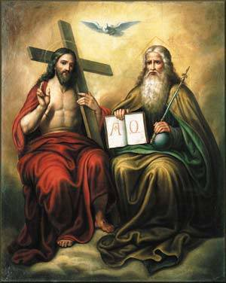
What Catholics Think About the SDA Trinity
“Her ongoing revelations formed the basis of the doctrine upon which she and her husband, James, founded the Seventh-day Adventist Church (so-called because White claimed that Christ wanted to be worshipped on the Jewish Sabbath). These doctrines included the revival of Jewish dietary customs (although most Adventists are vegetarian today); identification of the pope as Antichrist; three separate Divine Persons rather than the orthodox doctrine of Trinity; and several other unique teachings. https://catholicherald.co.uk/heretic-of-the-week-ellen-g-white/

Slide 22
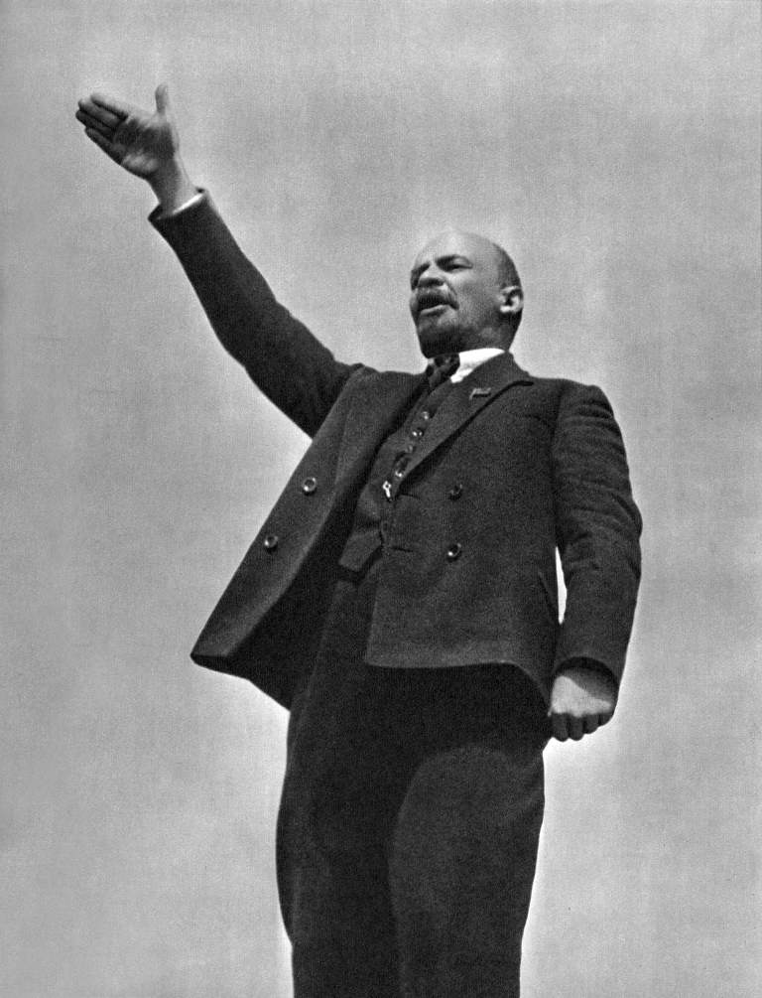
Accuse Others Of What You Are Doing…
“The cleverest trick used in propaganda against Germany during the war was to accuse Germany of what our enemies themselves were doing.“ (Goebbels at Nuremberg — 1934, https://research.calvin.edu/german-propaganda-archive/goeb59.htm)
Vladimir Lenin or Karl Marx: “Accuse the victim of what you do.”

Slide 23
Don’t Forget Your ONLY Mission!
We are now living in the closing scenes of this world's history. Let men tremble with the sense of the responsibility of knowing the truth. The ends of the world are come. Proper consideration of these things will lead all to make an entire consecration of all that they have and are to their God. . . . The weighty obligation of warning a world of its coming doom is upon us. From every direction, far and near, calls are coming to us for help. The church, devotedly consecrated to the work, is to carry the message to the world: Come to the gospel feast; the supper is prepared, come. . . . Crowns, immortal crowns, are to be won. The kingdom of heaven is to be gained. A world, perishing in sin, is to be enlightened. The lost pearl is to be found. The lost sheep is to be brought back in safety to the fold. Who will join in the search? Who will bear the light to those who are wandering in the darkness of error? We should now feel the responsibility of laboring with intense earnestness to impart to others the truths that God has given for this time. We cannot be too much in earnest. . . . Now is the time for the last warning to be given. There is a special power in the presentation of the truth at the present time; but how long will it continue?--Only a little while. If there was ever a crisis, it is now. All are now deciding their eternal destiny. Men need to be aroused to realize the solemnity of the time, the nearness of the day when human probation shall be ended. Decided efforts should be made to bring the message for this time prominently before the people. The third angel is to go forth with great power. . . Evangelistic work, opening the Scriptures to others, warning men and women of what is coming upon the world, is to occupy more and still more of the time of God's servants. – Evangelism, p. 16,17

Slide 24
Haskell and Melchisedec
In the article below , which was originally published in Bible Training School, November 1, 1903, pg. 90, under the title “Melchisedec”; Haskell wrote,
“In the Review and Herald of February 18,1890, page 97, last paragraph, we read from Mrs. E. G. White: ‘It was Christ that spake through Melchisedec, the priest of the most high God. Melchisedec was not Christ, but he was the voice of God in this world, the representative of the Father.’
“There is but one being in the universe that fills all these specifications. That is the Spirit of God. He ever lives to intercede. He has no beginning of days or end of life. He represents the Father and the Son. He speaks peace to the troubled soul. He is not an angel of any kind, for angels are amenable to law, and were created. This being is equal to the Father and the Son. It is the voice of God in the world. A careful study of the above and a belief of the same will forever settle the question as to who Melchisedec is.”
Original source: Bible Training School, November 1, 1903, pg. 90

Slide 25
Haskell on Melchisedec
In the article. below, which was published in Bible Training School, November 1, 1904; Haskell refers to the Holy Spirit as the “third person of the Godhead” and he again identifies Melchisedec as the Holy Spirit. Haskell wrote,
The Holy Spirit, “the third person of the Godhead ” the soul-of Christ’s life, and the light and life of the world is the only one to whom all of the above specifications will apply. The Holy Spirit is the third person of the Godhead, and therefore is “King of righteousness, and after that also King of Salem, which is King of peace.”
The ” Spirit itself•maketh intercession for us with groanings which can not be uttered, and He that searcheth the hearts knoweth what is the mind of the Spirit, because He maketh intercession for the saints according to the will of God.” Rom. 8 : 26, 27. Therefore the Spirit ” abideth a priest continually,” and is a,”° priest of the most high God.”
The Spirit is the ” third person of the Godhead,” and therefore has no more beginning of days nor end of life ” than God Himself. There is no record of father, mother, or pedigree given of the Holy Spirit. As the third person of the Godhead, it is greater than Abraham and could bless him.
The Spirit comes to the world as a representative of Christ and thus is made like unto Christ. The Holy Spirit has visibly appeared to man under different forms. The Holy Ghost descended in a bodily shape like a dove upon Christ. Luke 3:22. It cadre as cloven tongues of fire upon the disciples on the day of Pentecost. To Abraham it appeared as a King, Priest. To-day It comes as a blessed Comforter to every one who will open his heart to receive it.
Original Source: Bible Training School November 1, 1904, pg 85, 86

Slide 26
Other Scriptures Pointing to the Person, Godliness, or Personal attributes of the Holy Spirit
1 Cor. 12:11 Titus 3:5 2 Sam. 23:2 Acts 16:6
1 Cor. 2:10,11 1 Pet. 1:2 Acts 10:19 Ps. 139:7,8
Phil. 2:1 Eph. 3:16 Acts 21:11 John 14:16,17
2 Cor. 13:14 Eph. 4:30 Acts 28:25-26 Is. 40:13
Acts 5:3-4,9 Matt. 28:19-Baptize Heb. 3:7-8 Zech. 4:6
2 Pet. 1:21 2 Cor. 3:16-18 Rev. 14:13 Luke 1:35-Creator
1 Cor. 6:19 Rom. 8:11 Rev. 22:17 Heb. 9:8
Matt. 12:31-Blasphemy John 6:63 Acts 15:28 1 Pet. 1:12
John 15:26 1 John 5:6 Acts 20:28 Job 33:4
John 16:7 John 14:26 Acts 5:32 Ps. 104:30
John 16:9 Is. 63:10 Luke 12:12 Matt. 12:28
John 16:13 Rom. 15:30 Matt. 4:1 1 Cor. 12:4-6
2 Cor. 13:14

Slide 27
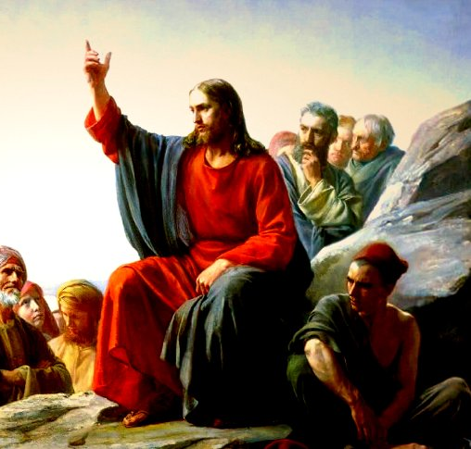
The Parable of the Comforter?
John 16:25-proverbs
John 14:16-18-Wanted to reveal the Father, he=Father
Rich man and Lazarus Parable-Abraham’s Bosom
John 14:22-Disciples say Jesus is coming
John 15:26-proceeds from the Father-Who is in the Sanctuary?

Slide 28
6. Spirit of truth, testify of Christ, therefore is Christ—If 3 are 1, then all symbols can apply to each
7. John 16:7-”I will send him unto you”—Christ could not send Spirit until he was glorified—Why then was He anointed with the Spirit at His baptism—was Christ’s ministry a farce? Stones into bread, come off the cross, legions
8. Spirit of a person and the person are the same thing right?
9. Holy Spirit as a person is a tradition, namely one from Rome—counterfeits of Satan
10. John 16:12-14-Not a new teacher—Christ is “truth” the “Spirit of truth” is the same Jesus Christ—NO TEACHER besides Christ—Son is glorified by the Father whose Spirit proceedeth from Him
11. John 16:26-27-All about the Father and Son of God-Sanctuary context
12. John 16:29-disciples said he speaks plain speech that He is the Son of God
13. This issue is NOT Christianity, not biblical-Become the 3rd Angel’s Message- Gal. 4:6—Is Christ omnipresent?
14. 1 John 2:1 “Comforter”—parakletos—is Jesus

Slide 29
Thus Saith the Lord
Wherever hearts are open to receive the truth, Christ is ready to instruct them. He reveals to them the Father, and the worship acceptable to Him who reads the heart. For such He uses no parables. To them, as to the woman at the well, He says, "I that speak unto thee am He.“– DA, 194
The disciples had been with Christ, and could understand Him; to them He need not talk in parables. He corrected their errors, and made plain to them the right way of approaching the people. He opened more fully to them the precious treasures of divine truth.– DA, 361
But the multitudes were slow of hearing, and in the home at Bethany Christ found rest from the weary conflict of public life. Here He opened to an appreciative audience the volume of Providence. In these private interviews He unfolded to His hearers that which He did not attempt to tell to the mixed multitude. He needed not to speak to His friends in parables.– DA, 524
If this is a parable, why is it not outlined and explained by Ellen White in any writing? Not the Desire of Ages, Not Christ’s Object Lessons???

Slide 30
Catholic Trinity Outline:
The Hislop Lie—it’s pagan, real quote x
BG Wilkinson confirms! x
Council of Nicea + Quote from Chris Chung on the Triune God x
Trinity or Godhead pamphlet xx
Holy Spirit is a an essence quote x
The Alpha of Apostasy and Kellogg (get Kellogg quote where they say we can’t fix your theology from Chris Chung series pt 4 last 10 minutes)
Rose Publishing Christianity Cults and Religions Pamphlet saying we believe in different Trinity

Slide 31
The Gaslighters Outline:
Lenin accuse others of what you yourself are doing… + Hitler quote on Lenin being trained by Jesuits
Recap: They quote Canright—he’s a liar, Hislop—he believes in the Trinity, & Kellogg issue—when it proves the opposite, You believe in the Catholic Trinity when they actually do
Nadar Mansour—the parable of the Comfortor + Jesus did not speak in parables directly to his disciples—they glory in their unbelief (see my own quote to Chris Chung)
Fanaticism leads to darkness and strong delusion (EGW vision about Satan breathing on people---this is about the Sanctuary)
The stenographer issue: They reject every quote proving the Trinity from stenographers but then use them when it serves to bolster their arguments
1 John 5:7 doesn’t belong in the Bible—it was added to create the Trinity doctrine (NIV, RSV, ESV comparison) + Ellen White doesn’t quote it directly (there are other Bible passages she does not touch—does that make them false also?) + Gail Riplinger quotes
3rd Angel’s Message is to engross our whole work compared to stats of false ministries that dedicate themselves to this false message

Slide 32
The Bible Evidence Outline:
0. Holy Spirit Characteristics (spirit of truth, would not speak for Himself, glorify the Father and Son, wrote the Bible, Order of Melchisedec)
1 John 5:7
The Spirit Sent Me
Created the flesh of Jesus
The 3 crowns in the Sanctuary
Genesis 1:1-3 the Trinity of Trinities
One LORD + Jewish admission that it could definitely mean that—see Chris Chung
Human traits of the Holy Spirit (Spirit strives with man, speaks, commands, Stephen you do resist the Holy Spirit, seven Spirits, blasphemy against the Holy Spirit is unpardonable)
Catholic Quote that the Holy Spirit is an essence.
Lying against the Holy Ghost—Ananias and Saphira

Slide 33
Melchisidec Outline:
Genesis 11 bread and wine
Jesus is of the “Order of Melchisedec”
Hebrews 7, without Father without mother, etc.
Melchisedec was not Christ but the Representative of the Father (connect to John 14-16: he represents Christ on earth) + no man hath seen the Father (ONLY 1 OPTION)
GB Starr + Haskell Quote—Holy Spirit is Melchisedec
Haskell Story of Daniel Quote
Catholic Melchisedec from printout from Paul Praino

Slide 34
Holy Spirit Vindicated Outline:
The Bible Evidence Recap
The SOP Evidence Recap
The Pioneer Evidence Recap
Their Best Arguments Defeated Recap (Parable of the Comforter, You’re Catholic Argument, The Father and Jesus are the Holy Spirit—Catholic spiritualism, Pioneers—fail… which ones?, Hislop liars, Kellogg liars, stenographer liars, Froom liars, Ellen White did not write that—with her own hand ML Andreason, the One True God is a false god doctrine)
The Parrots: Jesuit quote on how they would control minds—apes and parrots
Naming Names + Get back to the 3rd Angel’s Message—it’s salvational!

