Slide 1
The History of the Holy Spirit in Adventism pt 1: Revisionist Historians

Slide 2
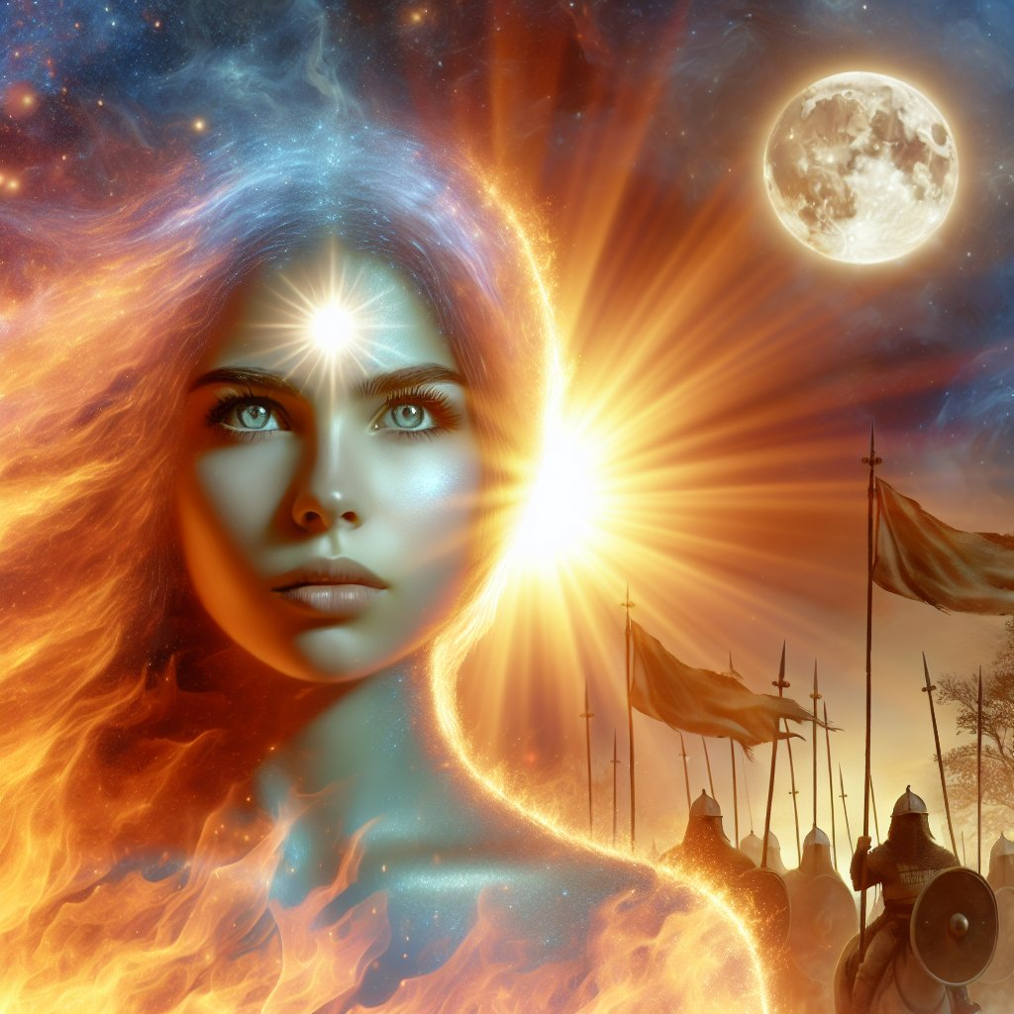
From Darkness to Light…
Continuing on with the analysis of true SDA history concerning the Holy Spirit doctrine we’ve found the following:
Most Adventists did not believe that the Holy Spirit is a Person in the same way that the Father and Son are Persons, but over time this changed as the Holy Spirit spoke through the pen of Ellen White making the doctrine abundantly clear in the late 1800s.
The problem “the pioneers” had with the Trinity doctrine related to the idea that there is one God cut into 3 Persons, instead of the biblically accurate Godhead of 3 Persons Who are One in Purpose, Goal, Will, Love, and Unity
ML Andreason had to see the personal handwriting of Ellen White for the Desire of Ages Manuscript before he would believe in the Eternality of Jesus Christ or the Personhood of the Holy Spirit.
Prov. 4:18 “But the path of the just is as the shining light, that shineth more and more unto the perfect day.”

Slide 3
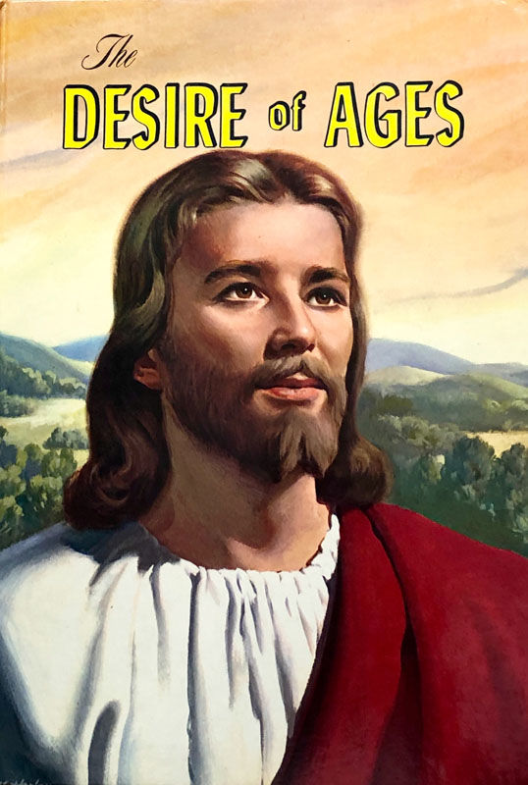
The Quote…
“The power of evil had been strengthening for centuries, and the submission of men to this satanic captivity was amazing. Sin could be resisted and overcome only through the mighty agency of the Third Person of the Godhead, who would come with no modified energy, but in the fullness of divine power.“ DA, 671

Slide 4
ML Andreason Full Quote—Jesus is Eternal, the Holy Spirit is God
“I had with me a number of quotations that I wanted to see if they were in the original in her own handwriting. I remember how astonished we were when Desire of Ages was first published, for it contained some things that we considered unbelievable; among others the doctrine of the Trinity, which was not generally accepted by the Adventists. Some of the quotations concerned theology, others I had selected for their beauty of expression. I wanted to see how these quotations looked before they were corrected by the proofreaders. So I was given access to the manuscripts. I stayed in California several months. Being a reasonably fast reader, I read nearly all Sister White had written in her own handwriting. I was particularly interested, in the statement in Desire of Ages which at one time caused great concern to the denomination theologically: ‘In Christ is life, original, unborrowed, underived.” p. 530. That statement may not seem very revolutionary to you, but to us it was. We could hardly believe it. but of course we could not preach contrary to it. I was sure Sister White had never written, ‘In Christ is life, original, unborrowed, underived.’ But now I found it in her own handwriting just as it had been published. It was so with other statements. As I checked up, I found that they were Sister White’s own expressions… In the final analysis it was her work all the way through.” (Original source: M. L. Andreasen, “The Spirit of Prophecy,” Chapel Talk, Loma Linda, California, November 30, 1948) (George R. Knight in “Lest We Forget” a daily devotional, published by the Review and Herald Publishing Association 2008, pg. 292.)

Slide 5
The Froom Argument…
“Since the death of Ellen White in 1915, how have compilations been prepared? The book Evangelism provides a case study. In August 1944, representatives from the Ministerial Association of the General Conference asked the White Estate whether there was enough specific counsel on evangelism to create a volume that would give guidance in the work of evangelism. If there was sufficient material, they hoped that these counsels could be brought together and published as a single volume. As Arthur White, at that time director of the White Estate, scanned the files, he found ample material that could be drawn together for a book of counsels on evangelism. On September 10, 1944, the Board of Trustees took the following action: "Voted: That, in harmony with the recommendation of the Ministerial Association Advisory Council, we authorize the compilation of a manuscript, 'Counsels to Evangelists and Bible Instructors,' the work to be done by a committee of five, appointed by the chair. The committee named as follows: A. L. White, W. H. Branson, R. A. Anderson, Miss Louise Kleuser, J. L. Shuler."--White Estate Board Minutes, Sept. 10, 1944.” Norma Collins, Compilations: What They Are and What They Are Not, p. 4

Slide 6
Ellen White Estate: Froom NOT on the Committee!
“As the committee members planned their work, they decided that the new volume would serve best if it were complete in its coverage, using both published and unpublished sources. This would include some repetition of articles already published. Arthur White and Louise Kleuser were named as a working team to prepare the manuscript. The plan they followed called for bringing together every item that had a bearing on the subject. Then with all the Ellen White statements before them, they organized the material and developed the manuscript. This plan minimized the influence of the compilers, allowing Mrs. White's thoughts and emphases to come through clearly in the finished work. As Elder White and Miss Kleuser made the selections, it was easy to see where Ellen White placed the emphasis, and the general outline of the subject matter fell naturally into about 22 general divisions. In cases where there were two or more statements covering the same point, the strongest or most complete was chosen and the other laid aside. Because there could be no change in Ellen White's words, which made up the text, the items were drawn together by using side headings highlighting the main point. Side headings and subtitles are almost always supplied by the compiler, and this is generally understood. At one point during preparation of the manuscript, Elder White sought counsel on using italics to emphasize certain parts of the manuscript. The ensuing Board action read: "Voted: That the Trustees feel that it would be out of place to use italics to emphasize certain parts of the manuscript, and might appear to take on the form of private interpretation."--White Estate Board Minutes, July 2, 1945. -Ellen White Estate”---Norma Collins, Compilations: What they Are and What They Are Not, p. 4

Slide 7
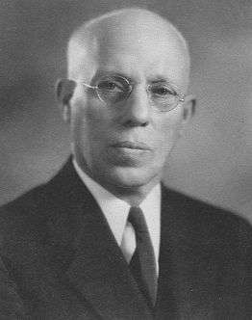
Arguments Destroyed by the Spirit of Prophecy, Bible, History, and Plain Reason:
All “the pioneers” were anti-trinitarians
Ellen White teaches that the Holy Spirit is not an Eternal Person
Ellen White did not write the section of Desire of Ages where she makes it clear that the Holy Spirit is a separate but equal Eternal Being—ML Andreason saw it in her handwriting!!
Leroy Froom injected the Trinity doctrine into the book Evangelism

Slide 8
Can’t Be More Clear!!!!
The prince of the power of evil can only be held in check by the power of God in the third person of the Godhead, the Holy Spirit.-- Special Testimonies, Series A, No. 10, p. 37. (1897)
The Comforter that Christ promised to send after He ascended to heaven, is the Spirit in all the fullness of the Godhead, making manifest the power of divine grace to all who receive and believe in Christ as a personal Saviour. There are three living persons of the heavenly trio; in the name of these three great powers --the Father, the Son, and the Holy Spirit--those who receive Christ by living faith are baptized, and these powers will co-operate with the obedient subjects of heaven in their efforts to live the new life in Christ.-- Special Testimonies, Series B, No. 7, pp. 62, 63. (1905)
When you gave yourself to Christ, you made a pledge in the presence of the Father, the Son, and the Holy Spirit—the three great personal Dignitaries of heaven. “Hold fast” to this pledge.– MS 92, 1901
Dignitary-An ecclesiastic who holds a dignity, or a benefice which gives him some pre-eminence over mere priests and canons, as a bishop, dean, archdeacon, prebendary, &c– 1828 Webster’s Dictionary

Slide 9
Ellen White On How to Study
“The truths most plainly revealed in the Bible have been involved in doubt and darkness by learned men, who, with a pretense of great wisdom, teach that the Scriptures have a mystical, a secret, spiritual meaning not apparent in the language employed. These men are false teachers. It was to such a class that Jesus declared: "Ye know not the Scriptures, neither the power of God." Mark 12:24. The language of the Bible should be explained according to its obvious meaning, unless a symbol or figure is employed. Christ has given the promise: "If any man will do His will, he shall know of the doctrine." John 7:17. If men would but take the Bible as it reads, if there were no false teachers to mislead and confuse their minds, a work would be accomplished that would make angels glad and that would bring into the fold of Christ thousands upon thousands who are now wandering in error.” GC, 598-599

Slide 10
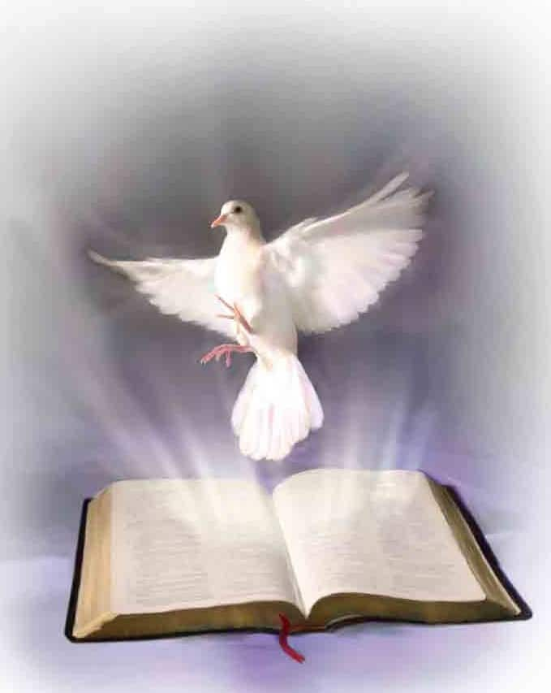
There Are 3!
“There are three living persons of the heavenly trio; in the name of these three great powers—the Father, the Son, and the Holy Spirit—those who receive Christ by living faith are baptized, and these powers will co-operate with the obedient subjects of heaven in their efforts to live the new life in Christ” MS 21, 1906
1 John 5:7,8 “For there are three that bear record in heaven, the Father, the Word, and the Holy Ghost: and these three are one. And there are three that bear witness in earth, the Spirit, and the water, and the blood: and these three agree in one.”

Slide 11
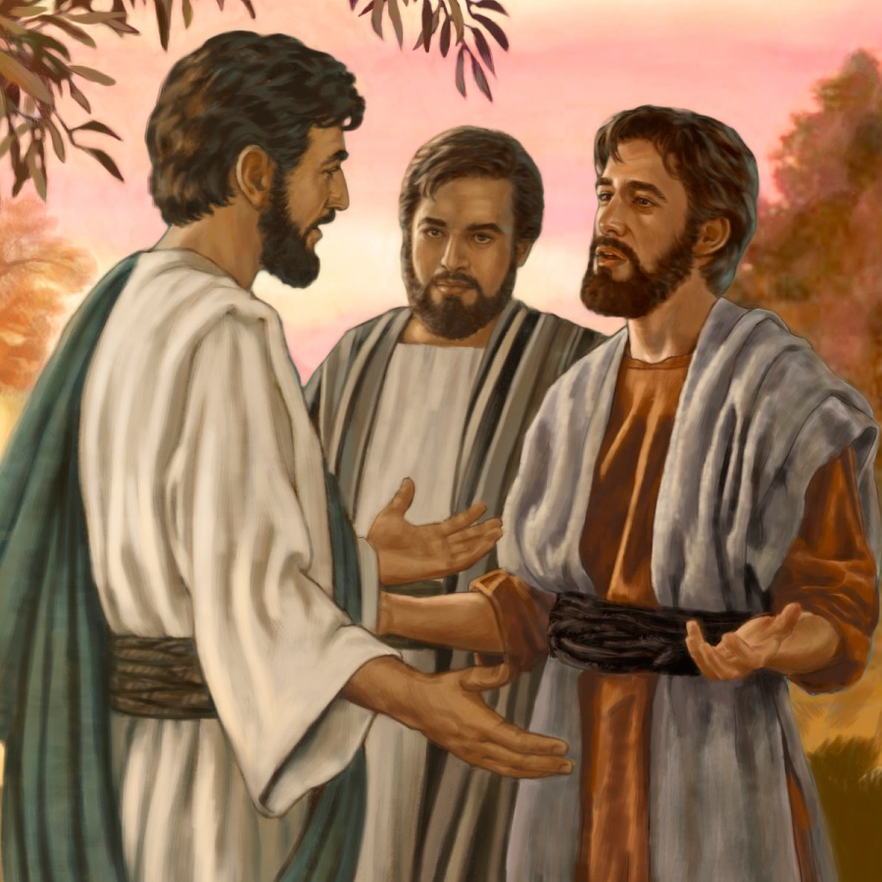
A Warning!
“They were not to add to His words, or give a forced meaning to His utterances. They were not to put a mystical interpretation upon the plain teaching of the Scriptures, or draw from theological stores to build up some man-made theory.” – RH, June 2, 1896

Slide 12
What Does the Bible Say?
1 John 5:7,8 “For there are three that bear record in heaven, the Father, the Word, and the Holy Ghost: and these three are one. And there are three that bear witness in earth, the Spirit, and the water, and the blood: and these three agree in one.”
Ephesians 4:4-6 “There is one body, and one Spirit, even as ye are called in one hope of your calling; One Lord, one faith, one baptism, One God and Father of all, who is above all, and through all, and in you all.”

Slide 13
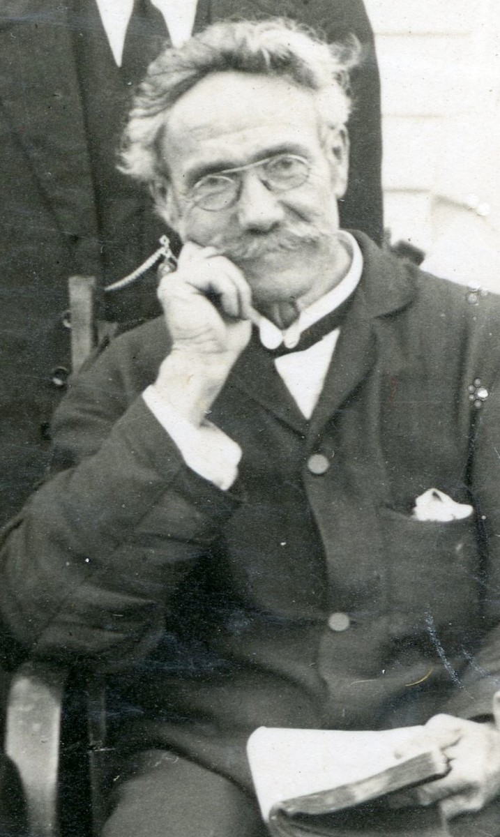
Let the Pioneers Speak…
“But God's great plan is clear and logical. There is a trinity, and in it there are three personalities. We have the Father described in Dan. 7:9, 10, a personality surely—the "Ancient of Days" enthroned. In Rev. 1:13- 18, we have the Son described. He is also a personality. The appearance and form of the Holy Spirit is not described. He is the agency whereby God revealed His Word to man, and of Him Christ declares, " He shall not speak of Himself." John 16:13. Hence the man who speaks much of himself has not a very close acquaintance with the Holy Spirit. The Holy Spirit is spoken of through the Scriptures as a personality. These divine persons are closely associated in the
work of God.” (Robert Hare, Union Conference Record July 19, 1909)

Slide 14
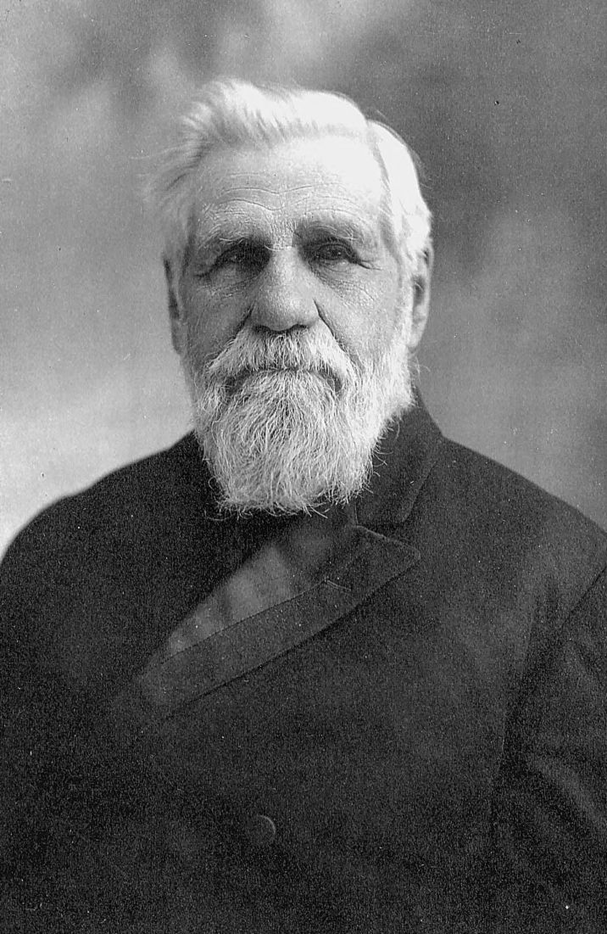
Haskell Says “Trinity”???
“The benediction pronounced upon those who do hear, and read, and keep the things written in this book, is very striking. ‘Grace be unto you, and peace from Him which is, and which was, and which is to come ( i.e., God the Father), and from the seven Spirits which are before His throne (i.e., the Holy Spirit), and from Jesus Christ, who is the faithful witness, and the first begotten of the dead, and the prince of the kings of the earth. Unto Him that loved us, and washed us from our sins in His own blood, And hath made us kings and priests unto God, and His Father; to Him be glory and dominion forever, and ever. Amen.’ Rev. 1:4-6. There are many inspired benedictions pronounced upon God’s people in the Bible; but none like this one. It comes from the Trinity, separately.” (Stephen Haskell, Bible Training School, February 1, 1914)

Slide 15
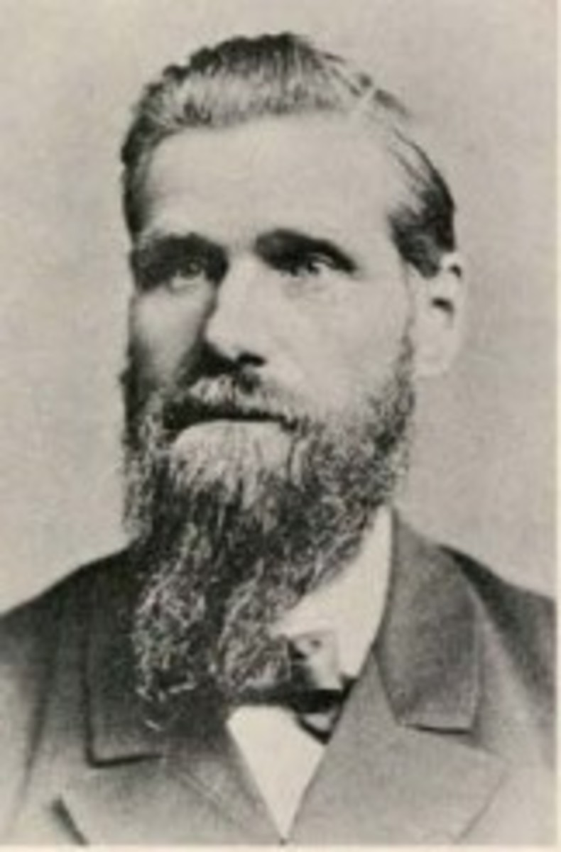
The Story of the Prophet Daniel: Trinity Quote
“The Saviour ascended to heaven, leaving His disciples alone, but not alone, for "behold, two men stood by them in white apparel." While heaven rang with songs of welcome to the returning Son of God, two angels stood on earth to comfort the lonely ones. One of these was Gabriel, Christ's attendant angel. Of all the angels of heaven none have been more closely connected with man than has Gabriel. Yet to John, who fell before him to worship, he said, "See thou do it not ; for I am thy fellow-servant." Gabriel was only an angel, upheld by the same Power that sustained John, and he would not for one moment allow John to be deceived by thinking he was a part of the great Trinity of heaven, and worthy of the worship of mankind. He assured John that he was only one of the hosts of "ministering spirits sent forth to minister for them who should be heirs of salvation," by saying, "I am thy fellow-servant." So bound up in the affairs of man is this mighty angel that he counts himself one with us” Stephen Haskell, The Story of Daniel the Prophet, p. 132-133

Slide 16
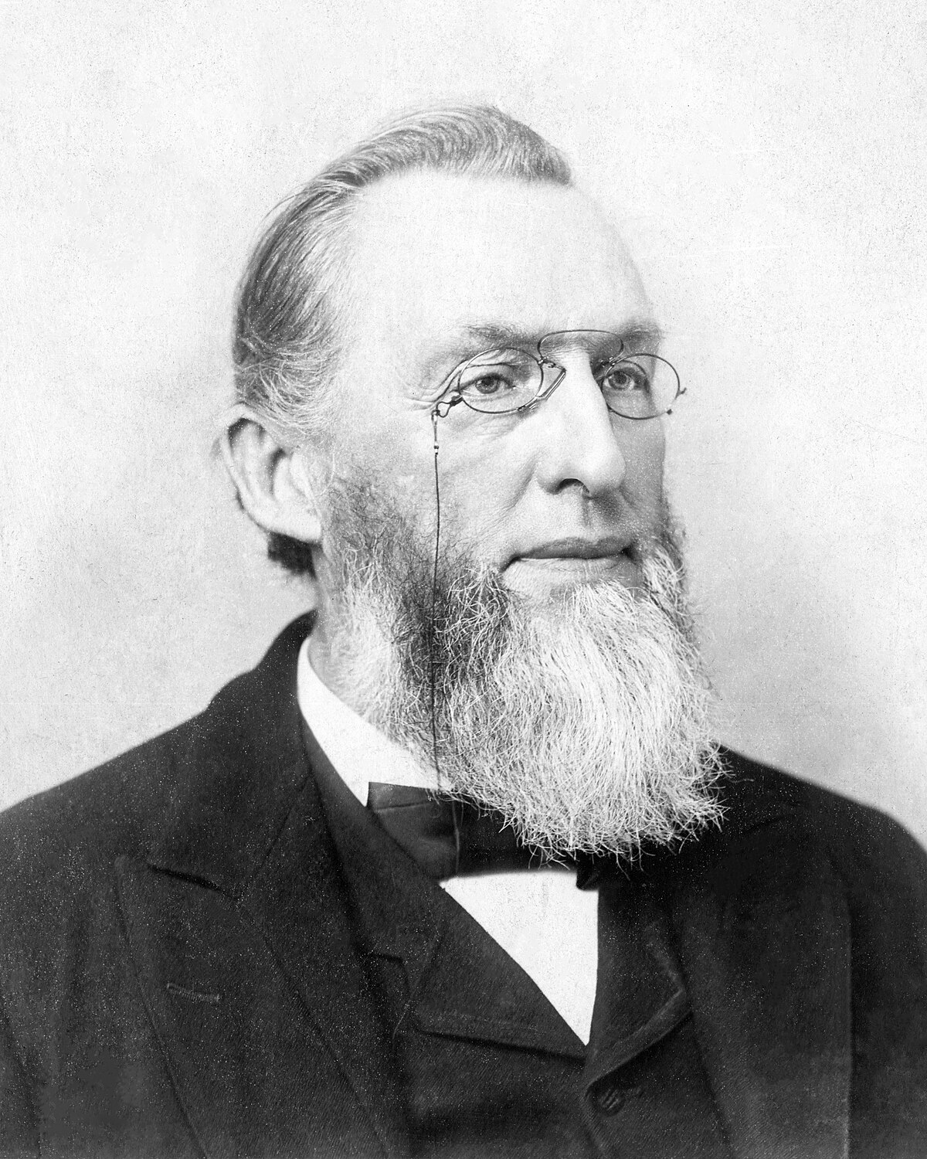
Uriah Smith Changes His Mind???
“We know of no place in the Bible where we are commanded to worship the Holy Spirit, as was commanded in the case of Christ(Her 1:6) or where we find an example of the worship of the Holy Spirit, as in the case of Christ. Luke 21:52. Yet in the formula for baptism, the name ” Holy Ghost,” or “Holy Spirit,” is associated with that of the Father and the Son. And if the name can be thus used, why could it not properly stand as a part of the same trinity in the hymn of praise, ” Praise Father, Son, and Holy Ghost.” Uriah Smith, RH, October 27, 1896

Slide 17
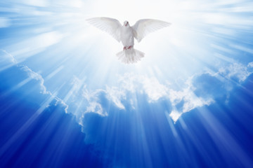
Only God Receives Worship!
“As the saints in the kingdom of God are accepted in the beloved, they hear: “Come, ye blessed of My Father, inherit the kingdom prepared for you from the foundation of the world.” And then the golden harps are touched, and the music flows all through the heavenly host, and they fall down and worship the Father and the Son and the Holy Spirit.” Ms139, 1906 para 32.

Slide 18
H.F. Phelps Chimes in…
“Preceding this beginning, there must have been, according to Rom. 16:25, R. V., ‘ times eternal,’ when there were no worlds, no created being, not even an angel; in fact, there were only three beings—God the Father, God the Son, and God the Holy Spirit ; these three persons in the Godhead” (HF Phelps, Review and Herald, Vol. 78, No. 1, January 1, 1901)

Slide 19
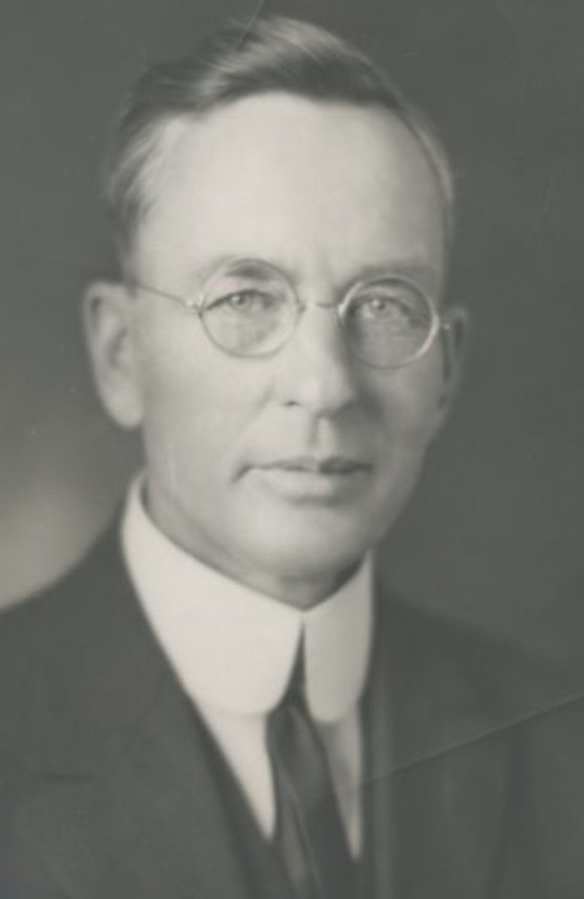
Francis M Wilcox
“For the benefit of those who may desire to know more particularly the cardinal features of the faith held by this denomination, we shall state that Seventh-day Adventists believe,- 1. In the divine Trinity. This Trinity consists of the eternal Father, a personal, spiritual being, omnipotent, omniscient, infinite in power, wisdom, and love; of the Lord Jesus Christ, the Son of the eternal Father, through whom all things were created, and through whom the salvation of the redeemed hosts will be accomplished; the Holy Spirit, the third person of the Godhead, the one regenerating agency in the work of redemption.” (FM Wilcox, Review and Herald, October 9, 1913)

Slide 20
EGW Counsels…
“There are the main pillars of our faith, subjects which are of vital interest, the Sabbath, the keeping of the commandments of God. Speculative ideas should not be agitated; for there are peculiar minds that love to get some point that others do not accept, and argue and attract everything to that one point, urging that point, magnifying that point, when it is really a matter which is not of vital importance, and will be understood differently. Twice I have been shown that everything of a character to cause our brethren to be diverted from the very points now essential for this time, should be kept in the background.” (Counsels to Writers and Editors, p. 77)

Slide 22
Haskell and Melchisedec
In the article below , which was originally published in Bible Training School, November 1, 1903, pg. 90, under the title “Melchisedec”; Haskell wrote,
“In the Review and Herald of February 18,1890, page 97, last paragraph, we read from Mrs. E. G. White: ‘It was Christ that spake through Melchisedec, the priest of the most high God. Melchisedec was not Christ, but he was the voice of God in this world, the representative of the Father.’
“There is but one being in the universe that fills all these specifications. That is the Spirit of God. He ever lives to intercede. He has no beginning of days or end of life. He represents the Father and the Son. He speaks peace to the troubled soul. He is not an angel of any kind, for angels are amenable to law, and were created. This being is equal to the Father and the Son. It is the voice of God in the world. A careful study of the above and a belief of the same will forever settle the question as to who Melchisedec is.”
Original source: Bible Training School, November 1, 1903, pg. 90

Slide 23
Haskell on Melchisedec
In the article. below, which was published in Bible Training School, November 1, 1904; Haskell refers to the Holy Spirit as the “third person of the Godhead” and he again identifies Melchisedec as the Holy Spirit. Haskell wrote,
The Holy Spirit, “the third person of the Godhead ” the soul-of Christ’s life, and the light and life of the world is the only one to whom all of the above specifications will apply. The Holy Spirit is the third person of the Godhead, and therefore is “King of righteousness, and after that also King of Salem, which is King of peace.”
The ” Spirit itself•maketh intercession for us with groanings which can not be uttered, and He that searcheth the hearts knoweth what is the mind of the Spirit, because He maketh intercession for the saints according to the will of God.” Rom. 8 : 26, 27. Therefore the Spirit ” abideth a priest continually,” and is a,”° priest of the most high God.”
The Spirit is the ” third person of the Godhead,” and therefore has no more beginning of days nor end of life ” than God Himself. There is no record of father, mother, or pedigree given of the Holy Spirit. As the third person of the Godhead, it is greater than Abraham and could bless him.
The Spirit comes to the world as a representative of Christ and thus is made like unto Christ. The Holy Spirit has visibly appeared to man under different forms. The Holy Ghost descended in a bodily shape like a dove upon Christ. Luke 3:22. It cadre as cloven tongues of fire upon the disciples on the day of Pentecost. To Abraham it appeared as a King, Priest. To-day It comes as a blessed Comforter to every one who will open his heart to receive it.
Original Source: Bible Training School November 1, 1904, pg 85, 86

Slide 24
Where then? Does this Doctrine Come From?
In order to understand the concept of person in God, we have to understand its foundation in the processions and relations within the inner life of God. And the Council of Florence, AD 1338-1445, can help us in this regard. . . The Son “proceeds” from the Father, and the Holy Spirit “proceeds from the Father and the Son.” These are the two processions in God. And these are foundational to the four relations that constitute the three persons in God. These are those four eternal relations in God:
1. The Father actively and eternally generates the Son, constituting the person of God, the Father.
2. The Son is passively generated of the Father, which constitutes the person of the Son.
3. The Father and the Son actively spirate the Holy Spirit in the one relation within the inner life of God that does not constitute a person. It does not do so because the Father and Son are already constituted as persons in relation to each other in the first two relations. This is why CCC 240 teaches, “[The Second Person of the Blessed Trinity] is Son only in relation to his Father.”
4. The Holy Spirit is passively spirated of the Father and the Son, constituting the person of the Holy Spirit. – Catholic Answers, June 20, 2014 (https://www.catholic.com/magazine/online-edition/explaining-the-trinity)

Slide 25
From the Beginning!
Genesis 1:1-3 “In the beginning God created the heaven and the earth. And the earth was without form, and void; and darkness was upon the face of the deep. And the Spirit of God moved upon the face of the waters. And God said, Let there be light: and there was light.”
Genesis 6:3 “And the Lord said, My spirit shall not always strive with man, for that he also is flesh: yet his days shall be an hundred and twenty years.”

Slide 26
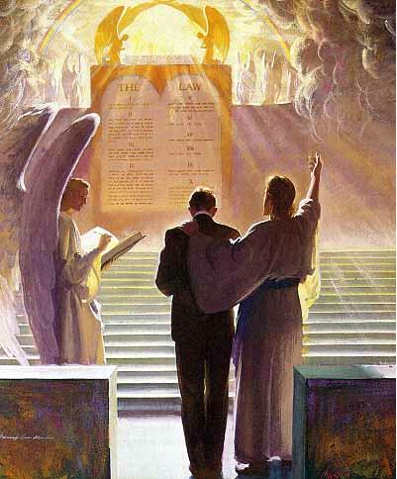
A Co-Intercessor
Romans 8:16, 26-27 “ The Spirit itself beareth witness with our spirit, that we are the children of God . . . Likewise the Spirit also helpeth our infirmities: for we know not what we should pray for as we ought: but the Spirit itself maketh intercession for us with groanings which cannot be uttered. And he that searcheth the hearts knoweth what is the mind of the Spirit, because he maketh intercession for the saints according to the will of God.

Slide 27
The Spirit Sent Christ!
Isaiah 48:16 “Come ye near unto me, hear ye this; I have not spoken in secret from the beginning; from the time that it was, there am I: and now the Lord GOD, and his Spirit, hath sent me.

Slide 28
The Holy Spirit Speaks
Acts 8:29 “Then the Spirit said unto Philip, Go near, and join thyself to this chariot.
Acts 13:2 “ As they ministered to the Lord, and fasted, the Holy Ghost said, Separate me Barnabas and Saul for the work whereunto I have called them.”
Acts 11:12 “And the Spirit bade me go with them, nothing doubting.”
1 Timothy 4:1 “Now the Spirit speaketh expressly, that in the latter times some shall depart from the faith, giving heed to seducing spirits, and doctrines of devils;

Slide 29
Other Scriptures Pointing to the Person, Godliness, or Personal attributes of the Holy Spirit
1 Cor. 12:11 Titus 3:5 2 Sam. 23:2 Acts 16:6
1 Cor. 2:10,11 1 Pet. 1:2 Acts 10:19 Ps. 139:7,8
Phil. 2:1 Eph. 3:16 Acts 21:11 John 14:16,17
2 Cor. 13:14 Eph. 4:30 Acts 28:25-26 Is. 40:13
Acts 5:3-4,9 Matt. 28:19-Baptize Heb. 3:7-8 Zech. 4:6
2 Pet. 1:21 2 Cor. 3:16-18 Rev. 14:13 Luke 1:35-Creator
1 Cor. 6:19 Rom. 8:11 Rev. 22:17 Heb. 9:8
Matt. 12:31-Blasphemy John 6:63 Acts 15:28 1 Pet. 1:12
John 15:26 1 John 5:6 Acts 20:28 Job 33:4
John 16:7 John 14:26 Acts 5:32 Ps. 104:30
John 16:9 Is. 63:10 Luke 12:12 Matt. 12:28
John 16:13 Rom. 15:30 Matt. 4:1 1 Cor. 12:4-6
2 Cor. 13:14

Slide 31
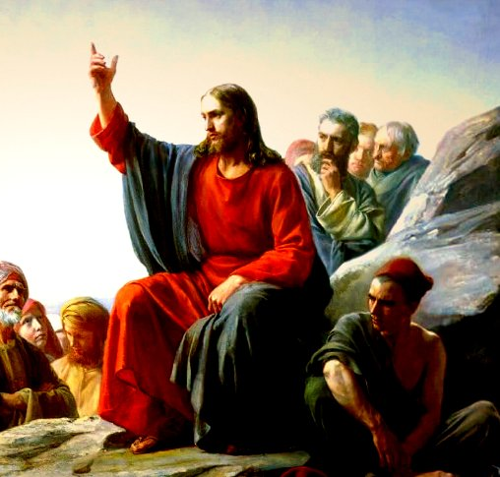
The Parable of the Comforter?
John 16:25-proverbs
John 14:16-18-Wanted to reveal the Father, he=Father
Rich man and Lazarus Parable-Abraham’s Bosom
John 14:22-Disciples say Jesus is coming
John 15:26-proceeds from the Father-Who is in the Sanctuary?

Slide 32
6. Spirit of truth, testify of Christ, therefore is Christ—If 3 are 1, then all symbols can apply to each
7. John 16:7-”I will send him unto you”—Christ could not send Spirit until he was glorified—Why then was He anointed with the Spirit at His baptism—was Christ’s ministry a farce? Stones into bread, come off the cross, legions
8. Spirit of a person and the person are the same thing right?
9. Holy Spirit as a person is a tradition, namely one from Rome—counterfeits of Satan
10. John 16:12-14-Not a new teacher—Christ is “truth” the “Spirit of truth” is the same Jesus Christ—NO TEACHER besides Christ—Son is glorified by the Father whose Spirit proceedeth from Him
11. John 16:26-27-All about the Father and Son of God-Sanctuary context
12. John 16:29-disciples said he speaks plain speech that He is the Son of God
13. This issue is NOT Christianity, not biblical-Become the 3rd Angel’s Message- Gal. 4:6—Is Christ omnipresent?
14. 1 John 2:1 “Comforter”—parakletos—is Jesus

Slide 33
Thus Saith the Lord
Wherever hearts are open to receive the truth, Christ is ready to instruct them. He reveals to them the Father, and the worship acceptable to Him who reads the heart. For such He uses no parables. To them, as to the woman at the well, He says, "I that speak unto thee am He.“– DA, 194
The disciples had been with Christ, and could understand Him; to them He need not talk in parables. He corrected their errors, and made plain to them the right way of approaching the people. He opened more fully to them the precious treasures of divine truth.– DA, 361
But the multitudes were slow of hearing, and in the home at Bethany Christ found rest from the weary conflict of public life. Here He opened to an appreciative audience the volume of Providence. In these private interviews He unfolded to His hearers that which He did not attempt to tell to the mixed multitude. He needed not to speak to His friends in parables.– DA, 524
If this is a parable, why is it not outlined and explained by Ellen White in any writing? Not the Desire of Ages, Not Christ’s Object Lessons???

Slide 34
Where then? Does this Doctrine Come From?
In order to understand the concept of person in God, we have to understand its foundation in the processions and relations within the inner life of God. And the Council of Florence, AD 1338-1445, can help us in this regard. . . The Son “proceeds” from the Father, and the Holy Spirit “proceeds from the Father and the Son.” These are the two processions in God. And these are foundational to the four relations that constitute the three persons in God. These are those four eternal relations in God:
1. The Father actively and eternally generates the Son, constituting the person of God, the Father.
2. The Son is passively generated of the Father, which constitutes the person of the Son.
3. The Father and the Son actively spirate the Holy Spirit in the one relation within the inner life of God that does not constitute a person. It does not do so because the Father and Son are already constituted as persons in relation to each other in the first two relations. This is why CCC 240 teaches, “[The Second Person of the Blessed Trinity] is Son only in relation to his Father.”
4. The Holy Spirit is passively spirated of the Father and the Son, constituting the person of the Holy Spirit. – Catholic Answers, June 20, 2014 (https://www.catholic.com/magazine/online-edition/explaining-the-trinity)

Slide 35
Don’t Forget Your ONLY Mission!
We are now living in the closing scenes of this world's history. Let men tremble with the sense of the responsibility of knowing the truth. The ends of the world are come. Proper consideration of these things will lead all to make an entire consecration of all that they have and are to their God. . . . The weighty obligation of warning a world of its coming doom is upon us. From every direction, far and near, calls are coming to us for help. The church, devotedly consecrated to the work, is to carry the message to the world: Come to the gospel feast; the supper is prepared, come. . . . Crowns, immortal crowns, are to be won. The kingdom of heaven is to be gained. A world, perishing in sin, is to be enlightened. The lost pearl is to be found. The lost sheep is to be brought back in safety to the fold. Who will join in the search? Who will bear the light to those who are wandering in the darkness of error? We should now feel the responsibility of laboring with intense earnestness to impart to others the truths that God has given for this time. We cannot be too much in earnest. . . . Now is the time for the last warning to be given. There is a special power in the presentation of the truth at the present time; but how long will it continue?--Only a little while. If there was ever a crisis, it is now. All are now deciding their eternal destiny. Men need to be aroused to realize the solemnity of the time, the nearness of the day when human probation shall be ended. Decided efforts should be made to bring the message for this time prominently before the people. The third angel is to go forth with great power. . . Evangelistic work, opening the Scriptures to others, warning men and women of what is coming upon the world, is to occupy more and still more of the time of God's servants. – Evangelism, p. 16,17

Slide 36
Catholic Trinity Outline:
The Hislop Lie—it’s pagan, real quote
BG Wilkinson confirms!
Council of Nicea + Quote from Chris Chung on the Triune God
Trinity or Godhead pamphlet
Holy Spirit is a an essence quote
The Alpha of Apostasy and Kellogg (get Kellogg quote where they say we can’t fix your theology from Chris Chung series pt 4 last 10 minutes)
Rose Publishing Christianity Cults and Religions Pamphlet saying we believe in different Trinity

Slide 37
The Gaslighters Outline:
Lenin accuse others of what you yourself are doing… + Hitler quote on Lenin being trained by Jesuits
Recap: They quote Canright—he’s a liar, Hislop—he believes in the Trinity, & Kellogg issue—when it proves the opposite, You believe in the Catholic Trinity when they actually do
Nadar Mansour—the parable of the Comfortor + Jesus did not speak in parables directly to his disciples—they glory in their unbelief (see my own quote to Chris Chung)
Fanaticism leads to darkness and strong delusion (EGW vision about Satan breathing on people---this is about the Sanctuary)
The stenographer issue: They reject every quote proving the Trinity from stenographers but then use them when it serves to bolster their arguments
1 John 5:7 doesn’t belong in the Bible—it was added to create the Trinity doctrine (NIV, RSV, ESV comparison) + Ellen White doesn’t quote it directly (there are other Bible passages she does not touch—does that make them false also?) + Gail Riplinger quotes
3rd Angel’s Message is to engross our whole work compared to stats of false ministries that dedicate themselves to this false message

Slide 38
The Bible Evidence Outline:
0. Holy Spirit Characteristics (spirit of truth, would not speak for Himself, glorify the Father and Son, wrote the Bible, Order of Melchisedec)
1 John 5:7
The Spirit Sent Me
Created the flesh of Jesus
The 3 crowns in the Sanctuary
Genesis 1:1-3 the Trinity of Trinities
One LORD + Jewish admission that it could definitely mean that—see Chris Chung
Human traits of the Holy Spirit (Spirit strives with man, speaks, commands, Stephen you do resist the Holy Spirit, seven Spirits, blasphemy against the Holy Spirit is unpardonable)
Catholic Quote that the Holy Spirit is an essence.
Lying against the Holy Ghost—Ananias and Saphira

Slide 39
Melchisidec Outline:
Genesis 11 bread and wine
Jesus is of the “Order of Melchisedec”
Hebrews 7, without Father without mother, etc.
Melchisedec was not Christ but the Representative of the Father (connect to John 14-16: he represents Christ on earth) + no man hath seen the Father (ONLY 1 OPTION)
GB Starr + Haskell Quote—Holy Spirit is Melchisedec
Haskell Story of Daniel Quote
Catholic Melchisedec from printout from Paul Praino

Slide 40
Holy Spirit Vindicated Outline:
The Bible Evidence Recap
The SOP Evidence Recap
The Pioneer Evidence Recap
Their Best Arguments Defeated Recap (Parable of the Comforter, You’re Catholic Argument, The Father and Jesus are the Holy Spirit—Catholic spiritualism, Pioneers—fail… which ones?, Hislop liars, Kellogg liars, stenographer liars, Froom liars, Ellen White did not write that—with her own hand ML Andreason, the One True God is a false god doctrine)
The Parrots: Jesuit quote on how they would control minds—apes and parrots
Naming Names + Get back to the 3rd Angel’s Message—it’s salvational!

