Slide 1
The History of the Holy Spirit in Adventism pt 4: Nonproducers

Slide 2
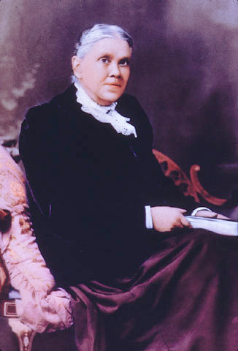
Which Work Are We To Do?
“In a special sense Seventh-day Adventists have been set in the world as watchmen and light-bearers. To them has been entrusted the last warning for a perishing world. On them is shining wonderful light from the Word of God. They have been given a work of the most solemn import,—the proclamation of the first, second, and third angels’ messages. There is no other work of so great importance. They are to allow nothing else to absorb their attention.” Evangelism, p. 119

Slide 3
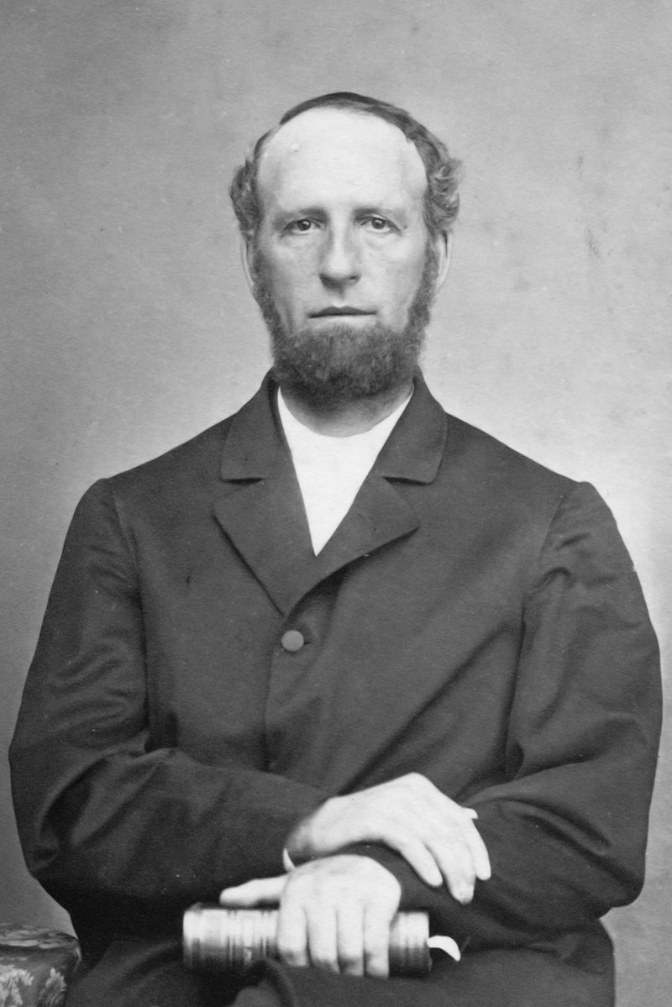
James White: NOT A MAJOR DOCTRINE
“The principal difference between the two bodies is the immortality question. The S. D. Adventists hold the divinity of Christ so nearly with the trinitarian, that we apprehend no trial here. And as the practical application of the subject of the Gifts of the Spirit to our people and to our work is better understood by our S. D. Baptist brethren, they manifest less concern for us on this account. In the divine law, and in the gospel of the divine Son, are the tests of Christian character. And it is with an ill grace that those who have been splitting up into petty sects during the nineteenth century over forms of church government, matters of expediency, free and restricted salvation, trinity and unity, whether we may sing any good hymn in church, or only the Psalms of David, and other matters which constitute no test of fitness for Heaven, now pounce upon us, and display any amount of religious horror, simply because we regard strict conformity to the commandments of God, and the faith of Jesus the only true tests of Christian character.” (James White, RH Oct, 12, 1876)

Slide 4
Ellen White: Silence is Golden
“The nature of the Holy Spirit is a mystery. Men cannot explain it, because the Lord has not revealed it to them. Men having fanciful views may bring together passages of Scripture and put a human construction on them, but the acceptance of these views will not strengthen the church. Regarding such mysteries, which are too deep for human understanding, silence is golden.” AA, 52

Slide 5
Indifferent VS Fanatic
“We have found in our experience that if Satan cannot keep souls bound in the ice of indifference, he will try to push them into the fire of fanaticism. When the Spirit of the Lord comes among His people, the enemy seizes his opportunity to work also upon different minds and lead them to mingle their own peculiar traits of character with the work of God. Thus there is always danger that they may allow their own spirit to mingle with the work and that unwise moves may be made. Many carry on a work of their own devising that is not prompted by God.”--Lt 34, 1889.

Slide 6
“Many who should have devoted their time and talents to the one purpose of sounding warning to the world, were absorbed in opposing the Sabbath truth, and in turn, the labor of its advocates was necessarily spent in answering these opponents and defending the truth. Thus the work was hindered, and the world was left in darkness. Had the whole Adventist body united upon the commandments of God and the faith of Jesus, how widely different would have been our history! It was not the will of God that the coming of Christ should be thus delayed. God did not design that His people, Israel, should wander forty years in the wilderness. He promised to lead them directly to the land of Canaan, and establish them there a holy, healthy, happy people. But those to whom it was first preached, ‘went not in because of unbelief’ (Heb. 3:19). Their hearts were filled with murmuring, rebellion, and hatred, and He could not fulfill His covenant with them. For forty years did unbelief, murmuring, and rebellion shut out ancient Israel from the land of Canaan. The same sins have delayed the entrance of modern Israel into the heavenly Canaan. In neither case were the promises of God at fault. It is the unbelief, the worldliness, unconsecration, and strife among the Lord's professed people that have kept us in this world of sin and sorrow so many years” 1SM, p. 68-69 (Stated in 1883)

Slide 7
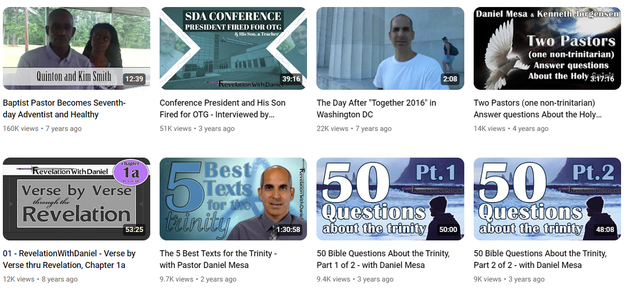
Daniel Mesa: Most Popular

Slide 8
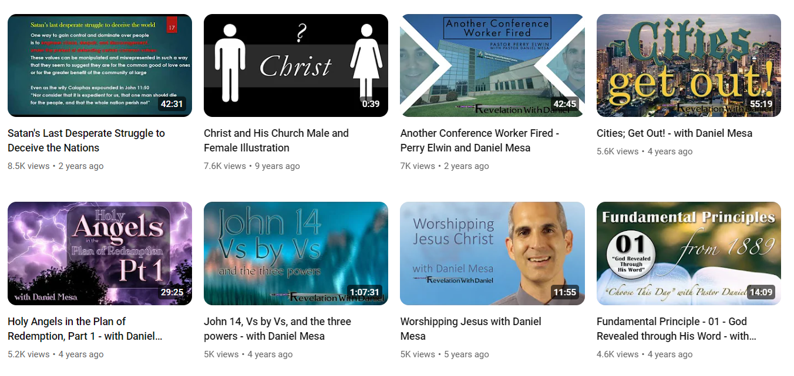

Slide 9
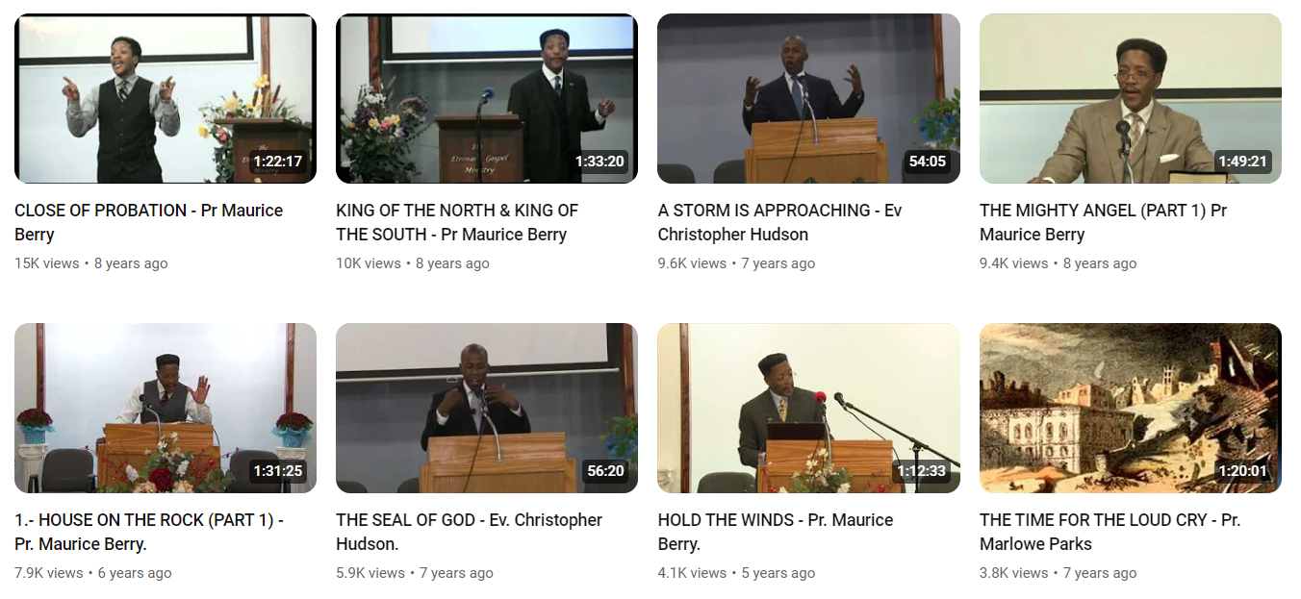
Maurice Berry: Most Popular

Slide 10
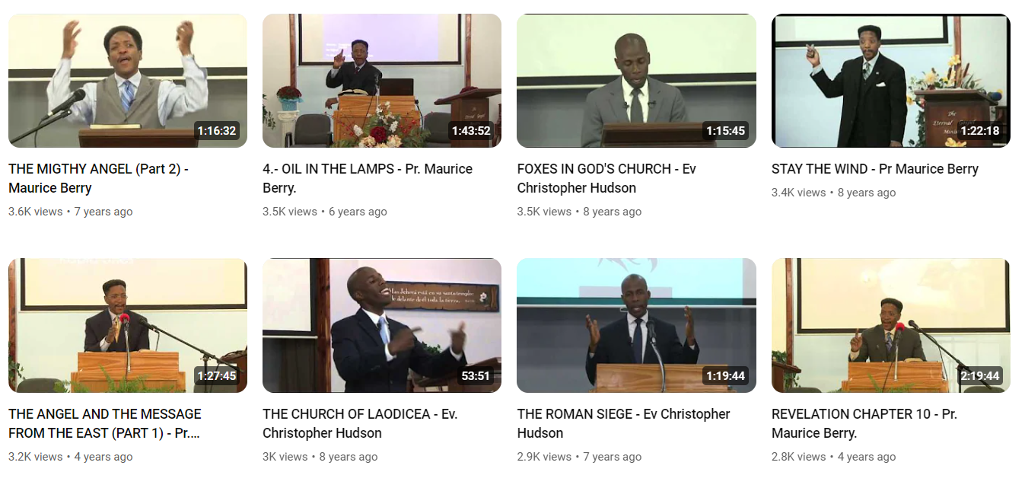

Slide 11
Beware of False Prophets Who Come to You in Sheep’s Clothing…
Matt. 7:15-18 “Beware of false prophets, which come to you in sheep's clothing, but inwardly they are ravening wolves. Ye shall know them by their fruits. Do men gather grapes of thorns, or figs of thistles? Even so every good tree bringeth forth good fruit; but a corrupt tree bringeth forth evil fruit. A good tree cannot bring forth evil fruit, neither can a corrupt tree bring forth good fruit.”

Slide 12
Daniel Mesa and Allen Davis….
Daniel Mesa worked at Secrets Unsealed and Allen Davis worked at Amazing Facts… Both left because they wanted to promote the antitrinitarian doctrine freely and unhindered… Let’s examine some fruits!

Slide 13
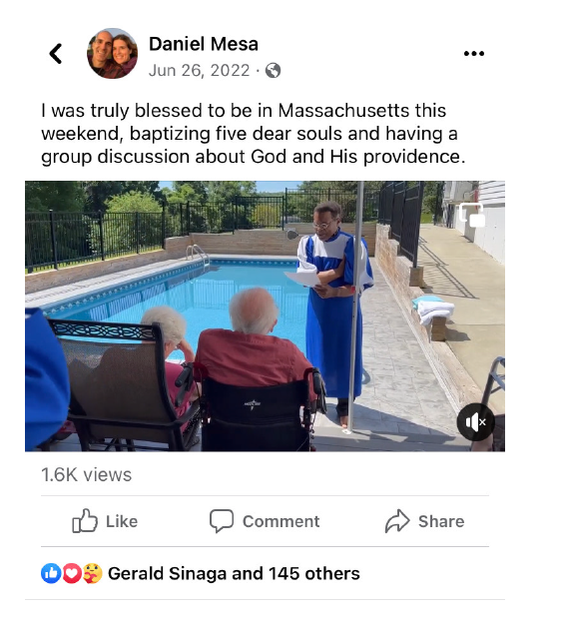
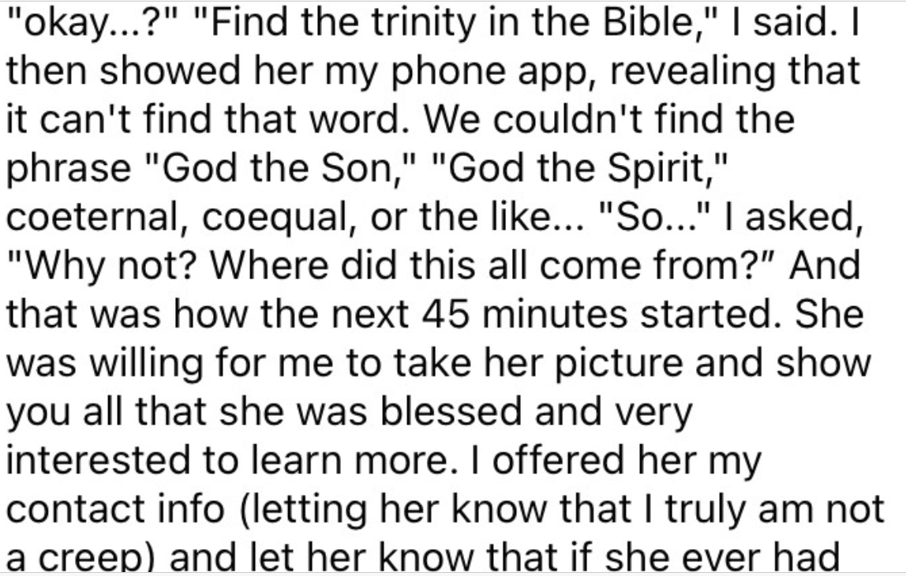
Snip-it from Daniel Mesa’s Facebook page, referring to the Jun. 26, 2022 “conversion” story. Photo provided by Chris Chung

Slide 14
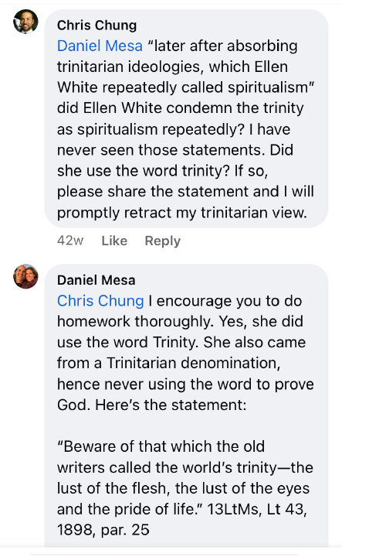
“Modern non trinitarian leaders often spend the majority of their time emphasizing their view of the Godhead. Daniel Mesa recently held an evangelistic series in which five converts were baptized. All five were SDA trinitarians converting to non trinitarian belief.” Chris Chung, A History of the Trinity Within Adventism, pt. 2
Daniel Mesa: Dishonest, Deceptive, Preaching and Converting Others to a Message We Have NOT Been Given As a People….

Slide 15
Dr. Allen Davis Leaves Adventism—Thanks Holy Spirit Doctrine

Slide 17
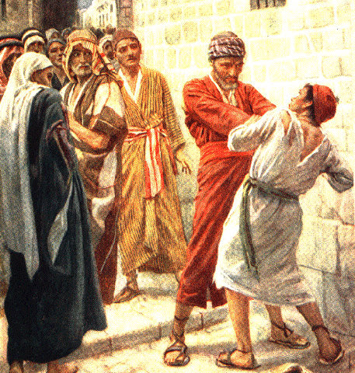
Luke 12:40-47 “Be ye therefore ready also: for the Son of man cometh at an hour when ye think not. Then Peter said unto him, Lord, speakest thou this parable unto us, or even to all? And the Lord said, Who then is that faithful and wise steward, whom his lord shall make ruler over his household, to give them their portion of meat in due season? Blessed is that servant, whom his lord when he cometh shall find so doing. Of a truth I say unto you, that he will make him ruler over all that he hath. But and if that servant say in his heart, My lord delayeth his coming; and shall begin to beat the menservants and maidens, and to eat and drink, and to be drunken; The lord of that servant will come in a day when he looketh not for him, and at an hour when he is not aware, and will cut him in sunder, and will appoint him his portion with the unbelievers. And that servant, which knew his lord's will, and prepared not himself, neither did according to his will, shall be beaten with many stripes.”

Slide 18
God’s Will or my will????
1 Cor. 3:13-14 “Every man's work shall be made manifest: for the day shall declare it, because it shall be revealed by fire; and the fire shall try every man's work of what sort it is. If any man's work abide which he hath built thereupon, he shall receive a reward.”

Slide 19
EGW Counsels…
“There are the main pillars of our faith, subjects which are of vital interest, the Sabbath, the keeping of the commandments of God. Speculative ideas should not be agitated; for there are peculiar minds that love to get some point that others do not accept, and argue and attract everything to that one point, urging that point, magnifying that point, when it is really a matter which is not of vital importance, and will be understood differently. Twice I have been shown that everything of a character to cause our brethren to be diverted from the very points now essential for this time, should be kept in the background.” (Counsels to Writers and Editors, p. 77)

Slide 20
Simple—Unanswerable Quotes
"The Godhead was stirred with pity for the race, and the Father, the Son, and the Holy Spirit gave Themselves to the working out of the plan of redemption.“ Counsels on Health, p. 222
"These three all cooperate in the great work of the covenant made by baptism in the sight of the heavenly universe.“ MR6, p. 163
"The salvation of human beings is a vast enterprise, that calls into action every attribute of the divine nature. The Father, the Son, and the Holy Spirit have pledged themselves to make God's children more than conquerors through Him that loved them.“ R&H, January 27, 1903

Slide 21
Accuse Others of What You Yourself Are Doing
If I had a vision in meeting, many would say that it was excite-
ment and that someone mesmerized me. Then I would go away
alone in the woods, where no eye or ear but God’s could see or
hear, and pray to Him, and He would sometimes give me a vision
there. I then rejoiced, and told them what God had revealed to me
alone, where no mortal could influence me. But I was told by some
that I mesmerized myself. Oh, thought I, has it come to this that
those who honestly go to God alone to plead His promises and to
claim His salvation, are to be charged with being under the foul and
soul-damning influence of mesmerism? Do we ask our kind Father
in heaven for “bread,” only to receive a “stone” or a “scorpion”?[22]
These things wounded my spirit, and wrung my soul in keen anguish,
well-nigh to despair, while many would have me believe that there
was no Holy Ghost and that all the exercises that holy men of God
have experienced were only mesmerism or the deceptions of Satan.
At this time there was fanaticism in Maine. Some refrained
wholly from labor and disfellowshiped all those who would not
receive their views on this point, and some other things which they
held to be religious duties. God revealed these errors to me in vision
and sent me to His erring children to declare them; but many of them
wholly rejected the message, and charged me with conforming to the
world. On the other hand, the nominal Adventists charged me with
fanaticism, and I was falsely, and by some wickedly, represented
as being the leader of the fanaticism that I was actually laboring to
correct. EW, 21-22

