Slide 1
The History of the Holy Spirit in Adventism pt 7: Accuse Others of What You Are Doing

Slide 2
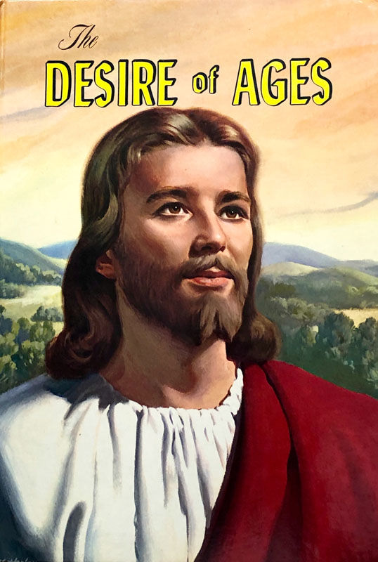
The Quote…
“The power of evil had been strengthening for centuries, and the submission of men to this satanic captivity was amazing. Sin could be resisted and overcome only through the mighty agency of the Third Person of the Godhead, who would come with no modified energy, but in the fullness of divine power.“ DA, 671

Slide 3
Makes Decisions
Renews us
Spirit Speaks through David
HS forbids
Spirit reads man and God
Sanctifies us—3 mentioned
Spirit speaks/directs Peter
HS is omnipresent
Has Fellowship with us
Strengthens us
Spirit Speaks through Agabus
You can know the HS
Communion/relationship with us
You can grieve Him
Spirit spoke through Isaiah
No one directs the Spirit of the LORD
Lied to HS=Lied to God
Baptized in His Name
HS power is how we overcome
HS speaks via Paul
Wrote the Bible
HS is the Lord
Spirit gives eulogy
HS created the body of Jesus in the whom of Mary
Our Body is HS Temple
Jesus explains HS work
John 16:15
Rom. 8:26
Spirit says “Come”
HS taught Israel about the Sanctuary
Blasphemy not forgiven against HS
HS makes decisions
HS testified of Jesus’ sufferings and then powered the Gospel
HS is Intercessor/Groans
He testifies of Christ
HS bears witness
HS appoints positions
The Holy Spirit is the Creator
He is the Comforter/Person
Father sends in Jesus’ Name
HS is a witness
HS creates life
If they believe not on Jesus?
HS was vexed by ancient Israel
HS teaches
HS casts out Devils
Won’t speak of Himself
For the love the Spirit
Jesus directed by the HS
HS mentioned alongside the Son and the Father

Slide 4
A “Person” but not a Person?
Official Catholic Website teaches that the Holy Spirit is a metaphorical person:
"As an infinite act of love between the Father and Son, this “act” is so perfect and infinite that “it” becomes (not in time, of course, but eternally) a “He” in the third person of the Blessed Trinity. This revelation of God’s love personified is the foundation from which Scripture could reveal to us that “God is love” (I John 4:8).“ https://www.catholic.com/magazine/online-edition/explaining-the-trinity

Slide 5
1 John 5:7 Controversy….
KJV 1 John 5:6-8 “This is he that came by water and blood, even Jesus Christ; not by water only, but by water and blood. And it is the Spirit that beareth witness, because the Spirit is truth. For there are three that bear record in heaven, the Father, the Word, and the Holy Ghost: and these three are one. And there are three that bear witness in earth, the Spirit, and the water, and the blood: and these three agree in one.”
NIV: 1 John 5:6-8 “This is the one who came by water and blood—Jesus Christ. He did not come by water only, but by water and blood. And it is the Spirit who testifies, because the Spirit is the truth. ⁷ For there are three that testify: ⁸ the^{[a]} Spirit, the water and the blood; and the three are in agreement

Slide 6
1 John 5 Continued
Evidence that 1 John 5:7-8 existed in the original texts:
Versions: Old Syriac AD 170, Old Latin AD 200, Vulgate: 4th and 5th Century, Italic: 4th and 5th Century
Writers who quoted it: Tatian AD 150, Tertullian AD 200, Cyprian AD 225, Athanasius AD 350, Cassian AD 435, Jerome AD 450, Cassiadorius AD 480, Vigilius AD 484, Victor-Vita AD 489, Fulgentius AD 533, PS Athanasius AD 550
Writings: Liber Apologeticus AD 350, Council of Cathage AD 415 (Ibid., p. 421
New Catholic Bible (NCB) 1 John 5:6-8 “This is the one who came by water and blood, Jesus Christ—not by water alone, but by water and blood. And to this the Spirit bears witness, for the Spirit is truth.[b] 7 Thus, there are three[c] witnesses, 8 the Spirit, the water, and the blood, and these three are as one

Slide 7
Doubting the Testimonies
“It is Satan’s plan to weaken the faith of God’s people in the Testimonies. Next follows skepticism in regard to the vital points of our faith, the pillars of our position, then doubt as to the Holy Scriptures, and then the downward march to perdition. When the Testimonies, which were once believed, are doubted and given up, Satan knows the deceived ones will not stop at this; and he redoubles his efforts till he launches them into open rebellion, which becomes incurable and ends in destruction.”—Testimonies for the Church 4:211

Slide 8
Ellen White on the Scriptures: On Holy Ground!
“God waits for the co-operation of his church. He does not design to add a new element of efficiency to his Word; he has done his great work in giving his inspiration to the Word. The blood of Jesus, the Holy Spirit, the divine Word, are ours. The object of all this provision of heaven is before us; and it depends upon us to lay hold of the promises God has given, and become laborers together with him.” RH Oct. 15, 1908
“In giving the word, “holy men of God spake as they were moved by the Holy Ghost.” The word was not given at the option of men, and the use to be made of it is not left to their option. Men may not dissect or pronounce upon, wrest or misinterpret, take from or cast aside, any portion of that word according to their own judgment. Although its compilation, preservation, and transmission have been committed to men, it is wholly divine in its origin and in the thoughts expressed. It may not be demerited and pronounced upon by finite minds, because of its transmission through human agents.” Bible Echo, Aug. 26, 1895

Slide 9
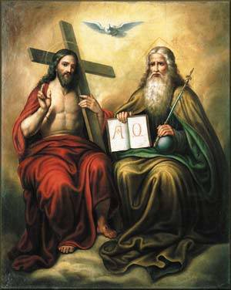
What Catholics Think About the SDA Trinity
“Her ongoing revelations formed the basis of the doctrine upon which she and her husband, James, founded the Seventh-day Adventist Church (so-called because White claimed that Christ wanted to be worshipped on the Jewish Sabbath). These doctrines included the revival of Jewish dietary customs (although most Adventists are vegetarian today); identification of the pope as Antichrist; three separate Divine Persons rather than the orthodox doctrine of Trinity; and several other unique teachings. https://catholicherald.co.uk/heretic-of-the-week-ellen-g-white/

Slide 10
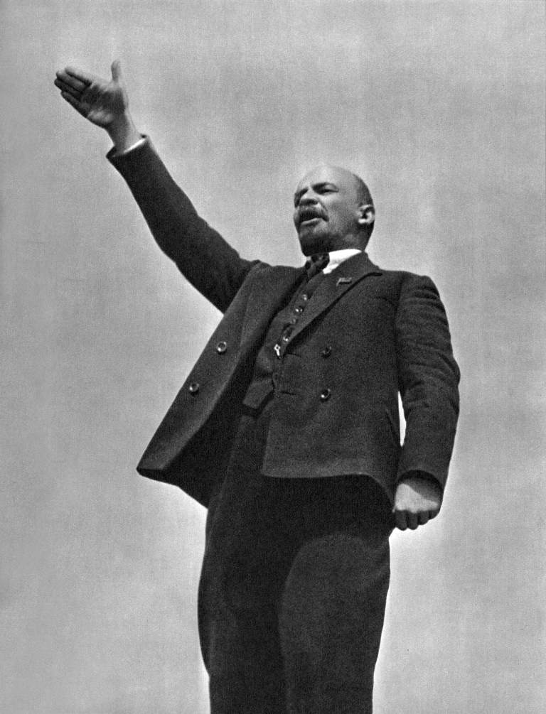
Accuse Others Of What You Are Doing…
“The cleverest trick used in propaganda against Germany during the war was to accuse Germany of what our enemies themselves were doing.“ (Goebbels at Nuremberg — 1934, https://research.calvin.edu/german-propaganda-archive/goeb59.htm)
Vladimir Lenin and/or Karl Marx: “Accuse the victim of what you do.”

Slide 11
We Should Be Ashamed of Ourselves!
“We deplore the fact that men idolize their own opinions, that they are willing to be governed by their own preconceived ideas rather than by a plain "Thus saith the Lord." It is the most difficult thing in the world to convince men who do not want to be convinced. Satan beclouds the perceptions, and hardens the heart so that men will not give up their own ways that they may work for the salvation of a backslidden church, and point sinners to the "Lamb of God which taketh away the sin of the world." Instead of engaging heartily in this work, they hold back, and almost hope and pray that those upon whom the Lord has laid the burden, will not succeed: for if success crowns the efforts of the burden-bearers, it will prove these doubters to be in the wrong." {Ellen G. White, 1888 materials, page 427}

Slide 12
Don’t Forget Your ONLY Mission!
We are now living in the closing scenes of this world's history. Let men tremble with the sense of the responsibility of knowing the truth. The ends of the world are come. Proper consideration of these things will lead all to make an entire consecration of all that they have and are to their God. . . . The weighty obligation of warning a world of its coming doom is upon us. From every direction, far and near, calls are coming to us for help. The church, devotedly consecrated to the work, is to carry the message to the world: Come to the gospel feast; the supper is prepared, come. . . . Crowns, immortal crowns, are to be won. The kingdom of heaven is to be gained. A world, perishing in sin, is to be enlightened. The lost pearl is to be found. The lost sheep is to be brought back in safety to the fold. Who will join in the search? Who will bear the light to those who are wandering in the darkness of error? We should now feel the responsibility of laboring with intense earnestness to impart to others the truths that God has given for this time. We cannot be too much in earnest. . . . Now is the time for the last warning to be given. There is a special power in the presentation of the truth at the present time; but how long will it continue?--Only a little while. If there was ever a crisis, it is now. All are now deciding their eternal destiny. Men need to be aroused to realize the solemnity of the time, the nearness of the day when human probation shall be ended. Decided efforts should be made to bring the message for this time prominently before the people. The third angel is to go forth with great power. . . Evangelistic work, opening the Scriptures to others, warning men and women of what is coming upon the world, is to occupy more and still more of the time of God's servants. – Evangelism, p. 16,17

Slide 13
Those who feel at liberty to doubt
“Those who feel at liberty to question the Word of God, to doubt everything where there is any chance to be unbelieving, will find that it will require a tremendous struggle to have faith when trouble comes. It will be almost impossible to overcome the influence that binds the mind which has been educated in the line of unbelief, for by this course the soul is bound in Satan’s snare and becomes powerless to break the dreadful net that has been woven closer and closer about the soul. In taking a position of doubt, man calls to his aid the agencies of Satan. But the only hope of one who has been educated in the line of unbelief is to fall all helpless upon the Saviour and, like a child, submit his will and his way to Christ that he may be brought out of darkness into His marvelous light. Man does not have the power to recover himself from the snare of Satan. He who educates himself in the line of questioning, doubting, and criticizing strengthens himself in infidelity.—Manuscript 3, 1895.(LDE, 68-69)

Slide 14
Other Arguments Coming
Washburn quote
Kellogg quote
EGW Quotes
1 john 5:7 is not part of the Bible

Slide 15
Haskell and Melchisedec
In the article below , which was originally published in Bible Training School, November 1, 1903, pg. 90, under the title “Melchisedec”; Haskell wrote,
“In the Review and Herald of February 18,1890, page 97, last paragraph, we read from Mrs. E. G. White: ‘It was Christ that spake through Melchisedec, the priest of the most high God. Melchisedec was not Christ, but he was the voice of God in this world, the representative of the Father.’
“There is but one being in the universe that fills all these specifications. That is the Spirit of God. He ever lives to intercede. He has no beginning of days or end of life. He represents the Father and the Son. He speaks peace to the troubled soul. He is not an angel of any kind, for angels are amenable to law, and were created. This being is equal to the Father and the Son. It is the voice of God in the world. A careful study of the above and a belief of the same will forever settle the question as to who Melchisedec is.”
Original source: Bible Training School, November 1, 1903, pg. 90

Slide 16
Haskell on Melchisedec
In the article. below, which was published in Bible Training School, November 1, 1904; Haskell refers to the Holy Spirit as the “third person of the Godhead” and he again identifies Melchisedec as the Holy Spirit. Haskell wrote,
The Holy Spirit, “the third person of the Godhead ” the soul-of Christ’s life, and the light and life of the world is the only one to whom all of the above specifications will apply. The Holy Spirit is the third person of the Godhead, and therefore is “King of righteousness, and after that also King of Salem, which is King of peace.”
The ” Spirit itself•maketh intercession for us with groanings which can not be uttered, and He that searcheth the hearts knoweth what is the mind of the Spirit, because He maketh intercession for the saints according to the will of God.” Rom. 8 : 26, 27. Therefore the Spirit ” abideth a priest continually,” and is a,”° priest of the most high God.”
The Spirit is the ” third person of the Godhead,” and therefore has no more beginning of days nor end of life ” than God Himself. There is no record of father, mother, or pedigree given of the Holy Spirit. As the third person of the Godhead, it is greater than Abraham and could bless him.
The Spirit comes to the world as a representative of Christ and thus is made like unto Christ. The Holy Spirit has visibly appeared to man under different forms. The Holy Ghost descended in a bodily shape like a dove upon Christ. Luke 3:22. It cadre as cloven tongues of fire upon the disciples on the day of Pentecost. To Abraham it appeared as a King, Priest. To-day It comes as a blessed Comforter to every one who will open his heart to receive it.
Original Source: Bible Training School November 1, 1904, pg 85, 86

Slide 17
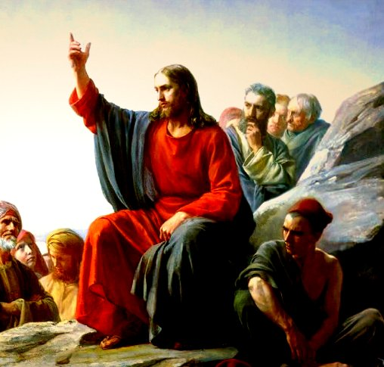
The Parable of the Comforter?
John 16:25-proverbs
John 14:16-18-Wanted to reveal the Father, he=Father
Rich man and Lazarus Parable-Abraham’s Bosom
John 14:22-Disciples say Jesus is coming
John 15:26-proceeds from the Father-Who is in the Sanctuary?

Slide 18
6. Spirit of truth, testify of Christ, therefore is Christ—If 3 are 1, then all symbols can apply to each
7. John 16:7-”I will send him unto you”—Christ could not send Spirit until he was glorified—Why then was He anointed with the Spirit at His baptism—was Christ’s ministry a farce? Stones into bread, come off the cross, legions
8. Spirit of a person and the person are the same thing right?
9. Holy Spirit as a person is a tradition, namely one from Rome—counterfeits of Satan
10. John 16:12-14-Not a new teacher—Christ is “truth” the “Spirit of truth” is the same Jesus Christ—NO TEACHER besides Christ—Son is glorified by the Father whose Spirit proceedeth from Him
11. John 16:26-27-All about the Father and Son of God-Sanctuary context
12. John 16:29-disciples said he speaks plain speech that He is the Son of God
13. This issue is NOT Christianity, not biblical-Become the 3rd Angel’s Message- Gal. 4:6—Is Christ omnipresent?
14. 1 John 2:1 “Comforter”—parakletos—is Jesus

Slide 19
Thus Saith the Lord
Wherever hearts are open to receive the truth, Christ is ready to instruct them. He reveals to them the Father, and the worship acceptable to Him who reads the heart. For such He uses no parables. To them, as to the woman at the well, He says, "I that speak unto thee am He.“– DA, 194
The disciples had been with Christ, and could understand Him; to them He need not talk in parables. He corrected their errors, and made plain to them the right way of approaching the people. He opened more fully to them the precious treasures of divine truth.– DA, 361
But the multitudes were slow of hearing, and in the home at Bethany Christ found rest from the weary conflict of public life. Here He opened to an appreciative audience the volume of Providence. In these private interviews He unfolded to His hearers that which He did not attempt to tell to the mixed multitude. He needed not to speak to His friends in parables.– DA, 524
If this is a parable, why is it not outlined and explained by Ellen White in any writing? Not the Desire of Ages, Not Christ’s Object Lessons???

Slide 20
Catholic Trinity Outline:
The Hislop Lie—it’s pagan, real quote x
BG Wilkinson confirms! x
Council of Nicea + Quote from Chris Chung on the Triune God x
Trinity or Godhead pamphlet xx
Holy Spirit is a an essence quote x
The Alpha of Apostasy and Kellogg (get Kellogg quote where they say we can’t fix your theology from Chris Chung series pt 4 last 10 minutes)
Rose Publishing Christianity Cults and Religions Pamphlet saying we believe in different Trinity

Slide 21
The Gaslighters Outline:
Lenin accuse others of what you yourself are doing… + Hitler quote on Lenin being trained by Jesuits
Recap: They quote Canright—he’s a liar, Hislop—he believes in the Trinity, & Kellogg issue—when it proves the opposite, You believe in the Catholic Trinity when they actually do
Nadar Mansour—the parable of the Comfortor + Jesus did not speak in parables directly to his disciples—they glory in their unbelief (see my own quote to Chris Chung)
Fanaticism leads to darkness and strong delusion (EGW vision about Satan breathing on people---this is about the Sanctuary)
The stenographer issue: They reject every quote proving the Trinity from stenographers but then use them when it serves to bolster their arguments
1 John 5:7 doesn’t belong in the Bible—it was added to create the Trinity doctrine (NIV, RSV, ESV comparison) + Ellen White doesn’t quote it directly (there are other Bible passages she does not touch—does that make them false also?) + Gail Riplinger quotes
3rd Angel’s Message is to engross our whole work compared to stats of false ministries that dedicate themselves to this false message

Slide 22
The Bible Evidence Outline:
0. Holy Spirit Characteristics (spirit of truth, would not speak for Himself, glorify the Father and Son, wrote the Bible, Order of Melchisedec)
1 John 5:7
The Spirit Sent Me
Created the flesh of Jesus
The 3 crowns in the Sanctuary
Genesis 1:1-3 the Trinity of Trinities
One LORD + Jewish admission that it could definitely mean that—see Chris Chung
Human traits of the Holy Spirit (Spirit strives with man, speaks, commands, Stephen you do resist the Holy Spirit, seven Spirits, blasphemy against the Holy Spirit is unpardonable)
Catholic Quote that the Holy Spirit is an essence.
Lying against the Holy Ghost—Ananias and Saphira

Slide 23
Melchisidec Outline:
Genesis 11 bread and wine
Jesus is of the “Order of Melchisedec”
Hebrews 7, without Father without mother, etc.
Melchisedec was not Christ but the Representative of the Father (connect to John 14-16: he represents Christ on earth) + no man hath seen the Father (ONLY 1 OPTION)
GB Starr + Haskell Quote—Holy Spirit is Melchisedec
Haskell Story of Daniel Quote
Catholic Melchisedec from printout from Paul Praino

Slide 24
Holy Spirit Vindicated Outline:
The Bible Evidence Recap
The SOP Evidence Recap
The Pioneer Evidence Recap
Their Best Arguments Defeated Recap (Parable of the Comforter, You’re Catholic Argument, The Father and Jesus are the Holy Spirit—Catholic spiritualism, Pioneers—fail… which ones?, Hislop liars, Kellogg liars, stenographer liars, Froom liars, Ellen White did not write that—with her own hand ML Andreason, the One True God is a false god doctrine)
The Parrots: Jesuit quote on how they would control minds—apes and parrots
Naming Names + Get back to the 3rd Angel’s Message—it’s salvational!

Slide 25
Accuse Others of What You Yourself Are Doing
If I had a vision in meeting, many would say that it was excite-
ment and that someone mesmerized me. Then I would go away
alone in the woods, where no eye or ear but God’s could see or
hear, and pray to Him, and He would sometimes give me a vision
there. I then rejoiced, and told them what God had revealed to me
alone, where no mortal could influence me. But I was told by some
that I mesmerized myself. Oh, thought I, has it come to this that
those who honestly go to God alone to plead His promises and to
claim His salvation, are to be charged with being under the foul and
soul-damning influence of mesmerism? Do we ask our kind Father
in heaven for “bread,” only to receive a “stone” or a “scorpion”?[22]
These things wounded my spirit, and wrung my soul in keen anguish,
well-nigh to despair, while many would have me believe that there
was no Holy Ghost and that all the exercises that holy men of God
have experienced were only mesmerism or the deceptions of Satan.
At this time there was fanaticism in Maine. Some refrained
wholly from labor and disfellowshiped all those who would not
receive their views on this point, and some other things which they
held to be religious duties. God revealed these errors to me in vision
and sent me to His erring children to declare them; but many of them
wholly rejected the message, and charged me with conforming to the
world. On the other hand, the nominal Adventists charged me with
fanaticism, and I was falsely, and by some wickedly, represented
as being the leader of the fanaticism that I was actually laboring to
correct. EW, 21-22

