Slide 1
Amazing Grace, pt. 4
‘Simeon the Cruel’

Slide 2
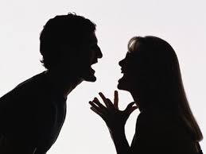
Cruel Beginnings
“And when the LORD saw that Leah was hated, he opened her womb: but Rachel was barren. And Leah conceived, and bare a son, and she called his name Reuben: for she said, Surely the LORD hath looked upon my affliction; now therefore my husband will love me. And she conceived again, and bare a son; and said, Because the LORD hath heard that I was hated, he hath therefore given me this son also: and she called his name Simeon.” Gen. 29:31-33

Slide 3
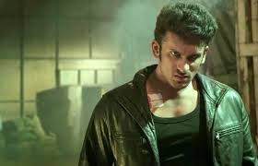
Growing up in that climate, what kind of young man would Simeon be? H saw the anger, harsh words, deception, hypocrisy, and every other ill in his home. His mom was the hated wife and she had to resort to everything devilish to get attention. She never knew love from her husband and her children felt this.

Slide 4
The Anger Explodes
After their sister was ill treated by Shechem, we read, “And it came to pass on the third day, when they were sore, that two of the sons of Jacob, Simeon and Levi, Dinah's brethren, took each man his sword, and came upon the city boldly, and slew all the males. And they slew Hamor and Shechem his son with the edge of the sword, and took Dinah out of Shechem's house, and went out. The sons of Jacob came upon the slain, and spoiled the city, because they had defiled their sister. They took their sheep, and their oxen, and their asses, and that which was in the city, and that which was in the field, And all their wealth, and all their little ones, and their wives took they captive, and spoiled even all that was in the house. And Jacob said to Simeon and Levi, Ye have troubled me to make me to stink among the inhabitants of the land, among the Canaanites and the Perizzites: and I being few in number, they shall gather themselves together against me, and slay me; and I shall be destroyed, I and my house. And they said, Should he deal with our sister as with an harlot?” Gen. 34:25-31

Slide 5
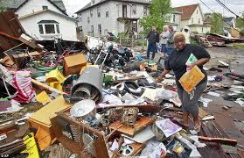
What a Mess!
Violence and bloodshed. Two brothers were involved in the guilt of murder, a whole city had been given to ruin and slaughter…The treacherous cruelty of Simeon and Levi was not unprovoked; yet in their course toward the Shechemites they committed a grievous sin. They had carefully concealed from Jacob their intentions, and the tidings of their revenge filled him with horror. Heartsick at the deceit and violence.” PP, pgs. 204, 205

Slide 6
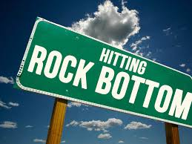
This Was the Beginning!
After the treachery at Shechem, you would think that Simeon had hit rock bottom, but that was only the beginning. Where the trouble had begun, it was boiling over the top and there was no let up! Simeon’s dad did a dumb thing in giving Simeon’s younger brother a coat of many colors. That was too much for him. He would bide his time; Joseph would pay!!!

Slide 7
Deadly Attempt
“The sight of the coat, the token of their father's love, filled them with frenzy. "Behold, this dreamer cometh," they cried in mockery. Envy and revenge, long secretly cherished, now controlled them. "Let us slay him," they said, "and cast him into some pit, and we will say, Some evil beast hath devoured him; and we shall see what will become of his dreams." They would have executed their purpose but for Reuben. He shrank from participating in the murder of his brother, and proposed that Joseph be cast alive into a pit, and left there to perish; secretly intending, however, to rescue him and return him to his father. Having persuaded all to consent to this plan, Reuben left the company, fearing that he might fail to control his feelings, and that his real intentions would be discovered.
Joseph came on, unsuspicious of danger, and glad that the object of his long search was accomplished; but instead of the expected greeting, he was terrified by the angry and revengeful glances which he met. He was seized and his coat stripped from him. Taunts and threats revealed a deadly purpose.” PP, pg. 211

Slide 8
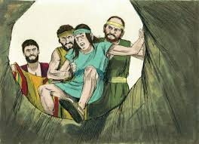
Simeon, the chief Instigator
“On his return he commanded that Simeon be bound before them and again committed to prison. In the cruel treatment of their brother, Simeon had been the instigator and chief actor, and it was for this reason that the choice fell upon him.” PP, pg. 226

Slide 9
Something Begins to Change
“And he knew it, and said, It is my son's coat; an evil beast hath devoured him; Joseph is without doubt rent in pieces. And Jacob rent his clothes, and put sackcloth upon his loins, and mourned for his son many days. And all his sons and all his daughters rose up to comfort him; but he refused to be comforted; and he said, For I will go down into the grave unto my son mourning. Thus his father wept for him.” Gen. 37:33-35

Slide 10
Change Comes!
“During the years since Joseph had been separated from his brothers, these sons of Jacob had changed in character. Envious, turbulent, deceptive, cruel, and revengeful they had been; but now, when tested by adversity, they were shown to be unselfish, true to one another, devoted to their father, and, themselves middle-aged men, subject to his authority.” PP, pg. 225

Slide 11
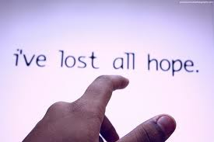
Hopelessness
In those quiet moments of reflection, Simeon was utterly drilled with guilt for his murderous ways. Sometimes life seemed to heavy for him to continue. Death seemed to be a sweet release from what he was currently suffering. Was there any hope for him?

Slide 12
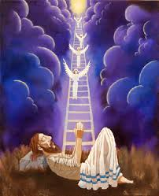
Amazing Grace at Work!
The amazing grace of God would speak to his mind. There is still hope for you. No matter what you have done, you can begin again! Your father was hopeless, but I showed him that he could be forgiven, and make a new start! Remember the ladder!

Slide 13
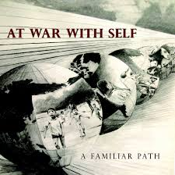
A Battle and a March
The restoration of a man did not happen in a moment. It had been years that Simeon had been filled with anger and hatred. For years, he had imbibed these feelings till they well-nigh consumed him. It would take years for this angry man to become a humble child of God!

Slide 14
No Pit for him!
“His mercy was still extended to His erring, distrustful servant. The Lord compassionately revealed just what Jacob needed--a Saviour. He had sinned, but his heart was filled with gratitude as he saw revealed a way by which he could be restored to the favor of God.” PP, pg. 183
“Then he is gracious unto him, and saith, Deliver him from going down to the pit: I have found a ransom. His flesh shall be fresher than a child's: he shall return to the days of his youth: He shall pray unto God, and he will be favourable unto him: and he shall see his face with joy: for he will render unto man his righteousness.” Job 33:24-26

Slide 15
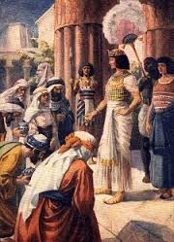
Humility
“They humbly confessed their sin and entreated his forgiveness. They had long suffered anxiety and remorse, and now they rejoiced that he was still alive.” PP, pg. 231

Slide 16
Simeon’s Experience
“But when the heart yields to the influence of the Spirit of God, the conscience will be quickened, and the sinner will discern something of the depth and sacredness of God's holy law, the foundation of His government in heaven and on earth. The "Light, which lighteth every man that cometh into the world," illumines the secret chambers of the soul, and the hidden things of darkness are made manifest. John 1:9. Conviction takes hold upon the mind and heart. The sinner has a sense of the righteousness of Jehovah and feels the terror of appearing, in his own guilt and uncleanness, before the Searcher of hearts. He sees the love of God, the beauty of holiness, the joy of purity; he longs to be cleansed and to be restored to communion with Heaven.” Steps to Christ, pg. 24

Slide 17
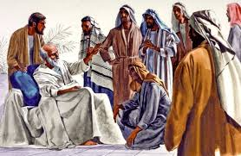
“Another act of humiliation remained for the ten brothers. They now confessed to their father the deceit and cruelty that for so many years had embittered his life and theirs. Jacob had not suspected them of so base a sin, but he saw that all had been overruled for good, and he forgave and blessed his erring children.” PP, pg. 232

Slide 18
Posterity Suffered and Disappeared
“They had been united in their cruelty toward the Shechemites, and they had also been the most guilty in the selling of Joseph. Concerning them it was declared--
"I will divide them in Jacob, And scatter them in Israel.”
At the numbering of Israel, just before their entrance to Canaan, Simeon was the smallest tribe. Moses, in his last blessing, made no reference to Simeon. In the settlement of Canaan this tribe had only a small portion of Judah's lot, and such families as afterward became powerful formed different colonies and settled in territory outside the borders of the Holy Land.” PP, pgs. 235,236

