Slide 1
Still Standing, Desmond!! Sorry, pt. 2

Slide 2
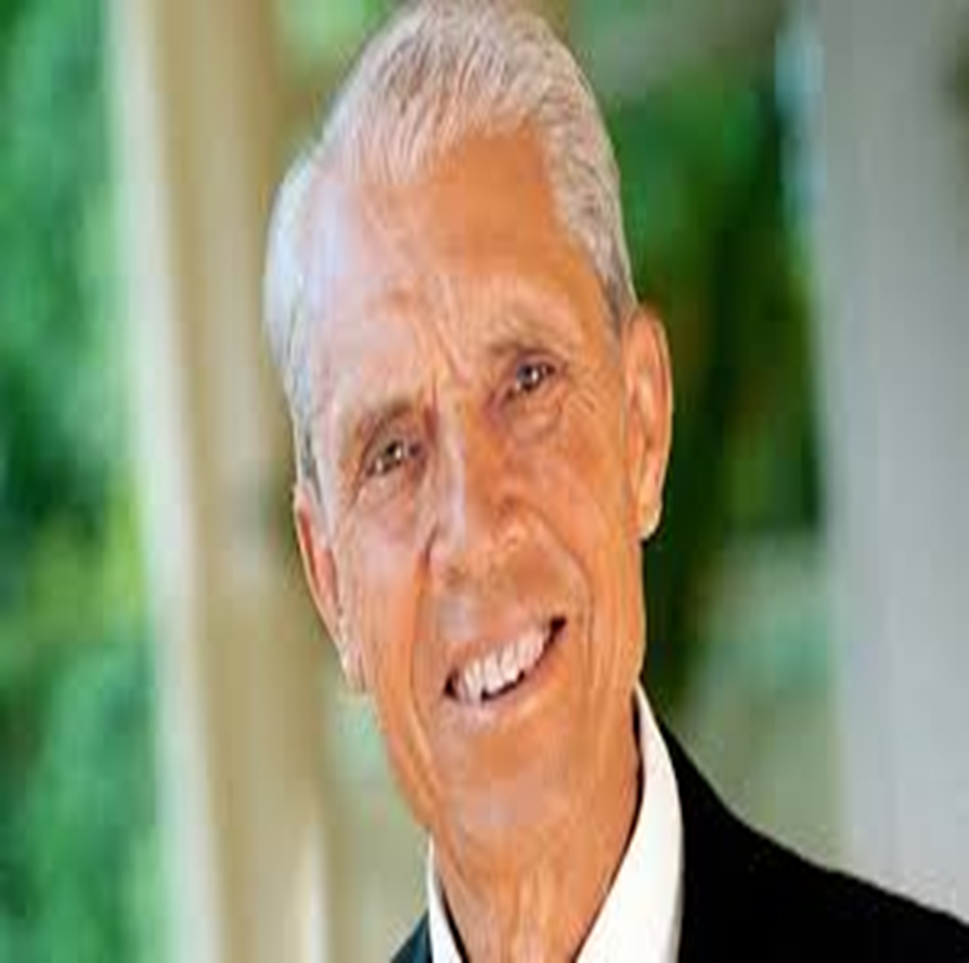
No one Did More!!!!!!
Take a good look at this man, Dr. Desmond Ford. No man did more, since Dudley M. Canright, to try and DESTROY the messages given to Seventh day Adventists. For the better part of 65 YEARS, Desmond Ford tried to annihilate the 3 Angel’s messages, the Spirit of Prophecy, and the movement of Seventh day Adventism. He did this across two continents and at two prestigious Adventist colleges: Avondale in Australia, and Pacific Union College in California. His heinous efforts failed as will all who seek to attack the messages of Seventh day Adventism!!! Praise God!

Slide 3
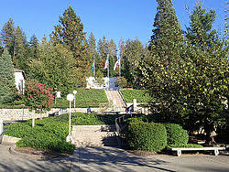
Showdown Time
For nearly 20 years, Desmond Ford poisoned a generation of Adventist young ministerial students at Avondale College in Australia. Now, in the later half of the 1970’s, he was brought to teach theology to Adventist young people at the cream of the crop of Adventist schools, Pacific Union College in the Napa Valley! Here, Ford would make a move that would cost him dearly.
The year was 1979!

Slide 4
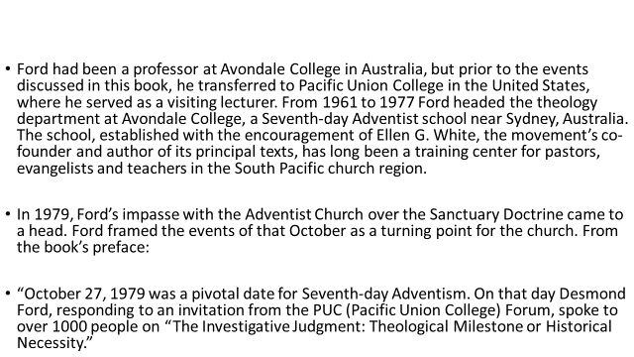

Slide 5
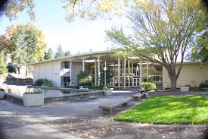
In this Sabbath afternoon engagement, Ford would show his true colors for all to see.
He stated that Adventists believing that Leviticus 16 and Daniel 8 are connected was totally erroneous.
He came out very clearly that Christ should have appeared in the 1st century and all prophecy should have been fulfilled by that time.
He stated that Ellen White was only good for devotional thought, but certainly not for doctrine.
He reiterated his belief that atonement was completed at the cross!

Slide 6
Ford Argues!
Unto 2300 days, then shall the sanctuary be cleansed.” On the basis of that word, our pioneers linked this prophecy with Leviticus 16, but the word isn’t there. You say, “Of course it’s there.” No, it’s not there. The KJV is a mistranslation. The word translated “cleanse” there is not found in Leviticus 16. It’s a different word altogether. That’s why almost all modern translations do not use “cleanse,” and therefore, from all other translations, you are crippled as a way of getting back to Leviticus 16” (pg. 12).
Ford argued vigorously against literalistic interpretations of apocalyptic texts:
“Apocalyptic visions are not to be taken as graphical, literal representations of the unseen, my friends. They are sketches within the experience and culture of the contemporary prophet to teach them something. It’s very important to understand that” (pg. 15).

Slide 7
Scholars, Bah Humbug!!!
“Unto 2300 days, then shall the sanctuary be cleansed.” On the basis of that word, our pioneers linked this prophecy with Leviticus 16, but the word isn’t there. You say, “Of course it’s there.” No, it’s not there. The KJV is a mistranslation. The word translated “cleanse” there is not found in Leviticus 16. It’s a different word altogether. That’s why almost all modern translations do not use “cleanse,” and therefore, from all other translations, you are crippled as a way of getting back to Leviticus 16” (pg. 12).
WOW!!! WOW!!! WOW!!! Desmond Ford declares that the word for cleansed in Daniel 8:14 is not the same word used in Leviticus and because of this, scholars see no connection between the two chapters and Adventists are wrong in connecting them. This is shocking and disgustingly unscholarly!! The word used in Leviticus 16 for cleansed is 2893. tahorah -- purifying, cleansing
... Word Origin from taher Definition purifying, cleansing NASB Word Usage becomes clean (1), cleansed (1), cleansing (6), purification (4), purifying (1). ...
/Hebrew/2893.htm - 6k

Slide 8
Cleansed, Made Right, Restored,??????
So, the Hebrew word in Leviticus 16 means clean, cleansed , purified. The word for cleansed in Daniel 8:14 is different than the word for cleansed in Leviticus 16. However, it means the same thing. Daniel 8:14, the word is Nasdaq. First, there is the idea of the sanctuary being “restored to its rightful state.” Variations of the same idea include “have its rights restored,” “rights of the sanctuary be restored,” “declared right,” “put right,” “come into its right, “reestablished within its rights,” “properly restored,” or simply “restored.” A second idea conveyed by the translations of Nasdaq is the traditional one, “cleansed,” indicated already by the Greek Septuagint and Theodotian katharistheœsetai and the Latin mundábitur, and the Syriac and Coptic. This translation of “shall be purified/cleansed” is followed in English by major modern versions in Protestant, Catholic, and Jewish traditions. (The Strong's Concordance uses cleansed as one of the definitions) The third idea represented by the English translations of Nasdaq is that of vindication. Several translations read “shall be vindicated,” others, “shall be justified” or “its cause vindicated,” or the related “emerge victorious.”

Slide 9

Foolish Scholars!!!
The word in Lev. 16 and the word in Daniel 8 are different. However, they both use cleansed as one meaning for both words. Clearly, there is a link between the two chapters.
Will we say there is no link between two people and what they are saying if one says money and the other says cash, or loot, or bread, bucks, etc. Different words, but mean the same thing! This is what we have in Leviticus 16 and Daniel 8:14! Thank God, we are not beholden to foolish scholars!!!!!!

Slide 10
Jesus Coming in the First Century?????
“My friends, it’s as plain as the nose on your face that the New Testament teaches that the end was meant to come just after the First Advent. If the church had seized hold of the gospel, understood the good news, and in the exuberance of joy and the great gift of God, gone out to spread it to the whole world—because Jesus cannot come until the whole world has heard the gospel. And the only thing that holds up the Second Advent is that people understand the gospel” (pg. 18).
Ford took issue with Ellen White’s use by many as an authoritative source of Adventist doctrine. He insisted that all Adventist doctrines could (and should) be argued on the basis of Scripture alone. Interestingly, the revision committee tasked with editing Adventism’s 28 Fundamental Beliefs in 2015 essentially agreed, striking the words “continuing and authoritative source of truth” with reference to Ellen White’s writings. The 2015 General Conference Session in San Antonio ratified the changes, indicating a subtle but important shift in the denomination's understanding of Ellen White's role. During his remarks in 1979, Ford said, “Ellen White’s role, my friends, is pastoral, not canonical” [...] “The gift of prophecy is not the gift of omniscience” (pg. 20).
In Dr. Eric Syme’s response, for which the book also provides a transcript, Syme agreed with Ford’s rejection of Ellen White as the decider of doctrine:
“We have no business, absolutely no business in trying to shortcut the problem of research by going to statements from Ellen G. White. This is a question that will be solved by perspiration, not inspiration” (pg. 23).

Slide 11
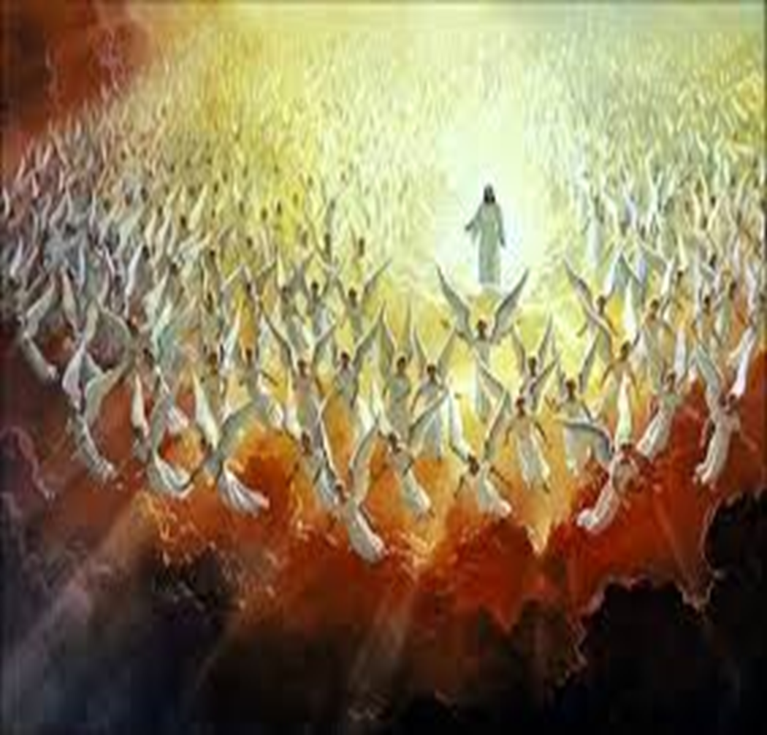
Could Jesus Have Come in the 1st Century?
“My friends, it’s as plain as the nose on your face that the New Testament teaches that the end was meant to come just after the First Advent.” Desmond, are you kidding?? You, a scholar, and you say that??? Could Jesus have come in the first century?
2 Thessalonians 2:1-6 “Now we beseech you, brethren, by the coming of our Lord Jesus Christ, and by our gathering together unto him, That ye be not soon shaken in mind, or be troubled, neither by spirit, nor by word, nor by letter as from us, as that the day of Christ is at hand. Let no man deceive you by any means: for that day shall not come, except there come a falling away first, and that man of sin be revealed, the son of perdition; Who opposeth and exalteth himself above all that is called God, or that is worshipped; so that he as God sitteth in the temple of God, shewing himself that he is God. Remember ye not, that, when I was yet with you, I told you these things? And now ye know what withholdeth that he might be revealed in his time.”

Slide 12
Paul Disagrees
Desmond Ford said that Jesus could have come in the 1st century. Paul says that is NOT possible. Paul says that BEFORE Christ could return, the man of lawlessness, the papacy had to appear and do his dirty work.. The papacy had to reign for 1260 years. Sometime AFTER the ending of this time period in 1798, then Jesus would return. He could not have returned prior to 1798. Paul’s teaching on the work of the papacy was based in Daniel 7:25!!! Paul told the church in Thessalonica this truth, but some forgot what he said and started telling people that Jesus coming was imminent. Paul cleared this up with his statement in 2 Thessalonians 2:1-6. Desmond Ford was DEAD WRONG!!!

Slide 13
Why Ford HATED the SOP!!!
“The apostle Paul warned the church not to look for the coming of Christ in his day. “That day shall not come,” he says, “except there come a falling away first, and that man of sin be revealed.” 2 Thessalonians 2:3. Not till after the great apostasy, and the long period of the reign of the “man of sin,” can we look for the advent of our Lord. The “man of sin,” which is also styled “the mystery of iniquity,” “the son of perdition,” and “that wicked,” represents the papacy, which, as foretold in prophecy, was to maintain its supremacy for 1260 years. This period ended in 1798. The coming of Christ could not take place before that time. Paul covers with his caution the whole of the Christian dispensation down to the year 1798. It is this side of that time that the message of Christ's second coming is to be proclaimed. No such message has ever been given in past ages. Paul, as we have seen, did not preach it; he pointed his brethren into the then far-distant future for the coming of the Lord. The Reformers did not proclaim it. Martin Luther placed the judgment about three hundred years in the future from his day. But since 1798 the book of Daniel has been unsealed, knowledge of the prophecies has increased, and many have proclaimed the solemn message of the judgment near.” GC. Pg. 356

Slide 14
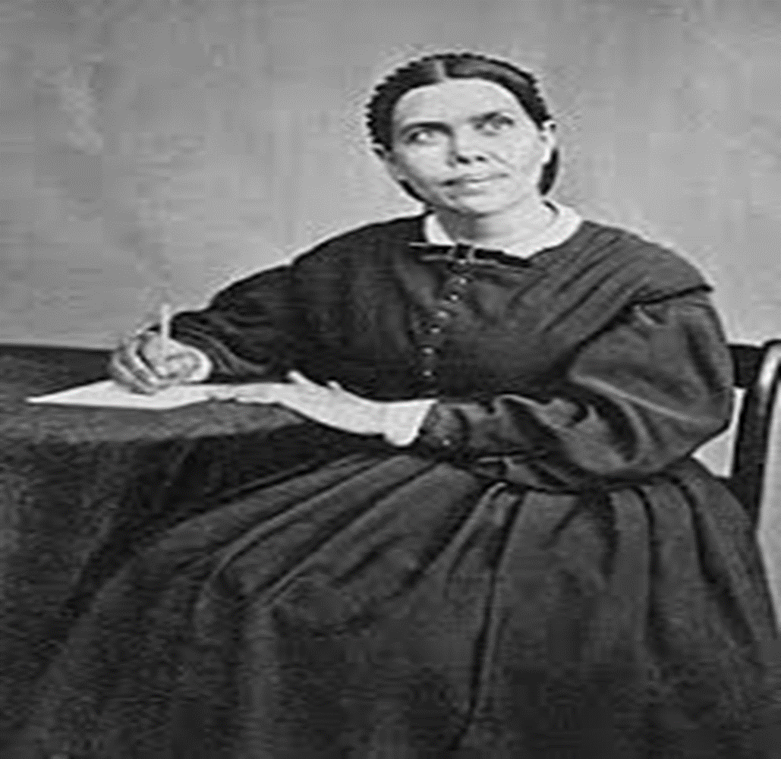
Divine Interpreter or of the Devil?????
“Ford took issue with Ellen White’s use by many as an authoritative source of Adventist doctrine…. During his remarks in 1979, Ford said, “Ellen White’s role, my friends, is pastoral, not canonical” [...] “The gift of prophecy is not the gift of omniscience” (pg. 20). “We have no business, absolutely no business in trying to shortcut the problem of research by going to statements from Ellen G. White. This is a question that will be solved by perspiration, not inspiration” (pg. 23).

