Slide 1
Insurmountable Difficulties

Slide 2
Called Out!
“Now in the first year of Cyrus king of Persia, that the word of the LORD by the mouth of Jeremiah might be fulfilled, the LORD stirred up the spirit of Cyrus king of Persia, that he made a proclamation throughout all his kingdom, and put it also in writing, saying, Thus saith Cyrus king of Persia, The LORD God of heaven hath given me all the kingdoms of the earth; and he hath charged me to build him an house at Jerusalem, which is in Judah. Who is there among you of all his people? his God be with him, and let him go up to Jerusalem, which is in Judah, and build the house of the LORD God of Israel, (he is the God,) which is in Jerusalem…Now these are the children of the province that went up out of the captivity, of those which had been carried away, whom Nebuchadnezzar the king of Babylon had carried away unto Babylon, and came again unto Jerusalem and Judah, every one unto his city; Which came with Zerubbabel:” Ezra 1:1-3; 2:1,2

Slide 3
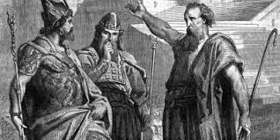
Special Purpose, Special Time
Zerubbabel and the children of Israel left Babylon in fulfillment of the time prophecy of Daniel 9:24, 25. The Lord called them to do a special work at a special time. They were to restore the sanctuary in Jerusalem. Does there sound like any similarities between them and us?
1. called out at the end of a time period. 2,300 year prophecy.
2. called to restore the sanctuary. Revelation 14:7 ‘the hour of His judgment is come.

Slide 4
Ready to Work
“And when the builders laid the foundation of the temple of the LORD, they set the priests in their apparel with trumpets, and the Levites the sons of Asaph with cymbals, to praise the LORD, after the ordinance of David king of Israel. And they sang together by course in praising and giving thanks unto the LORD; because he is good, for his mercy endureth for ever toward Israel. And all the people shouted with a great shout, when they praised the LORD, because the foundation of the house of the LORD was laid. But many of the priests and Levites and chief of the fathers, who were ancient men, that had seen the first house, when the foundation of this house was laid before their eyes, wept with a loud voice; and many shouted aloud for joy: So that the people could not discern the noise of the shout of joy from the noise of the weeping of the people: for the people shouted with a loud shout, and the noise was heard afar off.” Ezra 3:10-13

Slide 5
Damper on the Work!
The house that was about to be rebuilt had been the subject of many prophecies concerning the favor that God desired to show Zion, and all who were present at the laying of the cornerstone should have entered heartily into the spirit of the occasion. Yet mingled with the music and the shouts of praise that were heard on that glad day, was a discordant note. "Many of the priests and Levites and chief of the fathers, who were ancient men, that had seen the first house, when the foundation of this house was laid before their eyes, wept with a loud voice." Verse 12. It was natural that sadness should fill the hearts of these aged men, as they thought of the results of long-continued impenitence. Had they and their generation obeyed God, and carried out His purpose for Israel, the temple built by Solomon would not have been destroyed and the captivity would not have been necessary. But because of ingratitude and disloyalty they had been scattered among the heathen. Conditions were now changed. In tender mercy the Lord had again visited His people and allowed them to return to their own land. Sadness because of the mistakes of the past should have given way to feelings of great joy. God had moved upon the heart of Cyrus to aid them in rebuilding the temple, and this should have called forth expressions of profound gratitude. But some failed of discerning God's opening providences. Instead of rejoicing, they cherished thoughts of discontent and discouragement. They had seen the glory of Solomon's temple, and they lamented because of the inferiority of the building now to be erected. The murmuring and complaining, and the unfavorable comparisons made, had a depressing influence on the minds of many and weakened the hands of the builders. The workmen were led to question whether they should proceed with the erection of a building that at the beginning was so freely criticized and was the cause of so much lamentation.” PK, pgs. 563,564

Slide 6
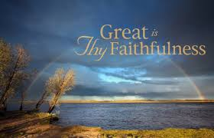
Time for Sorrow or Rejoicing?
As the song says,
“Be still and know that He is God
Be still and know that He is faithful
Consider all that He has done
Stand in awe and be amazed
And know that He will never change
Be still

Slide 7
“Now when the adversaries of Judah and Benjamin heard that the children of the captivity builded the temple unto the LORD God of Israel; Then they came to Zerubbabel, and to the chief of the fathers, and said unto them, Let us build with you: for we seek your God, as ye do; and we do sacrifice unto him since the days of Esarhaddon king of Assur, which brought us up hither. But Zerubbabel, and Joshua, and the rest of the chief of the fathers of Israel, said unto them, Ye have nothing to do with us to build an house unto our God; but we ourselves together will build unto the LORD God of Israel, as king Cyrus the king of Persia hath commanded us. Then the people of the land weakened the hands of the people of Judah, and troubled them in building, And hired counsellors against them, to frustrate their purpose, all the days of Cyrus king of Persia, even until the reign of Darius king of Persia.” Ezra 4:1-5

Slide 8
The Samaritans
“Close by the Israelites who had set themselves to the task of rebuilding the temple, dwelt the Samaritans, a mixed race that had sprung up through the intermarriage of heathen colonists from the provinces of Assyria with the remnant of the ten tribes which had been left in Samaria and Galilee. In later years the Samaritans claimed to worship the true God, but in heart and practice they were idolaters. It is true, they held that their idols were but to remind them of the living God, the Ruler of the universe; nevertheless the people were prone to reverence graven images. During the period of the restoration, these Samaritans came to be known as "the adversaries of Judah and Benjamin…Only a remnant had chosen to return from Babylon; and now, as they undertake a work seemingly beyond their strength, their nearest neighbors come with an offer of help. The Samaritans refer to their worship of the true God, and express a desire to share the privileges and blessings connected with the temple service. "We seek your God, as ye do," they declare. "Let us build with you." But had the Jewish leaders accepted this offer of assistance, they would have opened a door for the entrance of idolatry. They discerned the insincerity of the Samaritans. They realized that help gained through an alliance with these men would be as nothing in comparison with the blessing they might expect to receive by following the plain commands of Jehovah.” PK, pgs. 567,568

Slide 9
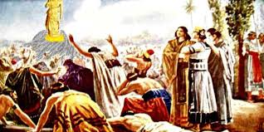
Really Idolaters!
Sometimes unconsecrated people come in and want to unite with the work and workers of God! We do not need their help. With the Lord, we are a majority!!
Let the unconsecrated ones leave. This causes discouragement, but the Lord’s hand is in this to push His work forward. Do not be discouraged, go forward, do the work, and the Lord will provide consecrated ones to push the work further and faster!!!

Slide 10
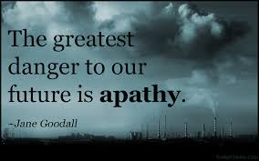
Apathy Among the People
“Thus speaketh the LORD of hosts, saying, This people say, The time is not come, the time that the LORD'S house should be built. Then came the word of the LORD by Haggai the prophet, saying, Is it time for you, O ye, to dwell in your ceiled houses, and this house lie waste? Now therefore thus saith the LORD of hosts; Consider your ways. Ye have sown much, and bring in little; ye eat, but ye have not enough; ye drink, but ye are not filled with drink; ye clothe you, but there is none warm; and he that earneth wages earneth wages to put it into a bag with holes. Thus saith the LORD of hosts; Consider your ways.” Haggai 1:1-7

Slide 11
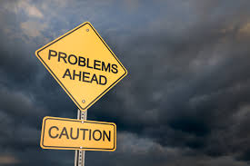
Problems, Problems, and More Problems
1. Those who sorrowed when they should have rejoiced. Looking the wrong way!
2. the Samaritan stragglers.
3. an apathetic people.
They all failed to see that the Lord had led them here for such a time as this.

Slide 12
Mountainous Problems
“Throughout the history of God's people great mountains of difficulty, apparently insurmountable, have loomed up before those who were trying to carry out the purposes of Heaven. Such obstacles are permitted by the Lord as a test of faith. When we are hedged about on every side, this is the time above all others to trust in God and in the power of His Spirit. The exercise of a living faith means an increase of spiritual strength and the development of an unfaltering trust. It is thus that the soul becomes a conquering power. Before the demand of faith, the obstacles placed by Satan across the pathway of the Christian will disappear; for the powers of heaven will come to his aid. "Nothing shall be impossible unto you." Matthew 17:20.” PK, pgs. 594,595

Slide 13
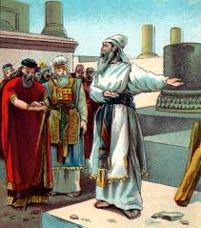
The Man For The Hour
God’s purposes will be accomplished with us or without us!! Nothing will stop the King of Kings and Lord of Lords!! Zerubbabel was called by Providence to fulfill the divine mandate of restoring the temple and its worship. Zerubbabel could refuse to be used and then the Lord would raise up another. “For if thou altogether holdest thy peace at this time, then shall there enlargement and deliverance arise to the Jews from another place; but thou and thy father's house shall be destroyed: and who knoweth whether thou art come to the kingdom for such a time as this?” Esther 4:14

Slide 14
Zerubbabel’s Source of Power
“And the angel that talked with me came again, and waked me, as a man that is wakened out of his sleep, And said unto me, What seest thou? And I said, I have looked, and behold a candlestick all of gold, with a bowl upon the top of it, and his seven lamps thereon, and seven pipes to the seven lamps, which are upon the top thereof: And two olive trees by it, one upon the right side of the bowl, and the other upon the left side thereof. So I answered and spake to the angel that talked with me, saying, What are these, my lord? Then the angel that talked with me answered and said unto me, Knowest thou not what these be? And I said, No, my lord. Then he answered and spake unto me, saying, This is the word of the LORD unto Zerubbabel, saying, Not by might, nor by power, but by my spirit, saith the LORD of hosts.” Zechariah 4:1-6

Slide 15
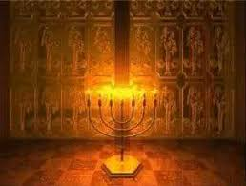
Zechariah saw two anointed ones; (the Old and New Testament). From these two sources comes the oil of the Holy Spirit. The Holy Spirit is then sent from Heaven to earth and fills the humble, lowly people of God with power and they become lights to the world. Zerubbabel realized that through his submission to Heaven’s power, he was unstoppable. This was the vision of Zechariah 4.

Slide 16
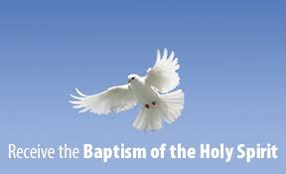
The Third Person of the Godhead
Armed with the power of the Holy Spirit, Zerubbabel was girded with strength to do the job, of fulfilling Heaven’s purpose! If God’s people, with contrite hearts, will submit to the Spirit’s leading, no opposing influence can halt the advance of God’s work. Nothing can stand before the Spirit’s power!!

Slide 17
Mountains Fall!
“Often men are tempted to falter before the perplexities and obstacles that confront them. But if they will hold the beginning of their confidence steadfast unto the end, God will make the way clear. Success will come to them as they struggle against difficulties. Before the intrepid spirit and unwavering faith of a Zerubbabel, great mountains of difficulty will become a plain; and he whose hands have laid the foundation, even "his hands shall also finish it." "He shall bring forth the headstone thereof with shoutings, crying, Grace, grace unto it." Zechariah 4:9, 7. Human power and human might did not establish the church of God, and neither can they destroy it. Not on the rock of human strength, but on Christ Jesus, the Rock of Ages, was the church founded, "and the gates of hell shall not prevail against it." Matthew 16:18. The presence of God gives stability to His cause. "Put not your trust in princes, nor in the son of man," is the word that comes to us. Psalm 146:3. "In quietness and in confidence shall be your strength." Isaiah 30:15. God's glorious work, founded on the eternal principles of right, will never come to nought. It will go on from strength to strength, "not by might, nor by power, but by My Spirit, saith the Lord of hosts." Zechariah 4:6.” PK, pgs. 595,596

