Slide 1
The History of the Holy Spirit in Adventism pt 1: Darkness to Light

Slide 2
From Darkness to Light…
The Millerites were a mixed bag of individuals ranging from many varied backgrounds. The people who made up the Millerites hailed from many different persuasions. Some were Baptists, Methodists, Seventh-day Baptists, Presbyterians, Campbellites, Anglicans, Congregationalists, Episcopalians, Catholics, conservative and liberal worldviews—every manner of theological view blew from within the hearts of what would become Seventh-day Adventism. “The Pioneers” studied out their views over years, even decades which brought out more and more light, such as: The Sanctuary, The Investigative Judgment, Daniel & Revelation, The Sabbath, The State of the Dead, Righteousness By Faith, Clean & Unclean Foods, Health Reform. Other issues had to be dealt with over time and corrected as well, such as: The 2520, Arianism, and…. The Godhead/Trinity Doctrine
Prov. 4:18 “But the path of the just is as the shining light, that shineth more and more unto the perfect day.”

Slide 3
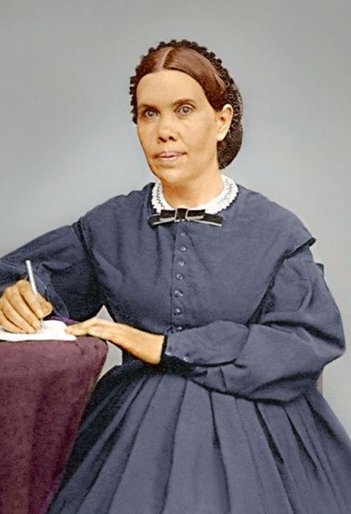
First A Warning From Ellen White
“It is not essential for you to know and be able to define just what the Holy Spirit is. Christ tells us that the Holy Spirit is the Comforter, and the Comforter is the Holy Ghost, "the Spirit of truth, which the Father shall send in My name." "I will pray the Father, and He shall give you another Comforter, that He may abide with you for ever; even the Spirit of truth; whom the world cannot receive, because it seeth Him not, neither knoweth Him: but ye know Him, for He dwelleth with you, and shall be in you" [John 14:16, 17]. This refers to the omnipresence of the Spirit of Christ, called the Comforter. Again Jesus says, "I have yet many things to say unto you, but ye cannot bear them now. Howbeit when He, the Spirit of truth is come, He will guide you into all truth" [John 16:12, 13]. There are many mysteries which I do not seek to understand or to explain; they are too high for me, and too high for you. On some of these points, silence is golden. Piety, devotion, sanctification of soul, body, and spirit--this is essential for us all.” (14MR, p. 179)

Slide 4
Omnipresence Forfeited
“Cumbered with humanity, Christ could not be in every place personally; therefore it was altogether for their advantage that he should leave them, go to his Father, and send the Holy Spirit to be his successor on earth. The Holy Spirit is himself, divested of the personality of humanity, and independent thereof. He would represent himself as present in all places by his Holy Spirit, as the Omnipresent.” – Manuscript Releases, vol 14, p. 93

Slide 5
Another Warning…
“The nature of the Holy Spirit is a mystery. Men cannot explain it, because the Lord has not revealed it to them. Men having fanciful views may bring together passages of Scripture and put a human construction on them, but the acceptance of these views will not strengthen the church. Regarding such mysteries, which are too deep for human understanding, silence is golden.” (AA 52)

Slide 6
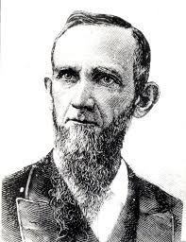
DM Canright…. A Solid Source?
“All trinitarian creeds make the Holy Ghost a person, equal in substance, power and eternity, and glory with the Father and the Son. Thus they claim three persons in the trinity, each one equal with both the others. If this be so, then the Holy Spirit is just as truly an individual, intelligent person as is the Father or the Son. But this we cannot believe. The Holy Spirit is not a person. “The Holy Spirit is not a person…but is an influence proceeding from God.” (D. M. Canright, Signs of the Times July 25th 1878, article ‘The Holy Spirit’)

Slide 7
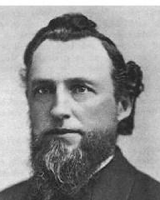
The Anti-Trinitarians
“Uriah Smith-The terms 'Holy Ghost,' are a harsh and repulsive translation. It should be 'Holy Spirit' (hagion pneuma) in every instance. This Spirit is the Spirit of God, and the Spirit of Christ; the Spirit being the same whether it is spoken of as pertaining to God or Christ. But respecting this Spirit, the Bible uses expressions which cannot be harmonized with the idea that it is a person like the Father and the Son. Rather it is shown to be a divine influence from them both, the medium which represents their presence and by which they have knowledge and power through all the universe, when not personally present.”– Uriah Smith, Review and Herald, Oct. 28th, 1890, ‘The Question Chair

Slide 8
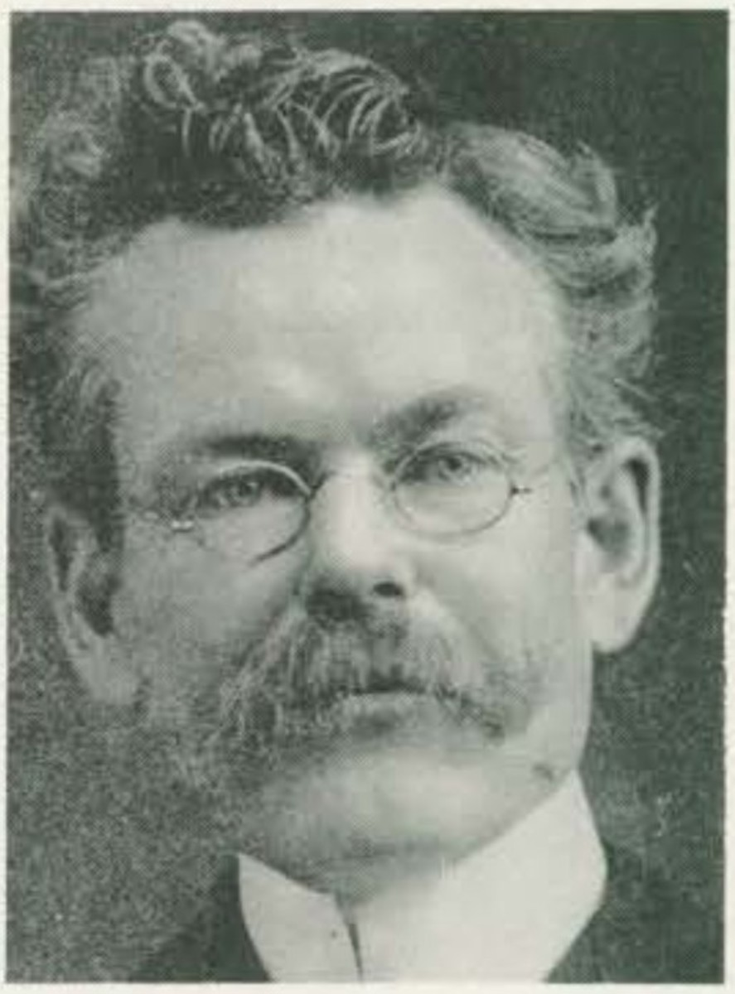
Sophistry From Unexpected Places….
M.C. Wilcox-The Holy Spirit is the mighty energy of the Godhead, the life and power of God flowing out from Him to all parts of the universe, and thus making a living connection between His throne and all creation.-- (M. C. Wilcox, Questions And Answers, Pacific Press, 1911 p.181)

Slide 9
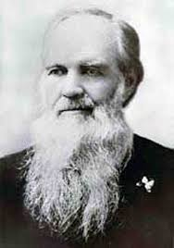
A Change…. New Common Belief???
“We have no sympathy with the speculations in which many indulge in regard to the nature or order of the Holy Spirit. WHETHER A PERSON, OR AN EMANATION FROM THE FATHER AND SON, as some teach, OR A MANIFESTATION OF THE POWER OF GOD, as others argue, WE HAVE NO OPINION TO OFFER.” JH Waggoner, Life Sketches of James and Ellen White, 1888, p. 408-409

Slide 10
White Estate Confirms
C7DA: “An email has been received from the White Estate on the quotation, confirming its authenticity yet lending surprising details about its author; it appears this section was published anonymously by the SDA Publishing Association after the death of James White, being primarily written by J.H. Waggoner. That it was an addition of the denominational publishing house, not the words of the original author, may be significant and is certainly surprising. The implication is that the “We” encapsulated in the statement represented not only James and Ellen White, but accurately reflected the denominational position in 1888.
EGW Estate: “Thank you for your email. The pages you sent are from the Appendix to the 1888 edition of Life Sketches of James and Ellen White (not to be confused with Ellen White’s Life Sketches [1915]). Approximately the first half of the book was taken from James White’s autobiography, and the second half was drawn from Ellen White’s autobiography–mostly Spiritual Gifts, vol. 2. The six Appendix chapters, of which the one in question is the 5th, were prepared by the publisher (SDA Publishing Association) after James White’s death in 1881. The principal author was J. H. Waggoner, although the Appendix is published anonymously. We trust this information is helpful to you. God bless! Tim Poirier Vice-Director E. G. White Estate” –https://c7da.us/articles/2021/12/15/whether-a-person-no-opinion-to-offer-life-sketches-appendix-developing-research/

Slide 11
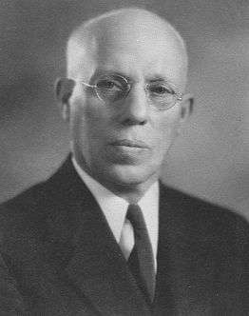
ML Andreason Comments on When The Change Began to Take Shape!
“How astonished we were when Desire of Ages was first published [1898], for it contained some things that we considered unbelievable; among others the doctrine of the Trinity, which was not generally accepted by the Adventists then”—ML Andreason, “The Spirit of Prophecy,” Chapel Talk, Loma Linda, California, November 30, 1948

Slide 12
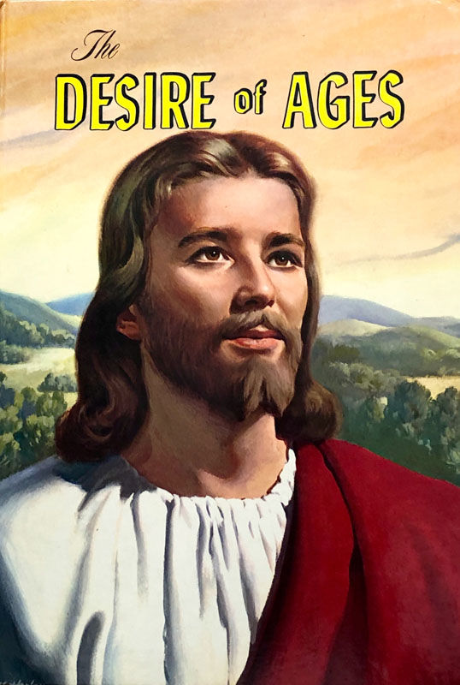
The Quote…
“The power of evil had been strengthening for centuries, and the submission of men to this satanic captivity was amazing. Sin could be resisted and overcome only through the mighty agency of the Third Person of the Godhead, who would come with no modified energy, but in the fullness of divine power.“ DA, 671

Slide 13
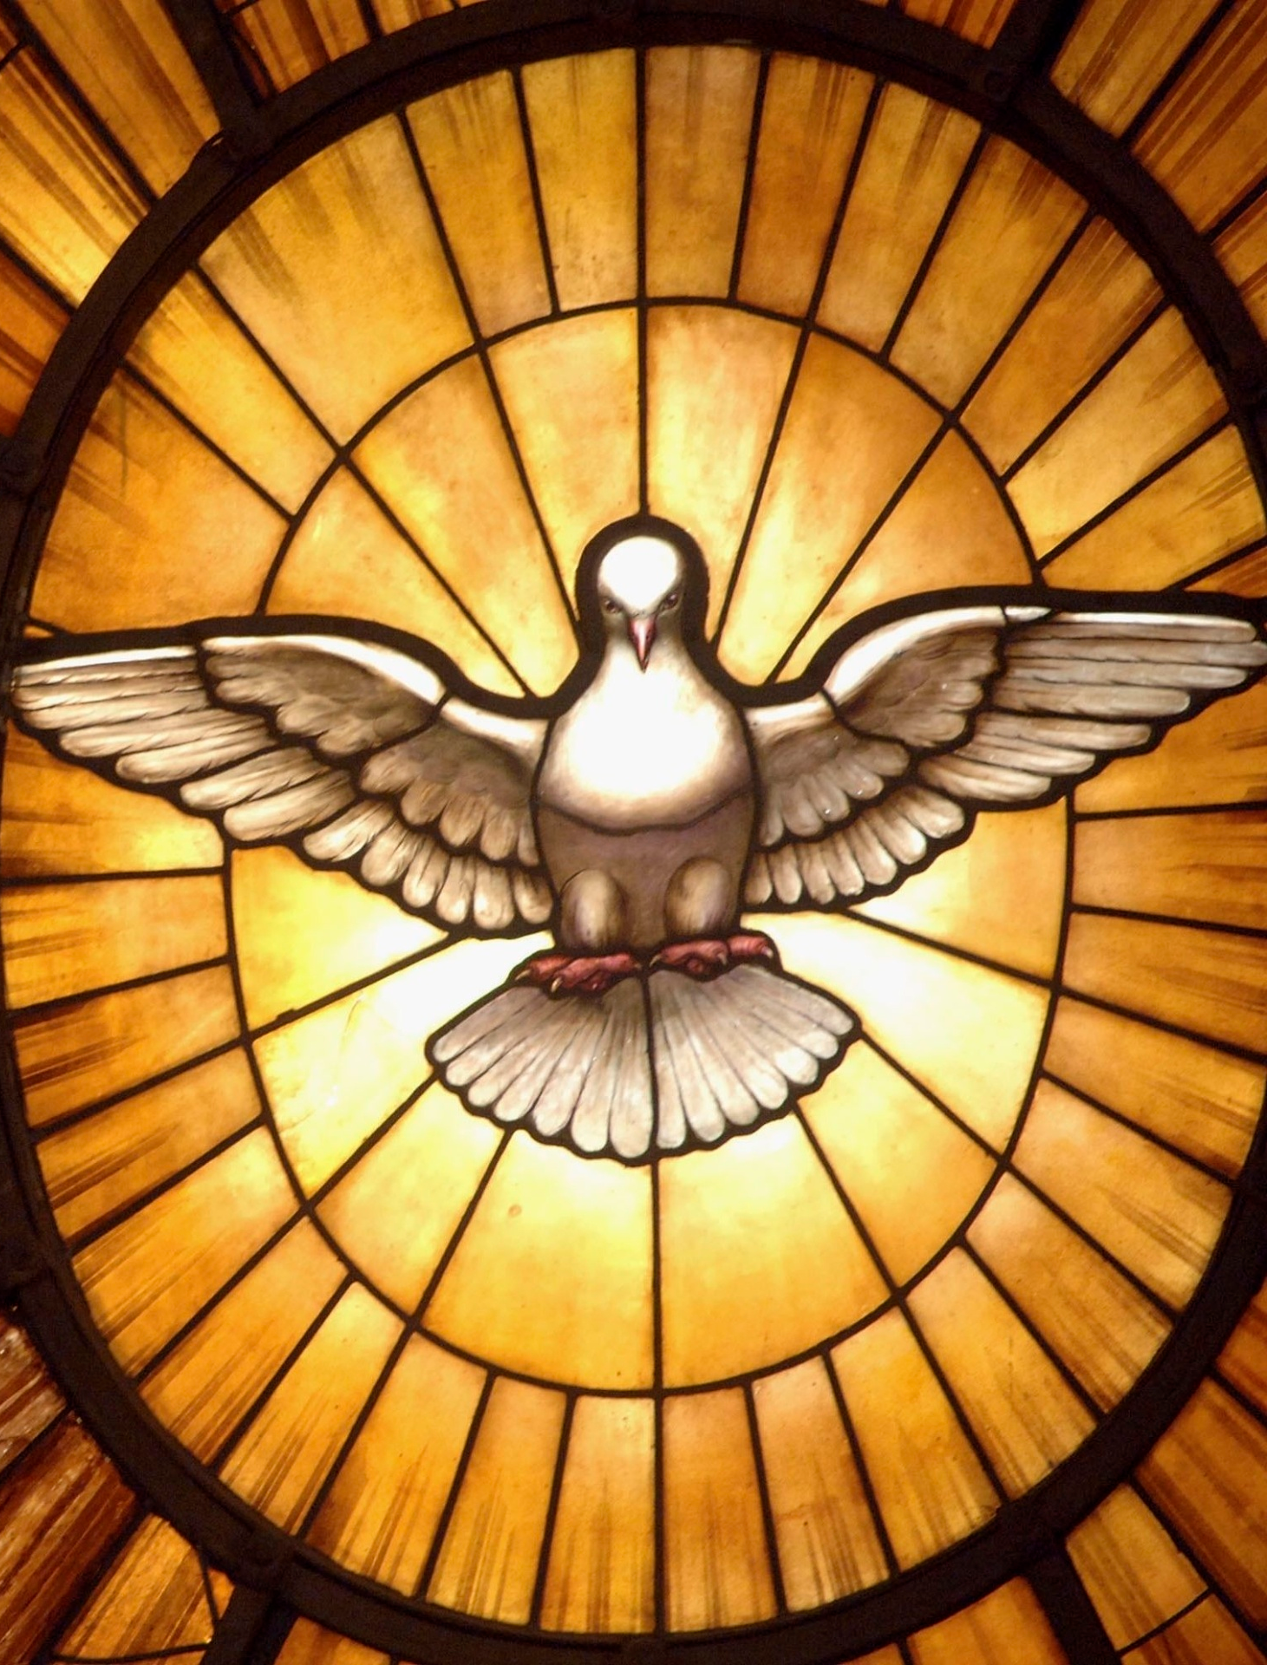
The Spirit of Prophecy Sheds More Light
“We need to realize that the Holy Spirit, who is as much a person as God is a person, is walking through these grounds.”-- Manuscript 66, 1899. (From a talk to the students at the Avondale School.)
“The Holy Spirit is a person, for He beareth witness with our spirits that we are the children of God. When this witness is borne, it carries with it its own evidence. At such times we believe and are sure that we are the children of God. . . . The Holy Spirit has a personality, else He could not bear witness to our spirits and with our spirits that we are the children of God. He must also be a divine person, else He could not search out the secrets which lie hidden in the mind of God. "For what man knoweth the things of a man, save the spirit of man which is in him? even so the things of God knoweth no man, but the Spirit of God."-- Manuscript 20, 1906

Slide 14
RA Underwood Figures it Out….
“It seems strange to me, now, that I ever believed that the Holy Spirit was only an influence, in view of the work he does. But we want the truth because it is truth, and we reject error because it is error, regardless of any views we may formerly have held, or any difficulty we may have had, or may now have, when we view the Holy Spirit as a person. Light is sown for the righteous. Satan's scheme is to destroy all faith in the personality of the Godhead, the Father, Son, and Holy Ghost, also in his own personality; and when this is done, he would have men deify the state, and set that up as a personal god, to
be worshiped and obeyed... Let us beware lest Satan shall lead us to take the first step in destroying our faith in the personality of this person of the Godhead, the Holy Ghost.” RA Underwood, “The Holy Spirit is a Person”, R&H, Vol. 75, No. 20, May 17, 1898

Slide 15
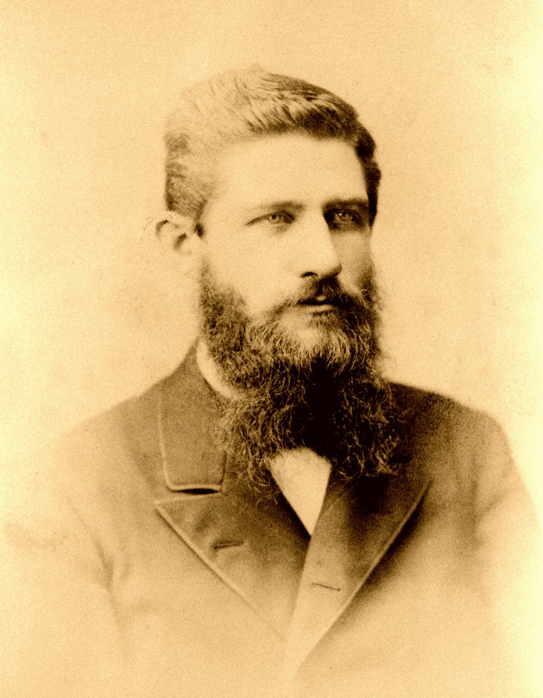
The Logic is Air-Tight!
“It was once hard for me to see how a spirit could be a person; but when I saw "that God is a spirit" (John 4:24), and that he is no less a person; when I saw that the last Adam (Christ) "was made a quickening spirit" (1 Cor. 15:45), and that he is a person; when I saw that the angels are "spirits" (Heb. 1:7, 14), and even that the fallen angels, called "devils" are said to be "unclean spirits" (Luke 8:26, 29; Acts 19:15, 16); and knowing that all these are persons, I could understand better how the Holy Spirit can be a person Christ has put into the field, as his personal representative, the Holy Ghost, who is in charge of all the forces of God's kingdom to overthrow Satan and his angels; and the Holy Ghost is the only one to whom is delegated this authority from God. "The prince of the power of evil can be held in check only by the power of God in the third person of the Godhead, the Holy Spirit” (Ibid.)

Slide 16
Can’t Be More Clear!!!!
The prince of the power of evil can only be held in check by the power of God in the third person of the Godhead, the Holy Spirit.-- Special Testimonies, Series A, No. 10, p. 37. (1897)
The Comforter that Christ promised to send after He ascended to heaven, is the Spirit in all the fullness of the Godhead, making manifest the power of divine grace to all who receive and believe in Christ as a personal Saviour. There are three living persons of the heavenly trio; in the name of these three great powers --the Father, the Son, and the Holy Spirit--those who receive Christ by living faith are baptized, and these powers will co-operate with the obedient subjects of heaven in their efforts to live the new life in Christ.-- Special Testimonies, Series B, No. 7, pp. 62, 63. (1905)
When you gave yourself to Christ, you made a pledge in the presence of the Father, the Son, and the Holy Spirit—the three great personal Dignitaries of heaven. “Hold fast” to this pledge.– MS 92, 1901
Dignitary-An ecclesiastic who holds a dignity, or a benefice which gives him some pre-eminence over mere priests and canons, as a bishop, dean, archdeacon, prebendary, &c– 1828 Webster’s Dictionary

Slide 17
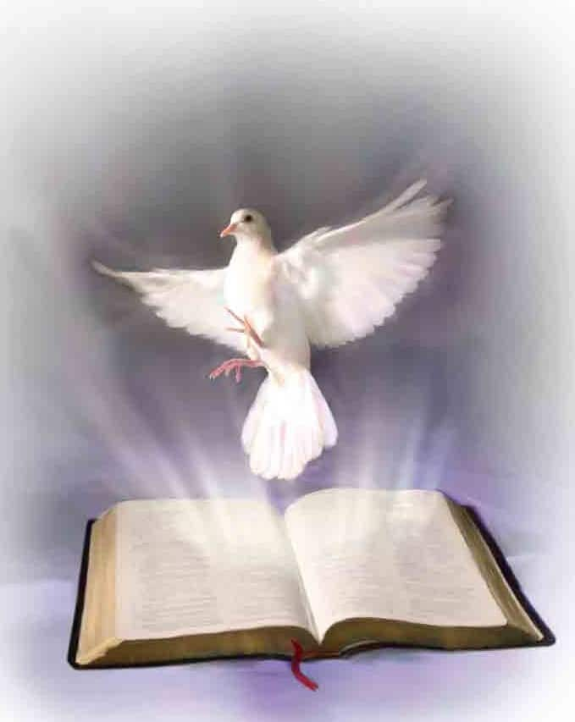
There Are 3!
“There are three living persons of the heavenly trio; in the name of these three great powers—the Father, the Son, and the Holy Spirit—those who receive Christ by living faith are baptized, and these powers will co-operate with the obedient subjects of heaven in their efforts to live the new life in Christ” MS 21, 1906
1 John 5:7,8 “For there are three that bear record in heaven, the Father, the Word, and the Holy Ghost: and these three are one. And there are three that bear witness in earth, the Spirit, and the water, and the blood: and these three agree in one.”

Slide 18
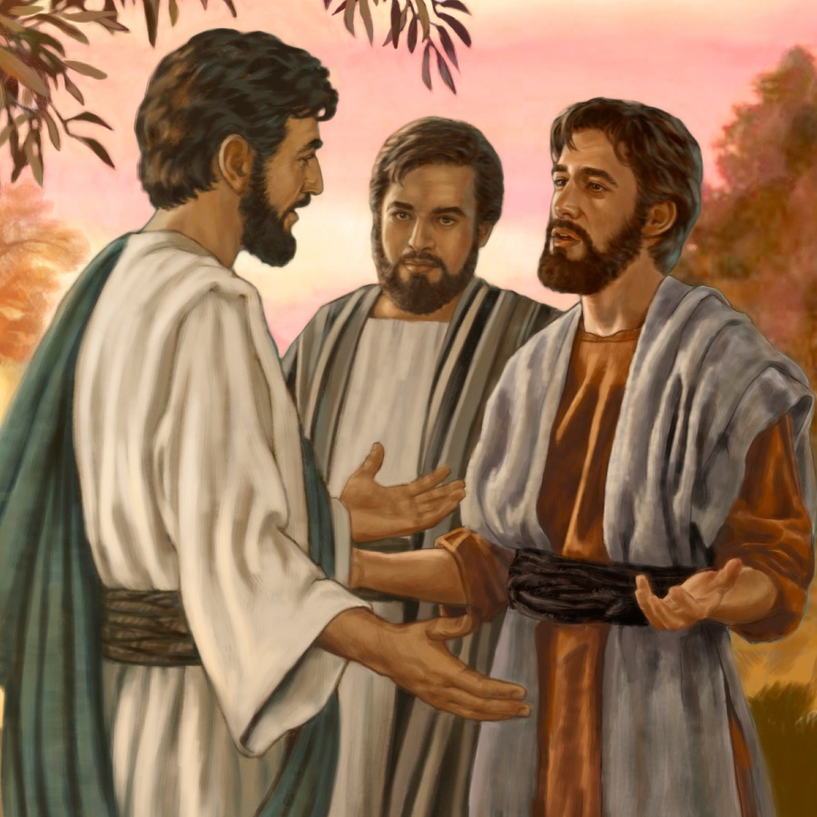
A Warning!
“They were not to add to His words, or give a forced meaning to His utterances. They were not to put a mystical interpretation upon the plain teaching of the Scriptures, or draw from theological stores to build up some man-made theory. – RH, June 2, 1896

Slide 20
What Does the Bible Say?
1 John 5:7,8 “For there are three that bear record in heaven, the Father, the Word, and the Holy Ghost: and these three are one. And there are three that bear witness in earth, the Spirit, and the water, and the blood: and these three agree in one.”
Ephesians 4:4-6 “There is one body, and one Spirit, even as ye are called in one hope of your calling; One Lord, one faith, one baptism, One God and Father of all, who is above all, and through all, and in you all.”

Slide 21
Haskell and Melchisedec
In the article below , which was originally published in Bible Training School, November 1, 1903, pg. 90, under the title “Melchisedec”; Haskell wrote,
“In the Review and Herald of February 18,1890, page 97, last paragraph, we read from Mrs. E. G. White: ‘It was Christ that spake through Melchisedec, the priest of the most high God. Melchisedec was not Christ, but he was the voice of God in this world, the representative of the Father.’
“There is but one being in the universe that fills all these specifications. That is the Spirit of God. He ever lives to intercede. He has no beginning of days or end of life. He represents the Father and the Son. He speaks peace to the troubled soul. He is not an angel of any kind, for angels are amenable to law, and were created. This being is equal to the Father and the Son. It is the voice of God in the world. A careful study of the above and a belief of the same will forever settle the question as to who Melchisedec is.”
Original source: Bible Training School, November 1, 1903, pg. 90

Slide 22
Haskell on Melchisedec
In the article. below, which was published in Bible Training School, November 1, 1904; Haskell refers to the Holy Spirit as the “third person of the Godhead” and he again identifies Melchisedec as the Holy Spirit. Haskell wrote,
The Holy Spirit, “the third person of the Godhead ” the soul-of Christ’s life, and the light and life of the world is the only one to whom all of the above specifications will apply. The Holy Spirit is the third person of the Godhead, and therefore is “King of righteousness, and after that also King of Salem, which is King of peace.”
The ” Spirit itself•maketh intercession for us with groanings which can not be uttered, and He that searcheth the hearts knoweth what is the mind of the Spirit, because He maketh intercession for the saints according to the will of God.” Rom. 8 : 26, 27. Therefore the Spirit ” abideth a priest continually,” and is a,”° priest of the most high God.”
The Spirit is the ” third person of the Godhead,” and therefore has no more beginning of days nor end of life ” than God Himself. There is no record of father, mother, or pedigree given of the Holy Spirit. As the third person of the Godhead, it is greater than Abraham and could bless him.
The Spirit comes to the world as a representative of Christ and thus is made like unto Christ. The Holy Spirit has visibly appeared to man under different forms. The Holy Ghost descended in a bodily shape like a dove upon Christ. Luke 3:22. It cadre as cloven tongues of fire upon the disciples on the day of Pentecost. To Abraham it appeared as a King, Priest. To-day It comes as a blessed Comforter to every one who will open his heart to receive it.
Original Source: Bible Training School November 1, 1904, pg 85, 86

Slide 23
Haskell Says “Trinity”
Also, we find in his later statement (Bible Training School, February 1, 1914) written approximately 9 year later wherein he identifies the “seven Spirits” mentioned in Revelation 1:4 as the Holy Spirit and describes the benediction of Revelation 1:4-6 as coming “from the Trinity separately”. Haskell wrote:
“The benediction pronounced upon those who do hear, and read, and keep the things written in this book, is very striking. ‘Grace be unto you, and peace from Him which is, and which was, and which is to come ( i.e., God the Father), and from the seven Spirits which are before His throne (i.e., the Holy Spirit), and from Jesus Christ, who is the faithful witness, and the first begotten of the dead, and the prince of the kings of the earth. Unto Him that loved us, and washed us from our sins in His own blood, And hath made us kings and priests unto God, and His Father; to Him be glory and dominion forever, and ever. Amen.’ Rev. 1 : 4-6. There are many inspired benedictions pronounced upon God’s people in the Bible ; but none like this one. It comes from the Trinity, separately.” -------he also uses the word “Trinity” in the book “The Story of Daniel the Prophet” (1905, 1908)

Slide 24
The Story of the Prophet Daniel Trinity Quote
“The Saviour ascended to heaven, leaving His disciples alone, but not alone, for "behold, two men stood by them in white apparel." While heaven rang with songs of welcome to the returning Son of God, two angels stood on earth to comfort the lonely ones. One of these was Gabriel, Christ's attendant angel. Of all the angels of heaven none have been more closely connected with man than has Gabriel. Yet to John, who fell before him to worship, he said, "See thou do it not ; for I am thy fellow-servant." Gabriel was only an angel, upheld by the same Power that sustained John, and he would not for one moment allow John to be deceived by thinking he was a part of the great Trinity of heaven, and worthy of the worship of mankind. He assured John that he was only one of the hosts of "ministering spirits sent forth to minister for them who should be heirs of salvation," by saying, "I am thy fellow-servant." S o bound up in the affairs of man is this mighty angel that he counts himself one with us” Stephen Haskell, The Story of Daniel the Prophet, p. 132-133

Slide 25
Where then? Does this Doctrine Come From?
In order to understand the concept of person in God, we have to understand its foundation in the processions and relations within the inner life of God. And the Council of Florence, AD 1338-1445, can help us in this regard. . . The Son “proceeds” from the Father, and the Holy Spirit “proceeds from the Father and the Son.” These are the two processions in God. And these are foundational to the four relations that constitute the three persons in God. These are those four eternal relations in God:
1. The Father actively and eternally generates the Son, constituting the person of God, the Father.
2. The Son is passively generated of the Father, which constitutes the person of the Son.
3. The Father and the Son actively spirate the Holy Spirit in the one relation within the inner life of God that does not constitute a person. It does not do so because the Father and Son are already constituted as persons in relation to each other in the first two relations. This is why CCC 240 teaches, “[The Second Person of the Blessed Trinity] is Son only in relation to his Father.”
4. The Holy Spirit is passively spirated of the Father and the Son, constituting the person of the Holy Spirit. – Catholic Answers, June 20, 2014 (https://www.catholic.com/magazine/online-edition/explaining-the-trinity)

Slide 26
ML Andreason Full Quote—Jesus NOT Begotten
“I had with me a number of quotations that I wanted to see if they were in the original in her own handwriting. I remember how astonished we were when Desire of Ages was first published, for it contained some things that we considered unbelievable; among others the doctrine of the Trinity, which was not generally accepted by the Adventists. Some of the quotations concerned theology, others I had selected for their beauty of expression. I wanted to see how these quotations looked before they were corrected by the proofreaders.
“So I was given access to the manuscripts. I stayed in California several months. Being a reasonably fast reader, I read nearly all Sister White had written in her own handwriting. I was particularly interested, in the statement in Desire of Ages which at one time caused great concern to the denomination theologically: ‘In Christ is life, original, unborrowed, underived.” p. 530. That statement may not seem very revolutionary to you, but to us it was. We could hardly believe it. but of course we could not preach contrary to it. I was sure Sister White had never written, ‘In Christ is life, original, unborrowed, underived.’ But now I found it in her own handwriting just as it had been published. It was so with other statements. As I checked up, I found that they were Sister White’s own expressions… In the final analysis it was her work all the way through.” (Original source: M. L. Andreasen, “The Spirit of Prophecy,” Chapel Talk, Loma Linda, California, November 30, 1948) (George R. Knight in “Lest We Forget” a daily devotional, published by the Review and Herald Publishing Association 2008, pg. 292.)

Slide 27
From the Beginning!
Genesis 1:1-3 “In the beginning God created the heaven and the earth. And the earth was without form, and void; and darkness was upon the face of the deep. And the Spirit of God moved upon the face of the waters. And God said, Let there be light: and there was light.”
Genesis 6:3 “And the Lord said, My spirit shall not always strive with man, for that he also is flesh: yet his days shall be an hundred and twenty years.”

Slide 28
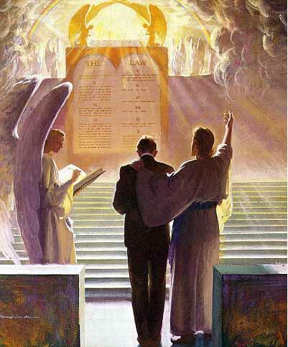
A Co-Intercessor
Romans 8:16, 26-27 “ The Spirit itself beareth witness with our spirit, that we are the children of God . . . Likewise the Spirit also helpeth our infirmities: for we know not what we should pray for as we ought: but the Spirit itself maketh intercession for us with groanings which cannot be uttered. And he that searcheth the hearts knoweth what is the mind of the Spirit, because he maketh intercession for the saints according to the will of God.

Slide 29
The Spirit Sent Christ!
Isaiah 48:16 “Come ye near unto me, hear ye this; I have not spoken in secret from the beginning; from the time that it was, there am I: and now the Lord GOD, and his Spirit, hath sent me.

Slide 30
The Holy Spirit Speaks
Acts 8:29 “Then the Spirit said unto Philip, Go near, and join thyself to this chariot.
Acts 13:2 “ As they ministered to the Lord, and fasted, the Holy Ghost said, Separate me Barnabas and Saul for the work whereunto I have called them.”
Acts 11:12 “And the Spirit bade me go with them, nothing doubting.”
1 Timothy 4:1 “Now the Spirit speaketh expressly, that in the latter times some shall depart from the faith, giving heed to seducing spirits, and doctrines of devils;

Slide 31
Other Scriptures Pointing to the Person, Godliness, or Personal attributes of the Holy Spirit
1 Cor. 12:11 Titus 3:5 2 Sam. 23:2 Acts 16:6
1 Cor. 2:10,11 1 Pet. 1:2 Acts 10:19 Ps. 139:7,8
Phil. 2:1 Eph. 3:16 Acts 21:11 John 14:16,17
2 Cor. 13:14 Eph. 4:30 Acts 28:25-26 Is. 40:13
Acts 5:3-4,9 Matt. 28:19-Baptize Heb. 3:7-8 Zech. 4:6
2 Pet. 1:21 2 Cor. 3:16-18 Rev. 14:13 Luke 1:35-Creator
1 Cor. 6:19 Rom. 8:11 Rev. 22:17 Heb. 9:8
Matt. 12:31-Blasphemy John 6:63 Acts 15:28 1 Pet. 1:12
John 15:26 1 John 5:6 Acts 20:28 Job 33:4
John 16:7 John 14:26 Acts 5:32 Ps. 104:30
John 16:9 Is. 63:10 Luke 12:12 Matt. 12:28
John 16:13 Rom. 15:30 Matt. 4:1 1 Cor. 12:4-6
2 Cor. 13:14

Slide 33
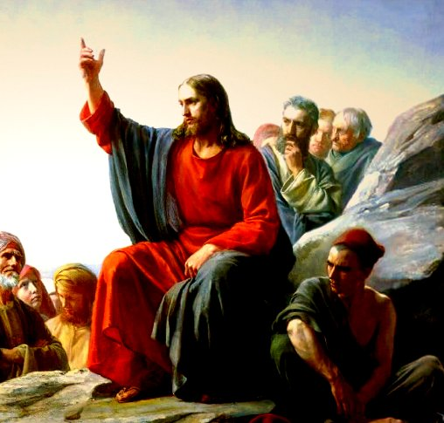
The Parable of the Comforter?
John 16:25-proverbs
John 14:16-18-Wanted to reveal the Father, he=Father
Rich man and Lazarus Parable-Abraham’s Bosom
John 14:22-Disciples say Jesus is coming
John 15:26-proceeds from the Father-Who is in the Sanctuary?

Slide 34
6. Spirit of truth, testify of Christ, therefore is Christ—If 3 are 1, then all symbols can apply to each
7. John 16:7-”I will send him unto you”—Christ could not send Spirit until he was glorified—Why then was He anointed with the Spirit at His baptism—was Christ’s ministry a farce? Stones into bread, come off the cross, legions
8. Spirit of a person and the person are the same thing right?
9. Holy Spirit as a person is a tradition, namely one from Rome—counterfeits of Satan
10. John 16:12-14-Not a new teacher—Christ is “truth” the “Spirit of truth” is the same Jesus Christ—NO TEACHER besides Christ—Son is glorified by the Father whose Spirit proceedeth from Him
11. John 16:26-27-All about the Father and Son of God-Sanctuary context
12. John 16:29-disciples said he speaks plain speech that He is the Son of God
13. This issue is NOT Christianity, not biblical-Become the 3rd Angel’s Message- Gal. 4:6—Is Christ omnipresent?
14. 1 John 2:1 “Comforter”—parakletos—is Jesus

Slide 35
Thus Saith the Lord
Wherever hearts are open to receive the truth, Christ is ready to instruct them. He reveals to them the Father, and the worship acceptable to Him who reads the heart. For such He uses no parables. To them, as to the woman at the well, He says, "I that speak unto thee am He.“– DA, 194
The disciples had been with Christ, and could understand Him; to them He need not talk in parables. He corrected their errors, and made plain to them the right way of approaching the people. He opened more fully to them the precious treasures of divine truth.– DA, 361
But the multitudes were slow of hearing, and in the home at Bethany Christ found rest from the weary conflict of public life. Here He opened to an appreciative audience the volume of Providence. In these private interviews He unfolded to His hearers that which He did not attempt to tell to the mixed multitude. He needed not to speak to His friends in parables.– DA, 524
If this is a parable, why is it not outlined and explained by Ellen White in any writing? Not the Desire of Ages, Not Christ’s Object Lessons???

Slide 36
Where then? Does this Doctrine Come From?
In order to understand the concept of person in God, we have to understand its foundation in the processions and relations within the inner life of God. And the Council of Florence, AD 1338-1445, can help us in this regard. . . The Son “proceeds” from the Father, and the Holy Spirit “proceeds from the Father and the Son.” These are the two processions in God. And these are foundational to the four relations that constitute the three persons in God. These are those four eternal relations in God:
1. The Father actively and eternally generates the Son, constituting the person of God, the Father.
2. The Son is passively generated of the Father, which constitutes the person of the Son.
3. The Father and the Son actively spirate the Holy Spirit in the one relation within the inner life of God that does not constitute a person. It does not do so because the Father and Son are already constituted as persons in relation to each other in the first two relations. This is why CCC 240 teaches, “[The Second Person of the Blessed Trinity] is Son only in relation to his Father.”
4. The Holy Spirit is passively spirated of the Father and the Son, constituting the person of the Holy Spirit. – Catholic Answers, June 20, 2014 (https://www.catholic.com/magazine/online-edition/explaining-the-trinity)

Slide 37
Don’t Forget Your ONLY Mission!
We are now living in the closing scenes of this world's history. Let men tremble with the sense of the responsibility of knowing the truth. The ends of the world are come. Proper consideration of these things will lead all to make an entire consecration of all that they have and are to their God. . . . The weighty obligation of warning a world of its coming doom is upon us. From every direction, far and near, calls are coming to us for help. The church, devotedly consecrated to the work, is to carry the message to the world: Come to the gospel feast; the supper is prepared, come. . . . Crowns, immortal crowns, are to be won. The kingdom of heaven is to be gained. A world, perishing in sin, is to be enlightened. The lost pearl is to be found. The lost sheep is to be brought back in safety to the fold. Who will join in the search? Who will bear the light to those who are wandering in the darkness of error? We should now feel the responsibility of laboring with intense earnestness to impart to others the truths that God has given for this time. We cannot be too much in earnest. . . . Now is the time for the last warning to be given. There is a special power in the presentation of the truth at the present time; but how long will it continue?--Only a little while. If there was ever a crisis, it is now. All are now deciding their eternal destiny. Men need to be aroused to realize the solemnity of the time, the nearness of the day when human probation shall be ended. Decided efforts should be made to bring the message for this time prominently before the people. The third angel is to go forth with great power. . . Evangelistic work, opening the Scriptures to others, warning men and women of what is coming upon the world, is to occupy more and still more of the time of God's servants. – Evangelism, p. 16,17

