Slide 1
Ezekiel, pt. 14
‘Aholah and Aholibah’

Slide 2
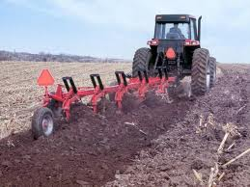
Backdrop
“Again in the ninth year, in the tenth month, in the tenth day of the month, the word of the LORD came unto me, saying,” Ezekiel 24:1
This would be the 9th year of Jehoiachin’s captivity. That would be 588 BC. Jerusalem would be plowed as a field in 586 BC!!

Slide 3
Conditions of God’s Professed People
“She doted upon the Assyrians her neighbours, captains and rulers clothed most gorgeously, horsemen riding upon horses, all of them desirable young men. Then I saw that she was defiled, that they took both one way,” Ezekiel 23:12,13
“And as soon as she saw them with her eyes, she doted upon them, and sent messengers unto them into Chaldea. And the Babylonians came to her into the bed of love, and they defiled her with their whoredom, and she was polluted with them, and her mind was alienated from them.” Ezekiel 23:16,17

Slide 4
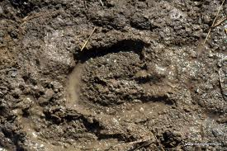
Doting on Lovers
“And the names of them were Aholah the elder, and Aholibah her sister: and they were mine, and they bare sons and daughters. Thus were their names; Samaria is Aholah, and Jerusalem Aholibah. And Aholah played the harlot when she was mine;” Ezekiel 23:4,5

Slide 5
The Women
The two women, Aholah and Aholibah, represented the professed people of God. In a time of judgment, God’s professed people were shacking up with heathen lovers. With Jerusalem about to be plowed like a field, God’s professed people were committing whoredoms with Assyria and Babylon. How we are repeating history; some things never change! The professed people of God are doing the same thing today!

Slide 6
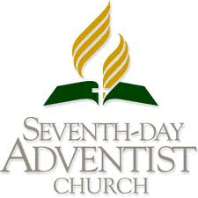
Joining with Apostate Protestantism

Slide 7
Continue
“The statement published here marks a major advance in the ecumenical journey. The result of a fifty-year process of study and consultation, this text on Baptism, Eucharist, and Ministry represents a theological convergence that has been achieved thorough decades of dialogue, under the guidance of the Holy Spirit. “Over 100 theologians met in Lima, Peru in January 1982, and recommended unanimously to transmit this agreed statement—the Lima Text—for the common study and official response of the churches. They represented virtually all the major church traditions: Eastern Orthodox, Oriental Orthodox, Roman Catholic, Old Catholic, Lutheran, Anglican, Reformed, Methodist, United, Disciples, Baptists, Adventists, and Pentecostal. “The churches’ response to this agreed statement will be a vital step of the ecumenical process of “reception.” (Lima Test, emphasis ours).
Dr. Raoul Dederen, professor at the Seminary at Andrews University, was the Seventh-day Adventist representative at this meeting.

Slide 8
Apostate Adventism’s Future
“And they shall come against thee with chariots, wagons, and wheels, and with an assembly of people, which shall set against thee buckler and shield and helmet round about: and I will set judgment before them, and they shall judge thee according to their judgments. And I will set my jealousy against thee, and they shall deal furiously with thee: they shall take away thy nose and thine ears; and thy remnant shall fall by the sword: they shall take thy sons and thy daughters; and thy residue shall be devoured by the fire.” Ezekiel 23:24,25

Slide 9
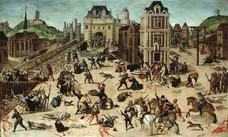
History is Repeating
Whenever God’s professed people unite with heathen, ‘religious’ people, the results are always the same. When things are ripe, the heathens turn on God’s apostate people and destruction is the result! Ask the Huguenots of France, they will tell you!

Slide 10
588 BC, 1572, and Soon!!
The massacre was instigated by Catherine de' Medici, the mother of King Charles IX, the massacre took place four days after the wedding of the king's sister Margaret to the Protestant Henry III of Navarre (the future Henry IV of France). This marriage was an occasion for which many of the most wealthy and prominent Huguenots had gathered in largely Catholic Paris.
The massacre began on 23 August 1572 (the eve of the feast of Bartholomew the Apostle), two days after the attempted assassination of Admiral Gaspard de Coligny, the military and political leader of the Huguenots. The king ordered the killing of a group of Huguenot leaders, including Coligny, and the slaughter spread throughout Paris. Lasting several weeks, the massacre expanded outward to other urban centres and the countryside.

Slide 11
Rather Simple
“ Therefore thus saith the Lord GOD; Because thou hast forgotten me, and cast me behind thy back, therefore bear thou also thy lewdness and thy whoredoms. The LORD said moreover unto me; Son of man, wilt thou judge Aholah and Aholibah? yea, declare unto them their abominations; That they have committed adultery, and blood is in their hands, and with their idols have they committed adultery, and have also caused their sons, whom they bare unto me, to pass for them through the fire, to devour them. Moreover this they have done unto me: they have defiled my sanctuary in the same day, and have profaned my sabbaths.” Ezekiel 23:35-38

Slide 12
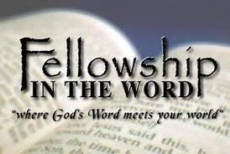
Remedy
“Acquaint now thyself with him, and be at peace: thereby good shall come unto thee.” Job 22:21
“Can a maid forget her ornaments, or a bride her attire? yet my people have forgotten me days without number.” Jer. 2:32

Slide 13
Seething Pot
”And utter a parable unto the rebellious house, and say unto them, Thus saith the Lord GOD; Set on a pot, set it on, and also pour water into it: Gather the pieces thereof into it, even every good piece, the thigh, and the shoulder; fill it with the choice bones. Take the choice of the flock, and burn also the bones under it, and make it boil well, and let them seethe the bones of it therein. Wherefore thus saith the Lord GOD; Woe to the bloody city, to the pot whose scum is therein, and whose scum is not gone out of it! bring it out piece by piece; let no lot fall upon it.” Ezekiel 24:3-6

Slide 14
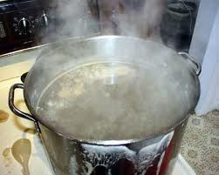
Pot of Protection
“ Then said he unto me, Son of man, these are the men that devise mischief, and give wicked counsel in this city: Which say, It is not near; let us build houses: this city is the caldron, and we be the flesh.” Ezekiel 11:2,3

Slide 15
Protective Pot
Ancient Adventists, in Ezekiel’s day, believed that safety was found within the city and the temple. They could do whatever they wanted, but as long as they were inside the church/city, they were safe.
“Thus saith the LORD of hosts, the God of Israel, Amend your ways and your doings, and I will cause you to dwell in this place. Trust ye not in lying words, saying, The temple of the LORD, The temple of the LORD, The temple of the LORD, are these…Will ye steal, murder, and commit adultery, and swear falsely, and burn incense unto Baal, and walk after other gods whom ye know not; And come and stand before me in this house, which is called by my name, and say, We are delivered to do all these abominations?” Jer. 7:3,4, 9, 10

Slide 16
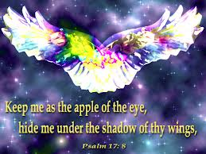
Only Place of Protection
There is no church, no denomination that can save anyone. Salvation is found in humble surrender of one’s life to Jesus Christ, allowing Him to be the Lord of our life, and to enable us to overcome sin! “Neither is there salvation in any other: for there is none other name under heaven given among men, whereby we must be saved.” Acts 4:12

Slide 17
The Desire of his Eyes
“Son of man, behold, I take away from thee the desire of thine eyes with a stroke: yet neither shalt thou mourn nor weep, neither shall thy tears run down. Forbear to cry, make no mourning for the dead, bind the tire of thine head upon thee, and put on thy shoes upon thy feet, and cover not thy lips, and eat not the bread of men. So I spake unto the people in the morning: and at even my wife died; and I did in the morning as I was commanded…Speak unto the house of Israel, Thus saith the Lord GOD; Behold, I will profane my sanctuary, the excellency of your strength, the desire of your eyes, and that which your soul pitieth; and your sons and your daughters whom ye have left shall fall by the sword.” Ezekiel 24:16-18,21

Slide 18
Sad Day
What you delight in, what you find refuge in; where you find your strength, will die, and be destroyed!!
“Yet in their blind and blasphemous presumption the instigators of this hellish work publicly declared that they had no fear that Jerusalem would be destroyed, for it was God's own city. To establish their power more firmly, they bribed false prophets to proclaim, even while Roman legions were besieging the temple, that the people were to wait for deliverance from God. To the last, multitudes held fast to the belief that the Most High would interpose for the defeat of their adversaries. But Israel had spurned the divine protection, and now she had no defense. Unhappy Jerusalem! rent by internal dissensions, the blood of her children slain by one another's hands .” GC

