Slide 1
Zerubbabel
Not by Might, nor by Power, but by My Spirit

Slide 2
That Old Man Again!
“The deliverance of Daniel from the den of lions had been used of God to create a favorable impression upon the mind of Cyrus the Great. The sterling qualities of the man of God as a statesman of farseeing ability led the Persian ruler to show him marked respect and to honor his judgment. And now, just at the time God had said He would cause His temple at Jerusalem to be rebuilt, He moved upon Cyrus as His agent to discern the prophecies concerning himself, with which Daniel was so familiar, and to grant the Jewish people their liberty. As the king saw the words foretelling, more than a hundred years before his birth, the manner in which Babylon should be taken; as he read the message addressed to him by the Ruler of the universe, "I girded thee, though thou hast not known Me: that they may know from the rising of the sun, and from the west, that there is none beside Me;" as he saw before his eyes the declaration of the eternal God, "For Jacob My servant's sake, and Israel Mine elect, I have even called thee by thy name: I have surnamed thee, though thou hast not known Me;" as he traced the inspired record, "I have raised him up in righteousness, and I will direct all his ways: he shall build My city, and he shall let go My captives, not for price nor reward," his heart was profoundly moved, and he determined to fulfill his divinely appointed mission. Isaiah 45:5, 6, 4, 13. He would let the Judean captives go free; he would help them restore the temple of Jehovah.” PK, pgs. 557,558

Slide 3
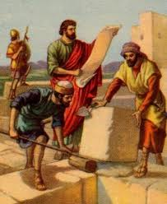
Prophecy Fulfilled-Rebuild the Temple
The 70 years were over. Babylonian captivity was done. Time to go home and rebuild the temple and the city!
Babylonian captivity ended 1798! Time to restore the sanctuary truth and the law/Sabbath! It would not be easy!

Slide 4
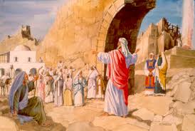
The Man chosen-Zerubbabel!
“Even those did Cyrus king of Persia bring forth by the hand of Mithredath the treasurer, and numbered them unto Sheshbazzar, the prince of Judah…Which came with Zerubbabel: Jeshua, Nehemiah,..” Ezra 1:8; 2:2 This occurred in 536 BC.

Slide 5
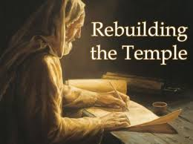
Zerubbabel
“Upon Zerubbabel (known also as Sheshbazzar), a descendant of King David, Cyrus placed the responsibility of acting as governor of the company returning to Judea; and with him was associated Joshua the high priest. The long journey across the desert wastes was accomplished in safety, and the happy company, grateful to God for His many mercies, at once undertook the work of re-establishing that which had been broken down and destroyed.” PK, pgs. 559, 560

Slide 6
Rebuilding the Temple
And when the builders laid the foundation of the temple of the LORD, they set the priests in their apparel with trumpets, and the Levites the sons of Asaph with cymbals, to praise the LORD, after the ordinance of David king of Israel. And they sang together by course in praising and giving thanks unto the LORD; because he is good, for his mercy endureth for ever toward Israel. And all the people shouted with a great shout, when they praised the LORD, because the foundation of the house of the LORD was laid. But many of the priests and Levites and chief of the fathers, who were ancient men, that had seen the first house, when the foundation of this house was laid before their eyes, wept with a loud voice; and many shouted aloud for joy: So that the people could not discern the noise of the shout of joy from the noise of the weeping of the people: for the people shouted with a loud shout, and the noise was heard afar off.” Ezra 3:10-13

Slide 7
Victory
“In the closing work of God in the earth, the standard of His law will be again exalted. False religion may prevail, iniquity may abound, the love of many may wax cold, the cross of Calvary may be lost sight of, and darkness, like the pall of death, may spread over the world; the whole force of the popular current may be turned against the truth; plot after plot may be formed to overthrow the people of God; but in the hour of greatest peril the God of Elijah will raise up human instrumentalities to bear a message that will not be silenced. In the populous cities of the land, and in the places where men have gone to the greatest lengths in speaking against the Most High, the voice of stern rebuke will be heard. Boldly will men of God's appointment denounce the union of the church with the world. Earnestly will they call upon men and women to turn from the observance of a man-made institution to the observance of the true Sabbath. "Fear God, and give glory to Him," they will proclaim to every nation; "for the hour of His judgment is come: and worship Him that made heaven, and earth, and the sea, and the fountains of waters. . . . If any man worship the beast and his image, and receive his mark in his forehead, or in his hand, the same shall drink of the wine of the wrath of God, which is poured out without mixture into the cup of His indignation." Revelation 14:7-10. God will not break His covenant, nor alter the thing that has gone out of His lips.” PK. Pgs. 186, 187

Slide 8
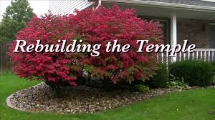
Just Like Us!
“And he said unto me, Unto two thousand and three hundred days; then shall the sanctuary be cleansed.” Daniel 8:14
“Saying with a loud voice, Fear God, and give glory to him; for the hour of his judgment is come: and worship him that made heaven, and earth, and the sea, and the fountains of waters.” Rev. 14:7

Slide 9
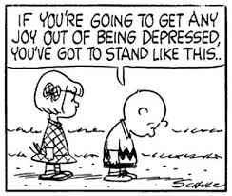
Trouble from Within
Some were upset by the rebuilding of the temple. This temple wasn’t as nice as Solomon’s. Some were hollowing in dismay!
“But some failed of discerning God's opening providences. Instead of rejoicing, they cherished thoughts of discontent and discouragement. They had seen the glory of Solomon's temple, and they lamented because of the inferiority of the building now to be erected. The murmuring and complaining, and the unfavorable comparisons made, had a depressing influence on the minds of many and weakened the hands of the builders. The workmen were led to question whether they should proceed with the erection of a building that at the beginning was so freely criticized and was the cause of so much lamentation.” PK, pgs. 564, 565

Slide 10
Further Troubles
“Now when the adversaries of Judah and Benjamin heard that the children of the captivity builded the temple unto the LORD God of Israel; Then they came to Zerubbabel, and to the chief of the fathers, and said unto them, Let us build with you: for we seek your God, as ye do; and we do sacrifice unto him since the days of Esarhaddon king of Assur, which brought us up hither. But Zerubbabel, and Jeshua, and the rest of the chief of the fathers of Israel, said unto them, Ye have nothing to do with us to build an house unto our God; but we ourselves together will build unto the LORD God of Israel, as king Cyrus the king of Persia hath commanded us. Then the people of the land weakened the hands of the people of Judah, and troubled them in building,” Ezra 4:1-4

Slide 11
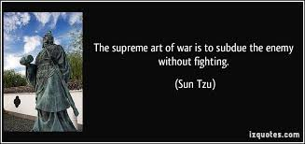
Samaritans
“But had the Jewish leaders accepted this offer of assistance, they would have opened a door for the entrance of idolatry. They discerned the insincerity of the Samaritans. They realized that help gained through an alliance with these men would be as nothing in comparison with the blessing they might expect to receive by following the plain commands of Jehovah.
Regarding the relation that Israel should sustain to surrounding peoples, the Lord had declared through Moses: "Thou shalt make no covenant with them, nor show mercy unto them: neither shalt thou make marriages with them; . . . for they will turn away thy son from following Me, that they may serve other gods: so will the anger of the Lord be kindled against you, and destroy thee suddenly.“ PK, pg. 568

Slide 12
Results
“The result that would follow an entrance into covenant relation with surrounding nations was plainly foretold. "The Lord shall scatter thee among all people, from the one end of the earth even unto the other," Moses had declared; "and there thou shalt serve other gods, which neither thou nor thy fathers have known, even wood and stone. And among these nations shalt thou find no ease, neither shall the sole of thy foot have rest: but the Lord shall give thee there a trembling heart, and failing of eyes, and sorrow of mind: and thy life shall hang in doubt before thee; and thou shalt fear day and night, and shalt have none assurance of thy life: in the morning thou shalt say, Would God it were even! and at even thou shalt say, Would God it were morning! for the fear of thine heart wherewith thou shalt fear, and for the sight of thine eyes which thou shalt see." Deuteronomy 28:64-67. "But if from thence thou shalt seek the Lord thy God," the promise had been, "thou shalt find Him, if thou seek Him with all thy heart and with all thy soul." Deuteronomy 4:29. Zerubbabel and his associates were familiar with these and many like scriptures; and in the recent captivity they had evidence after evidence of their fulfillment. And now, having repented of the evils that had brought upon them and their fathers the judgments foretold so plainly through Moses; having turned with all the heart to God, and renewed their covenant relationship with Him, they had been permitted to return to Judea, that they might restore that which had been destroyed. Should they, at the very beginning of their undertaking, enter into a covenant with idolaters? “ Pk, pgs. 569, 570

Slide 13
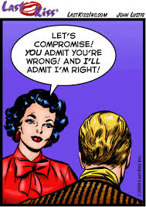
What if?
1. If we embraced Catholic Spiritual Formation?
2. If we have embraced women’s ordination?
3. If we went to the heathen of Willow Creek or Pentecostalism to learn new worship styles?
4. What would be the result?
Should we be praying for the blessing of God? Or expect His curse?

Slide 14
Battles Within and Without
“Through the prophet Daniel we are given a glimpse of this mighty struggle between the forces of good and the forces of evil. For three weeks Gabriel wrestled with the powers of darkness, seeking to counteract the influences at work on the mind of Cyrus; and before the contest closed, Christ Himself came to Gabriel's aid. "The prince of the kingdom of Persia withstood me one and twenty days," Gabriel declares; "but, lo, Michael, one of the chief princes, came to help me; and I remained there with the kings of Persia." Daniel 10:13. All that heaven could do in behalf of the people of God was done. The victory was finally gained; the forces of the enemy were held in check all the days of Cyrus, and all the days of his son Cambyses, who reigned about seven and a half years. This was a time of wonderful opportunity for the Jews. The highest agencies of heaven were working on the hearts of kings, and it was for the people of God to labor with the utmost activity to carry out the decree of Cyrus. They should have spared no effort to restore the temple and its services, and to re-establish themselves in their Judean homes. But in the day of God's power many proved unwilling.” PK, pgs. 571,572

Slide 15
Zerubbabel Faced it!
Throughout the history of God's people great mountains of difficulty, apparently insurmountable, have loomed up before those who were trying to carry out the purposes of Heaven. Such obstacles are permitted by the Lord as a test of faith. When we are hedged about on every side, this is the time above all others to trust in God and in the power of His Spirit. The exercise of a living faith means an increase of spiritual strength and the development of an unfaltering trust. It is thus that the soul becomes a conquering power. Before the demand of faith, the obstacles placed by Satan across the pathway of the Christian will disappear; for the powers of heaven will come to his aid. "Nothing shall be impossible unto you." Matthew 17:20. The way of the world is to begin with pomp and boasting. God's way is to make the day of small things the beginning of the glorious triumph of truth and righteousness.” PK, pgs. 594,595

Slide 16
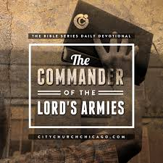
Zechariah the Prophet
“Therefore say thou unto them, Thus saith the LORD of hosts; Turn ye unto me, saith the LORD of hosts, and I will turn unto you, saith the LORD of hosts. Be ye not as your fathers, unto whom the former prophets have cried, saying, Thus saith the LORD of hosts; Turn ye now from your evil ways, and from your evil doings: but they did not hear, nor hearken unto me, saith the LORD.”

Slide 17
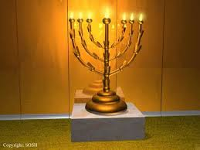
Zechariah
“ And said unto me, What seest thou? And I said, I have looked, and behold a candlestick all of gold, with a bowl upon the top of it, and his seven lamps thereon, and seven pipes to the seven lamps, which are upon the top thereof: And two olive trees by it, one upon the right side of the bowl, and the other upon the left side thereof. So I answered and spake to the angel that talked with me, saying, What are these, my lord? Then the angel that talked with me answered and said unto me, Knowest thou not what these be? And I said, No, my lord. Then he answered and spake unto me, saying, This is the word of the LORD unto Zerubbabel, saying, Not by might, nor by power, but by my spirit, saith the LORD of hosts.”

Slide 18
“From the two olive-trees, the golden oil was emptied through golden pipes into the bowl of the candlestick, and thence into the golden lamps that gave light to the sanctuary. So from the holy ones that stand in God’s presence, his Spirit is imparted to human instrumentalities that are consecrated to his service. The mission of the two anointed ones is to communicate light and power to God’s people. It is to receive blessing for us that they stand in God’s presence. As the olive-trees empty themselves into the golden pipes, so the heavenly messengers seek to communicate all that they receive from God. The whole heavenly treasure awaits our demand and reception; and as we receive the blessing, we in our turn are to impart it. Thus it is that the holy lamps are fed, and the church becomes a light-bearer in the world. This is the work that the Lord would have every soul prepared to do at this time, when the four angels are holding the four winds, that they shall not blow until the servants of God are sealed in their foreheads. There is no time now for self-pleasing. The lamps of the soul must be trimmed. They must be supplied with the oil of grace. “ (RH March 2, 1897)

Slide 19
Flowing Oil
“We should daily obtain a deep and living experience in the work of perfecting Christian character. We should daily receive the holy oil that we may impart to others. All may be light-bearers to the world if they will. We are to sink self out of sight in Jesus. We are to receive the word of the Lord in counsel and instruction, and gladly communicate it. There is now need of much prayer. Christ commands, “Pray without ceasing;” that is, keep the mind uplifted to God, the source of all power and efficiency.
We may have long followed the narrow path, but it is not safe to take this as proof that we shall follow it to the end. If we have walked with God in fellowship of the Spirit, it is because we have sought him daily by faith. From the two olive-trees, the golden oil flowing through the golden pipes has been communicated to us. But those who do not cultivate the spirit and habit of prayer cannot expect to receive the golden oil of goodness, patience, long-suffering, gentleness, love.” RH March 2, 1897, par. 10}

Slide 20
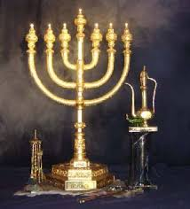
Oil Flows
“For who hath despised the day of small things? for they shall rejoice, and shall see the plummet in the hand of Zerubbabel with those seven; they are the eyes of the LORD, which run to and fro through the whole earth. Then answered I, and said unto him, What are these two olive trees upon the right side of the candlestick and upon the left side thereof? And I answered again, and said unto him, What be these two olive branches which through the two golden pipes empty the golden oil out of themselves? And he answered me and said, Knowest thou not what these be? And I said, No, my lord. Then said he, These are the two anointed ones, that stand by the Lord of the whole earth.” Zech. 4:10-14

