Slide 1
Amazing Grace, pt. 14 “Without a Peer”

Slide 2
He Needed Nothing
1. ‘the highest civil and military training’
2. ‘a military leader’
3. ‘a remarkable character’
4. ‘fitted to take pre-eminence among the great of the earth’
5. ‘His intellectual greatness distinguishes him above the great men of all ages.’
6. ‘As historian, poet, philosopher, general of armies, and legislator, he stands without a peer.’

Slide 3
What a Man!
He was Colin Powell and H. Norman Schwarzkopf, Jr. wrapped in one. He was highly respected in all circles. He was a leader of the highest degree; his brilliance would rival that of Solomon. Maybe, this sermon today is about Solomon?? He was Edward Gibbon, Maya Angelou , John Locke, George Washington, and Thomas Jefferson all wrapped in one man. ‘Without a peer’.

Slide 4
Rich and Increased with Goods..
He had it all. He could out talk, outsmart, and out fight anyone and everyone. He could buy anything, do anything, and conquer anything. The world lay at his feet. He had just one problem…He didn’t need anything or anyone to tell him anything because he already knew it all and he knew it.

Slide 5
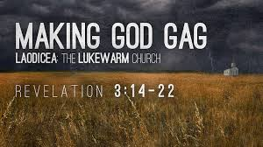
Sounds Like Laodicea..
The final church on earth says, “Because thou sayest, I am rich, and increased with goods, and have need of nothing; and knowest not that thou art wretched, and miserable, and poor, and blind, and naked:” Rev. 3:17

Slide 6
Must Have Need
“Blessed are the poor in spirit: for theirs is the kingdom of heaven.” Matthew 5:3
“When Jesus heard it, he saith unto them, They that are whole have no need of the physician, but they that are sick: I came not to call the righteous, but sinners to repentance.” Mark 2:17

Slide 7
Weakness is OK!
“In order to receive God's help, man must realize his weakness and deficiency; he must apply his own mind to the great change to be wrought in himself; he must be aroused to earnest and persevering prayer and effort. Wrong habits and customs must be shaken off; and it is only by determined endeavor to correct these errors and to conform to right principles that the victory can be gained. Many never attain to the position that they might occupy, because they wait for God to do for them that which He has given them power to do for themselves. All who are fitted for usefulness must be trained by the severest mental and moral discipline, and God will assist them by uniting divine power with human effort.” PP,pg. 248

Slide 8
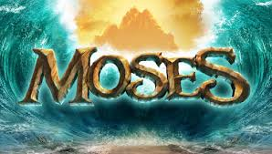
Self-Dependence=Trouble
When we are depending on ourselves, then we get into trouble. “He had yet to learn the same lesson of faith that Abraham and Jacob had been taught--not to rely upon human strength or wisdom, but upon the power of God for the fulfillment of His promises.” PP, pg. 247

Slide 9
His Way, His Power!
“And it came to pass in those days, when Moses was grown, that he went out unto his brethren, and looked on their burdens: and he spied an Egyptian smiting an Hebrew, one of his brethren. And he looked this way and that way, and when he saw that there was no man, he slew the Egyptian, and hid him in the sand. And when he went out the second day, behold, two men of the Hebrews strove together: and he said to him that did the wrong, Wherefore smitest thou thy fellow? And he said, Who made thee a prince and a judge over us? intendest thou to kill me, as thou killedst the Egyptian? And Moses feared, and said, Surely this thing is known.” Ex. 2:11-14

Slide 10
Too Smart for his Own Britches
“In slaying the Egyptian, Moses had fallen into the same error so often committed by his fathers, of taking into their own hands the work that God had promised to do. It was not God's will to deliver His people by warfare, as Moses thought, but by His own mighty power, that the glory might be ascribed to Him alone. Yet even this rash act was overruled by God to accomplish His purposes. Moses was not prepared for his great work. He had yet to learn the same lesson of faith that Abraham and Jacob had been taught--not to rely upon human strength or wisdom, but upon the power of God for the fulfillment of His promises. And there were other lessons that, amid the solitude of the mountains, Moses was to receive. In the school of self-denial and hardship he was to learn patience, to temper his passions. Before he could govern wisely, he must be trained to obey. His own heart must be fully in harmony with God before he could teach the knowledge of His will to Israel. By his own experience he must be prepared to exercise a fatherly care over all who needed his help.” PP, pg. 247

Slide 11
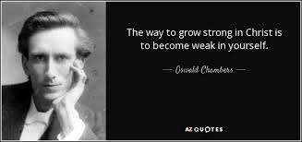
Change to Occur
1. the strong had to become weak.
2. the proud had to become meek.
3. the wise had to become a fool.
4. the man had to become a child.

Slide 12
Paul Too!
“And lest I should be exalted above measure through the abundance of the revelations, there was given to me a thorn in the flesh, the messenger of Satan to buffet me, lest I should be exalted above measure. For this thing I besought the Lord thrice, that it might depart from me. And he said unto me, My grace is sufficient for thee: for my strength is made perfect in weakness. Most gladly therefore will I rather glory in my infirmities, that the power of Christ may rest upon me. Therefore I take pleasure in infirmities, in reproaches, in necessities, in persecutions, in distresses for Christ's sake: for when I am weak, then am I strong.” 2 Corintians 12:7-10

Slide 13
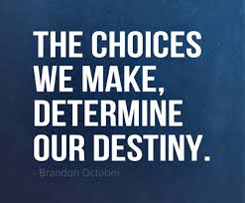
Choices to Make Daily
“He must apply his own mind to the great change to be wrought in himself; he must be aroused to earnest and persevering prayer and effort. Wrong habits and customs must be shaken off; and it is only by determined endeavor to correct these errors and to conform to right principles that the victory can be gained.” PP, pg. 248

Slide 14
Amazing Grace
The Lord did not give up on his erring servant. He changed the venue.
“Shut in by the bulwarks of the mountains, Moses was alone with God. The magnificent temples of Egypt no longer impressed his mind with their superstition and falsehood. In the solemn grandeur of the everlasting hills he beheld the majesty of the Most High, and in contrast realized how powerless and insignificant were the gods of Egypt. Everywhere the Creator's name was written. Moses seemed to stand in His presence and to be over-shadowed by His power. Here his pride and self-sufficiency were swept away. In the stern simplicity of his wilderness life, the results of the ease and luxury of Egypt disappeared. Moses became patient, reverent, and humble, "very meek, above all the men which were upon the face of the earth" (Numbers 12:3), yet strong in faith in the mighty God of Jacob.” PP., pgs. 248-251

Slide 15
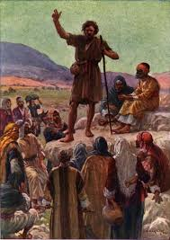
Ready Now!
“He looked upon the King in His beauty, and self was forgotten. He beheld the majesty of holiness, and felt himself to be inefficient and unworthy. He was ready to go forth as Heaven's messenger, unawed by the human, because he had looked upon the Divine. He could stand erect and fearless in the presence of earthly monarchs, because he had bowed low before the King of kings.” DA, pg. 103

Slide 16
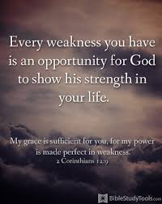
1. They beheld the greatness of the Lord and realized they weren’t much.
2. They saw His power and in contrast, saw their weakness.
3. They saw His wisdom and realized they weren’t very smart.
They were ready to go!

Slide 17
You are the Man!
“As Moses waited in reverent awe before God the words continued: "I have surely seen the affliction of My people which are in Egypt, and have heard their cry by reason of their taskmasters; for I know their sorrows; and I am come down to deliver them out of the hand of the Egyptians, and to bring them up out of that land unto a good land and a large, unto a land flowing with milk and honey. . . . Come now therefore, and I will send thee unto Pharaoh, that thou mayest bring forth My people the children of Israel out of Egypt."
Amazed and terrified at the command, Moses drew back, saying, "Who am I, that I should go unto Pharaoh, and that I should bring forth the children of Israel out of Egypt?" The reply was, "Certainly I will be with thee; and this shall be a token unto thee, that I have sent thee: When thou hast brought forth the people out of Egypt, ye shall serve God upon this mountain.“ PP, pg. 252

Slide 18
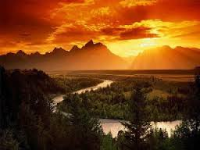
“The divine command given to Moses found him self-distrustful, slow of speech, and timid. He was overwhelmed with a sense of his incapacity to be a mouthpiece for God to Israel. But having once accepted the work, he entered upon it with his whole heart, putting all his trust in the Lord. The greatness of his mission called into exercise the best powers of his mind. God blessed his ready obedience, and he became eloquent, hopeful, self-possessed, and well fitted for the greatest work ever given to man. This is an example of what God does to strengthen the character of those who trust Him fully and give themselves unreservedly to His commands.” PP, PG. 255

