Slide 1
Amazing Grace, pt. 15
‘A Woman of 2 Cities’

Slide 2
A Woman in a Man’s Book
The Bible chronicles mostly men. Most of the lengthy stories in Scripture detail the lives of males. However, the character today, at intervals, has probably as much written about her in the Bible as any other lady. She is very rare in that most people are referred to as Jesus of Nazareth or Judas of Iscariot or Simon of Bethany. She is a woman of not one, but two cities.

Slide 3
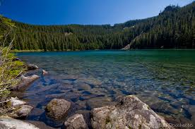
Easy to Condemn
In all that is written about her, this woman of two cities, much is said about her life after she experienced God’s Amazing Grace. So little is said about her life before that. The Bible highlights the triumphs and not the sins of this woman. Might we do the same!

Slide 4
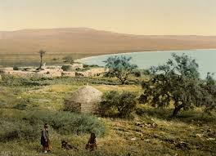
Her past
“And it came to pass afterward, that he went throughout every city and village, preaching and shewing the glad tidings of the kingdom of God: and the twelve were with him, And certain women, which had been healed of evil spirits and infirmities, …., out of whom went seven devils,” Luke 8:1,2

Slide 5
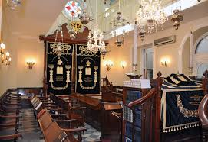
What Led to her Past?
In a synagogue in a little town called Bethany, about 2 miles east of Jerusalem, this young lady lived with her brother and sister. Unfortunately, an unsanctified man, who was not submitted to Christ, badly mistreated her. When people are not close to Christ, they sometimes mistreat others! Oftentimes, how we treat others is a barometer as to how to where we are with the Lord!

Slide 6
Amazing Grace
“By curing Simon of leprosy, Christ had saved him from a living death. But now Simon questioned whether the Saviour were a prophet. Because Christ allowed this woman to approach Him, because He did not indignantly spurn her as one whose sins were too great to be forgiven, because He did not show that He realized she had fallen, Simon was tempted to think that He was not a prophet. Jesus knows nothing of this woman who is so free in her demonstrations, he thought, or He would not allow her to touch Him. But it was Simon's ignorance of God and of Christ that led him to think as he did. He did not realize that God's Son must act in God's way, with compassion, tenderness, and mercy. Simon's way was to take no notice of Mary's penitent service. Her act of kissing Christ's feet and anointing them with ointment was exasperating to his hardheartedness. He thought that if Christ were a prophet, He would recognize sinners and rebuke them. As did Nathan with David, Christ concealed His home thrust under the veil of a parable. He threw upon His host the burden of pronouncing sentence upon himself. Simon had led into sin the woman he now despised. She had been deeply wronged by him.” DA, pg. 566

Slide 7
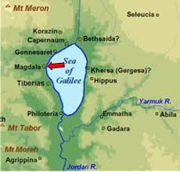
Mary of Bethany Became Mary Magdalene
She had to get away from Bethany. Rumors were ruining her. She headed to Magdala, plied the only trade she knew, became possessed, and was a wreck. There she met Jesus and her life was changed! Jesus gave the woman of two cities hope, power, and peace; a Friend and Savior for life!

Slide 8
Keynote of her Life
“Now it came to pass, as they went, that he entered into a certain village: and a certain woman named Martha received him into her house. And she had a sister called Mary, which also sat at Jesus' feet, and heard his word. But Martha was cumbered about much serving, and came to him, and said, Lord, dost thou not care that my sister hath left me to serve alone? bid her therefore that she help me. And Jesus answered and said unto her, Martha, Martha, thou art careful and troubled about many things: But one thing is needful: and Mary hath chosen that good part, which shall not be taken away from her.” Luke 10:38-42

Slide 9
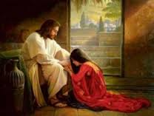
Everything was Right
World gives you garbage. Church people can be unkind or hypocritical, but everything is right at the feet of Jesus. Accepted , loved, cherished; power, forgiveness, peace all at Jesus feet!

Slide 10
Sorrow Hits!
“And when she had so said, she went her way, and called Mary her sister secretly, saying, The Master is come, and calleth for thee. As soon as she heard that, she arose quickly, and came unto him. Now Jesus was not yet come into the town, but was in that place where Martha met him. The Jews then which were with her in the house, and comforted her, when they saw Mary, that she rose up hastily and went out, followed her, saying, She goeth unto the grave to weep there. Then when Mary was come where Jesus was, and saw him, she fell down at his feet, saying unto him, Lord, if thou hadst been here, my brother had not died.” Jn. 11:28-32

Slide 11
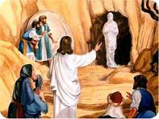
“On hearing the message, Mary rose hastily, and with an eager look on her face left the room. Thinking that she had gone to the grave to weep, the mourners followed her. When she reached the place where Jesus was waiting, she knelt at His feet, and said with quivering lips, "Lord, if Thou hadst been here, my brother had not died." The cries of the mourners were painful to her; for she longed for a few quiet words alone with Jesus. But she knew of the envy and jealousy cherished in the hearts of some present against Christ, and she was restrained from fully expressing her grief.” DA, pg. 533

Slide 12
Anointing Him for Burial
“And, behold, a woman in the city, which was a sinner, when she knew that Jesus sat at meat in the Pharisee's house, brought an alabaster box of ointment, And stood at his feet behind him weeping, and began to wash his feet with tears, and did wipe them with the hairs of her head, and kissed his feet, and anointed them with the ointment.” LK. 7:37,38

Slide 13
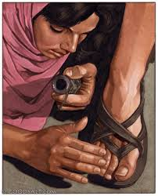
The Chosen
Mary was the only one who anointed Christ for His burial, yet thousands heard His words of approaching death. Her gift of love to her Savior meant so much to Him as He faced Calvary!
She knew that what Christ said happened. She knew that He would die soon and she wanted Him to know her appreciation for His sacrifice! Again, she was at His feet!

Slide 14
Still a Waste?
“The same want is evident in our world today. But few appreciate all that Christ is to them. If they did, the great love of Mary would be expressed, the anointing would be freely bestowed. The expensive ointment would not be called a waste. Nothing would be thought too costly to give for Christ, no self-denial or self-sacrifice too great to be endured for His sake. The words spoken in indignation, "To what purpose is this waste?" brought vividly before Christ the greatest sacrifice ever made,--the gift of Himself as the propitiation for a lost world. The Lord would be so bountiful to His human family that it could not be said of Him that He could do more. In the gift of Jesus, God gave all heaven. From a human point of view, such a sacrifice was a wanton waste. To human reasoning the whole plan of salvation is a waste of mercies and resources. Self-denial and wholehearted sacrifice meet us everywhere. Well may the heavenly host look with amazement upon the human family who refuse to be uplifted and enriched with the boundless love expressed in Christ.” DA, pgs. 565, 566

Slide 15
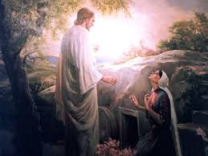
Still There
“And when she had thus said, she turned herself back, and saw Jesus standing, and knew not that it was Jesus. Jesus saith unto her, Woman, why weepest thou? whom seekest thou? She, supposing him to be the gardener, saith unto him, Sir, if thou have borne him hence, tell me where thou hast laid him, and I will take him away. Jesus saith unto her, Mary. She turned herself, and saith unto him, Rabboni; which is to say, Master. Jesus saith unto her, Touch me not; for I am not yet ascended to my Father: but go to my brethren, and say unto them, I ascend unto my Father, and your Father; and to my God, and your God.” Jn. 20:14-17

Slide 16
Christ Waited for One!
Heaven waited for the return of Christ. He had been away from heaven for 33 years. They longed for the reunion of their Commander and His return to the heavenly courts! But, Christ waited! He waited because He knew there was one person who needed Him! What Amazing Grace!

Slide 17
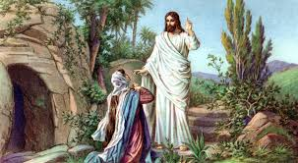
At His Feet
“But now in His own familiar voice Jesus said to her, "Mary." Now she knew that it was not a stranger who was addressing her, and turning she saw before her the living Christ. In her joy she forgot that He had been crucified. Springing toward Him, as if to embrace His feet, she said, "Rabboni." But Christ raised His hand, saying, Detain Me not; "for I am not yet ascended to My Father: but go to My brethren, and say unto them, I ascend unto My Father, and your Father; and to My God, and your God." And Mary went her way to the disciples with the joyful message. Jesus refused to receive the homage of His people until He had the assurance that His sacrifice was accepted by the Father. He ascended to the heavenly courts, and from God Himself heard the assurance that His atonement for the sins of men had been ample, that through His blood all might gain eternal life.” DA, pg. 790

Slide 18
Amazing Grace!
“Men whom God favored, and to whom He entrusted great responsibilities, were sometimes overcome by temptation and committed sin, even as we at the present day strive, waver, and frequently fall into error. Their lives, with all their faults and follies, are open before us, both for our encouragement and warning. If they had been represented as without fault, we, with our sinful nature, might despair at our own mistakes and failures. But seeing where others struggled through discouragements like our own, where they fell under temptations as we have done, and yet took heart again and conquered through the grace of God, we are encouraged in our striving after righteousness. As they, though sometimes beaten back, recovered their ground, and were blessed of God, so we too may be overcomers in the strength of Jesus. On the other hand, the record of their lives may serve as a warning to us. It shows that God will by no means clear the guilty. He sees sin in His most favored ones, and He deals with it in them even more strictly than in those who have less light and responsibility.” PP, pg. 238

