Slide 1
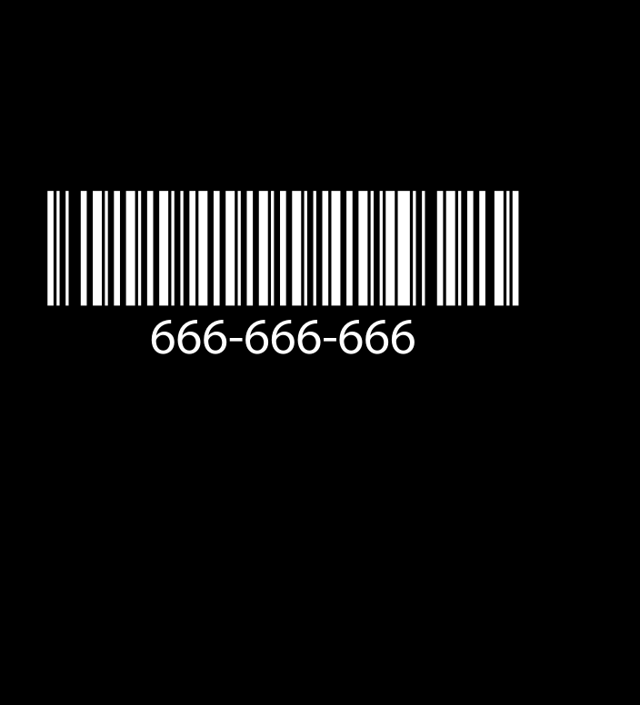
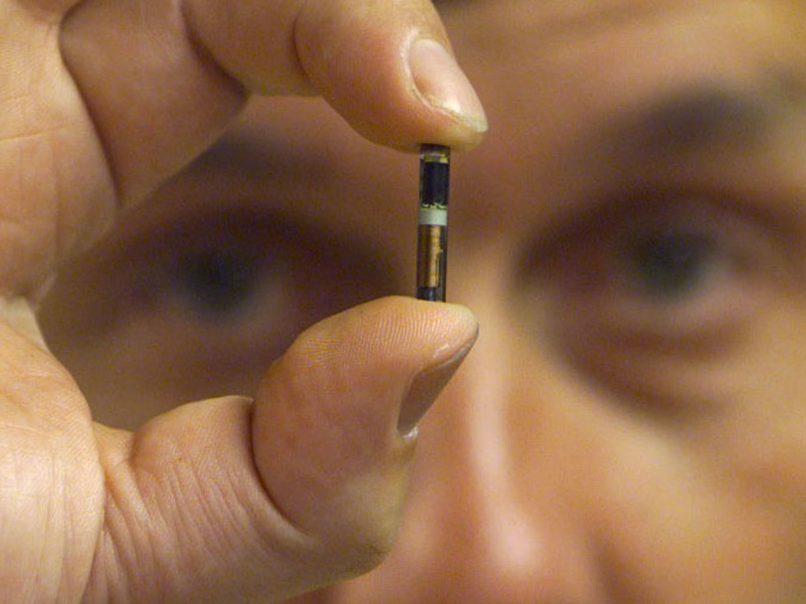
The Mark of the Beast: What is it?

Slide 2
The Verse(s) In Question…
Rev. 13:16-18 “And he causeth all, both small and great, rich and poor, free and bond, to receive a mark in their right hand, or in their foreheads: And that no man might buy or sell, save he that had the mark, or the name of the beast, or the number of his name. Here is wisdom. Let him that hath understanding count the number of the beast: for it is the number of a man; and his number is Six hundred threescore and six.”
Rev. 14:9-10 “And the third angel followed them, saying with a loud voice, If any man worship the beast and his image, and receive his mark in his forehead, or in his hand, The same shall drink of the wine of the wrath of God, which is poured out without mixture into the cup of his indignation; and he shall be tormented with fire and brimstone in the presence of the holy angels, and in the presence of the Lamb”

Slide 3
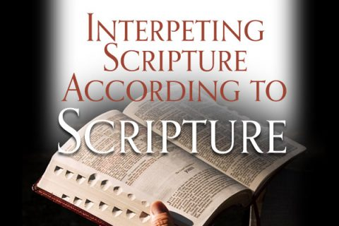
First… How Do We Study the Bible?
Is. 28:9-10 “Whom shall he teach knowledge? and whom shall he make to understand doctrine? . . . For precept must be upon precept, precept upon precept; line upon line, line upon line; here a little, and there a little”

Slide 4
The Major Questions We Want Answers To…
Who is “the Beast”?
What is the Number of his name?
What is the Mark?

Slide 5
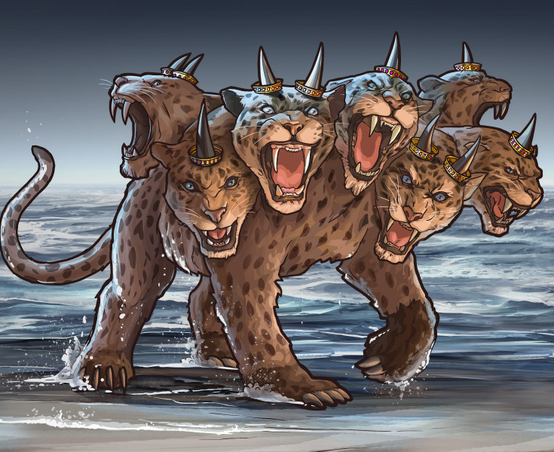
Clues About “the Beast”
Rev. 13:1-5 “And I stood upon the sand of the sea, and saw a beast rise up out of the sea, having seven heads and ten horns, and upon his horns ten crowns, and upon his heads the name of blasphemy. And the beast which I saw was like unto a leopard, and his feet were as the feet of a bear, and his mouth as the mouth of a lion: and the dragon gave him his power, and his seat, and great authority. And I saw one of his heads as it were wounded to death; and his deadly wound was healed: and all the world wondered after the beast. And they worshipped the dragon which gave power unto the beast: and they worshipped the beast, saying, Who is like unto the beast? who is able to make war with him? And there was given unto him a mouth speaking great things and blasphemies; and power was given unto him to continue forty and two months.”

Slide 6
Revelation 13 Clues
Comes out of the Sea
Has 7 heads/10 horns
Commits Blasphemy
Suffers a Deadly Wound which is healed
Reigns for 42 months
Things to Remember: This power has to do with worship and its name adds up to 666

Slide 7
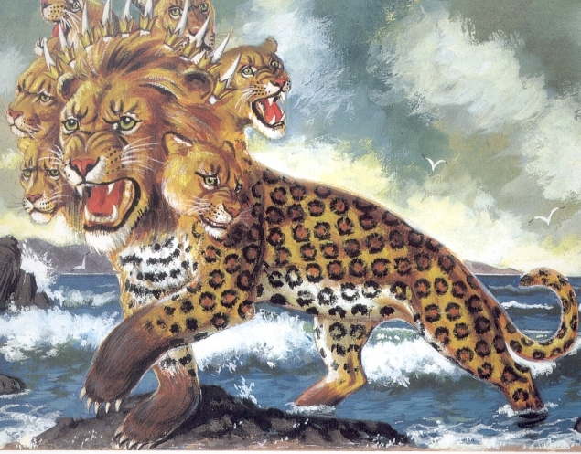
What are the Sea and Beast Symbolic of???
Rev. 17:15 “And he saith unto me, The waters which thou sawest, where the whore sitteth, are peoples, and multitudes, and nations, and tongues.”
Dan. 7:23 “Thus he said, The fourth beast shall be the fourth kingdom upon earth, which shall be diverse from all kingdoms, and shall devour the whole earth, and shall tread it down, and break it in pieces.”

Slide 8
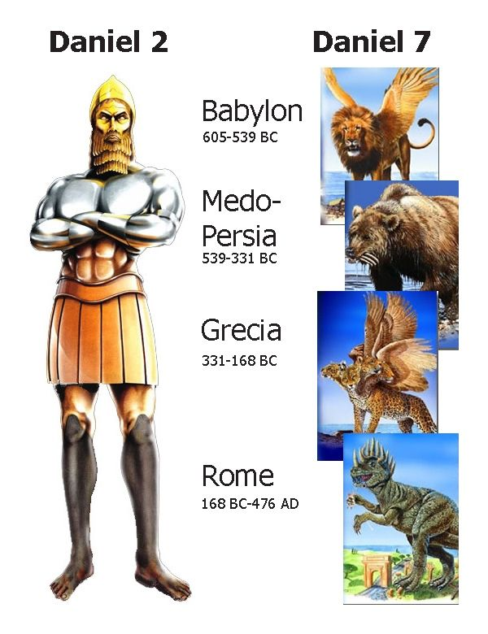
What are horns in prophecy???
Dan. 7:24 “And the ten horns out of this kingdom are ten kings that shall arise, and he shall be diverse from the first, and he shall subdue three kings.”

Slide 9
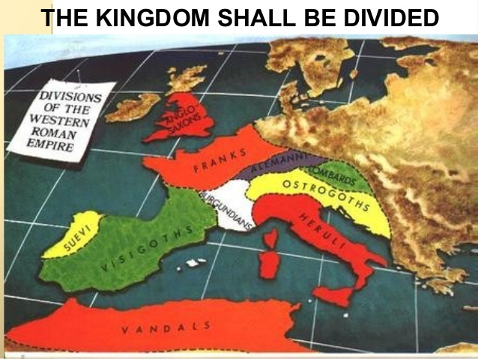
Alemanni (Germany), Franks (France), Visigoths (Spain), Suevi (Portugal), Lombards (Italy), Burgundians (Switzerland), Anglo-Saxons (Britain), Heruli (Italy and parts of Greece), Ostrogoths (Greece, Macedonia), Vandals (North Africa)—the last 3 kingdoms were destroyed according to history, because they would not accept the church’s decree on the divinity of Christ (Arian history)—The Heruli King Odoacer who took over Rome in 476AD was defeated by Ostrogoth King Theodoric in 493AD. Roman General Belisarius defeated the Vandals as a nation in 534AD, and the Ostrogoths in 538AD were eliminated from Rome.

Slide 10
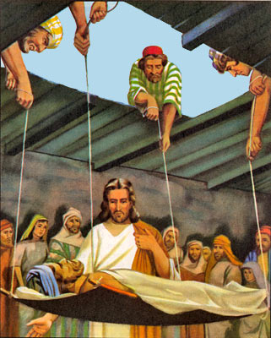
Commits Blasphemy
Mark 2:4-7 “And when they could not come nigh unto him for the press, they uncovered the roof where he was: and when they had broken it up, they let down the bed wherein the sick of the palsy lay. When Jesus saw their faith, he said unto the sick of the palsy, Son, thy sins be forgiven thee. But there was certain of the scribes sitting there, and reasoning in their hearts, Why doth this man thus speak blasphemies? who can forgive sins but God only?”

Slide 11
Blasphemy According to Scripture
John 10:30-33 “I and my Father are one. Then the Jews took up stones again to stone him. Jesus answered them, Many good works have I shewed you from my Father; for which of those works do ye stone me? The Jews answered him, saying, For a good work we stone thee not; but for blasphemy; and because that thou, being a man, makest thyself God.”

Slide 12
Getting Closer….
What World Empire/Power which has to do with worship, arose out of the 10 divisions of the Roman Empire by 538AD which claims to have the power to forgive sins and that it represents God on earth?
Answer: The Holy Roman Empire Rules Europe after the fall of the Empire, the worship element found in the rise of the Roman Catholic Church

Slide 13
Claims to Forgive Sins…
“the poor sinner kneels at his confessor’s feet. He KNOWS he is not speaking to an ordinary man but to ‘another Christ’ He hears the words: ‘I absolve thy sins…” and the hideous load of sins drop from his soul forever.”--William Doyle, Shall I be a priest, p 14-15
“This judicial authority will even include the power to forgive sin.”--The Catholic Encyclopaedia Vol xii, article ‘Pope’, p. 265
“And God himself is obliged to abide by the judgment of his priest and either not to pardon or to pardon, according as they refuse to give absolution, provided the penitent is capable of it.”—Liguori, Duties and Dignities of the Priest, p. 27

Slide 14
Claims to Be God…
“The Pope and God are the same, so he has all power in Heaven and earth”—Pope Pius V (1566-1572), Barclay, Cities Petrus Bertanous Chapter XXVII: 218
“We may according to the fulness of our power, dispose of the law and dispense above the law. Those whom the Pope of Rome doth separate, it is not a man that separates them but God. For the Pope holdeth place on earth, not simply of a man but of the true God.”—Pope Innocent III (1198-1216), Decretals of Gregory IX, Bk 1, ch. 3
“We declare, assert, define and pronounce to be subject to the Roman Pontiff is to every creature altogether necessary for salvation. . . I have the authority of the King of Kings. I am all in all, and above all, so that God Himself and I, the Vicar of Christ, have but one consistory, and I am able to do almost all that God can do. What therefore, can you make of me but God?”—Pope Boniface VIII (1294-1303), Papal Bull Unam Sanctum, 1302AD

Slide 15
“I alone . . . am the successor of the apostles, the vicar of Christ. I am the way, the truth, and the life”—Pope Pius XI (1922-1939), quoted in Henry Charles Sheldon, History of the Christian Church, p. 59
“All names which the Scriptures are applied to Christ, by virtue of which it is established that he is over the church, all the same names are applied to the Pope.”—Robert Bellarmine, On the Authority of Councils, Vol. 2: 266
“The Pope takes the place of Christ on earth. . . by divine right the Pope has supreme and full power in faith, in morals over each and every pastor and his flock. He is the true vicar, the head of the entire church, the father and teacher of all Christians. He is the infallible ruler, the founder of dogmas, the author of and the judge of all, being judged by no one, God himself on earth”—New York Catechism

Slide 16
Suffers a Deadly Wound—Reigns 42 Months
Num. 14:34 “After the number of the days in which ye searched the land, even forty days, each day for a year, shall ye bear your iniquities, even forty years, and ye shall know my breach of promise.”
Ez. 4:6 “And when thou hast accomplished them, lie again on thy right side, and thou shalt bear the iniquity of the house of Judah forty days: I have appointed thee each day for a year.”
Gen. 29:27 “Fulfil her week, and we will give thee this also for the service which thou shalt serve with me yet seven other years.”

Slide 17
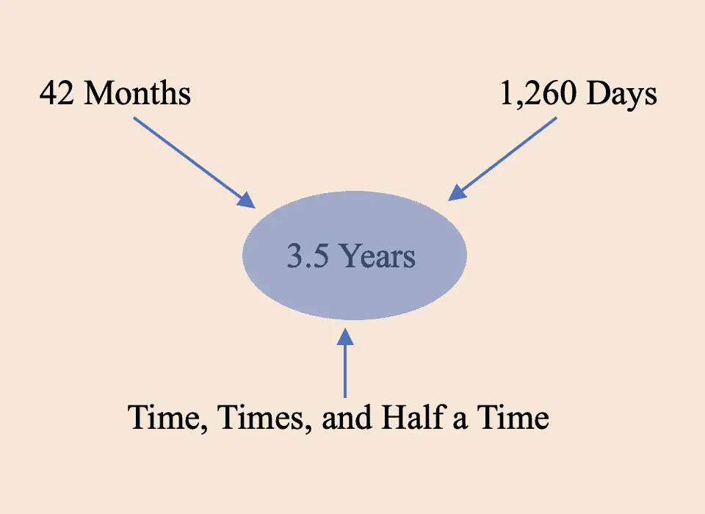
Sister Verses to the 42 Months
Dan. 7:25 “ . . . they shall be given into his hand until a time and times and the dividing of time.”
Dan. 12:7 “ . . . it shall be for a time, times, and an half . . .”
Rev. 11:2 “ . . . the holy city shall they tread under foot forty and two months.”
Rev. 11:3 “ . . . a thousand two hundred and threescore days . . .”
Rev. 12:6 “ . . . a thousand two hundred and threescore days.”
Rev. 12:14 “ . . . for a time, and times, and half a time . . .”
Rev. 13:5 “ . . . continue forty and two months.”

Slide 18
3-1/2 Years = 42 Months = 1,260 Days =
1,260 Literal Years

Slide 19
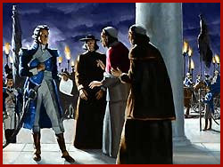
Did the Roman Church Reign for 1,260 Years in Europe?
538AD + 1,260 years = 1798… What Happened then?
“the deposing of the pope, the abolition of the papal government, and the decreeing of a republic in the city of Rome by the French in 1798 were acts of war, the consummation of the deadly wound administered to the papal system. From that day, the pope was not king until the signing of the concordat with Italy, February 11, 1929, when Pope Pius XI appeared on the upper balcony of St. Peter's and hundreds of voices from the street below joined in the jubilant cry, "Viva it papa-re! viva it papa-re!" (Long live the Pope King.) Now he is again in very truth a real king.”—( Ministry Magazine, CP Bollman, August 1931, Why the Year 538?)

Slide 20
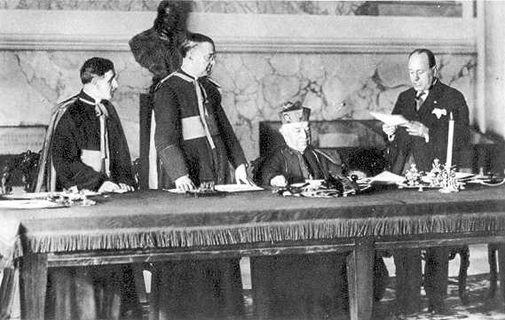
Deadly Wound Healed: The Papacy…
Benito Mussolini and Cardinal Gasparri (signing on behalf of Pope Pius XI).
The Lateran Treaty (Accord): 1929

Slide 21
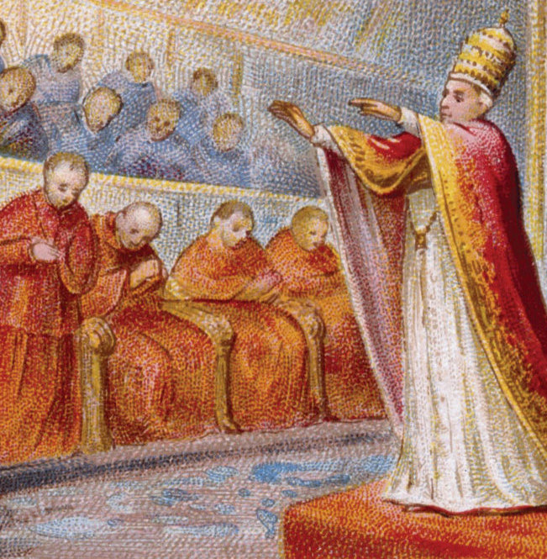
New York Times Article Confirms
“ROME, Feb. 11.--The Pope is again an independent sovereign ruler, as he was throughout the Middle Ages, though his temporal realm, established today, is the most microscopic independent State in the world, and probably the smallest in all history.” — THE NEW YORK TIMES, Tuesday, February 12, 1929.

Slide 22
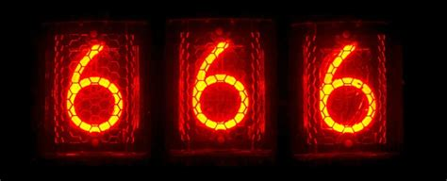
The Number of his Name…
Papal Titles:
Vicarius Christi (Vicar of Christ)
Vicarius Filii Dei (Vicar of the Son of God)
Pontifex Maximus (Supreme Pontiff)
Pope
Papacy
Holy See
Holy Father
Rev. 13:17-18 “ And that no man might buy or sell, save he that had the mark, or the name of the beast, or the number of his name. Here is wisdom. Let him that hath understanding count the number of the beast: for it is the number of a man; and his number is Six hundred threescore and six.”

Slide 23
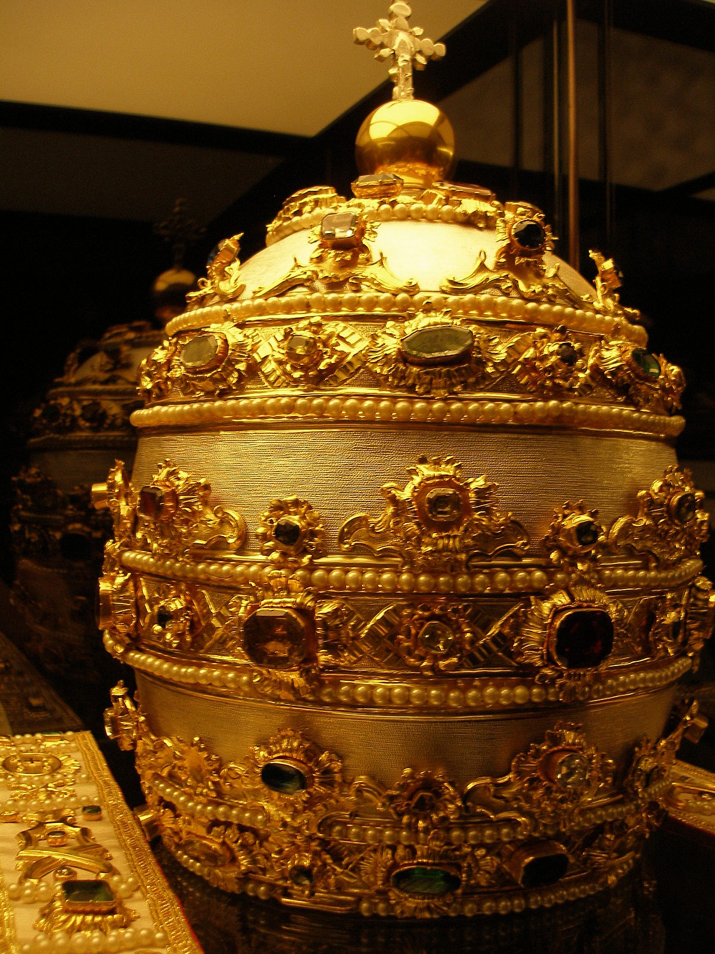
The Number and the Title (of a man)
Catholic F. Lucii Ferraris, in his Latin encyclopedia called Prompta Bibliotheca canonica juridica moralis: “As the blessed Peter was constituted Vicar of the Son of God [this is written as VICARIUS FILII DEI in Ferraris’ Latin publication] on earth, so it is seen that the Pontiffs, his successors, hold for us and our empire the power of a supremacy on the earth greater than the clemency of our earthly imperial serenity.”
“The title of the Pope of Rome is Vicarius Filii Dei. This is inscribed on his mitre; and if you take the letters of his title (printed large) and add them together they come to 666...add these together and the total will be 666.”—Our Sunday Visitor, November 5, 1914

Slide 25
What About the Mark?
In the Forehead:
Heb. 10:16 “This is the covenant that I will make with them after those days, saith the Lord, I will put my laws into their hearts, and in their minds will I write them”
In the Hand:
Ecc. 9:9-10 “Live joyfully with the wife whom thou lovest all the days of the life of thy vanity, which he hath given thee under the sun, all the days of thy vanity: for that is thy portion in this life, and in thy labour which thou takest under the sun. Whatsoever thy hand findeth to do, do it with thy might; for there is no work, nor device, nor knowledge, nor wisdom, in the grave, whither thou goest.”

Slide 26
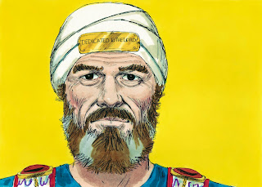
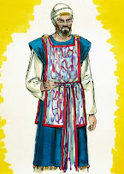
Law of God in the Forehead…
Ex. 13:9 “And it shall be for a sign unto thee upon thine hand, and for a memorial between thine eyes, that the Lord's law may be in thy mouth: for with a strong hand hath the Lord brought thee out of Egypt.”
Deut. 11:1, 8, 13-14, 18 “Therefore thou shalt love the Lord thy God, and keep his charge, and his statutes, and his judgments, and his commandments, alway. . . . Therefore shall ye keep all the commandments which I command you this day, that ye may be strong, and go in and possess the land, whither ye go to possess it . . . And it shall come to pass, if ye shall hearken diligently unto my commandments which I command you this day, to love the Lord your God, and to serve him with all your heart and with all your soul, That I will give you the rain of your land in his due season, the first rain and the latter rain, that thou mayest gather in thy corn, and thy wine, and thine oil. . . . Therefore shall ye lay up these my words in your heart and in your soul, and bind them for a sign upon your hand, that they may be as frontlets between your eyes.”

Slide 27
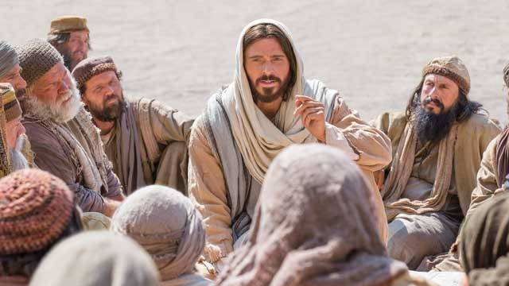
“It is well to remind the Presbyterians, Baptists, Methodists, and all other Christians, that the Bible does not support them anywhere in their observance of Sunday. Sunday is an institution of the Roman Catholic Church, and those who observe the day observe a commandment of the Catholic Church.”—Priest Brady, in an address reported in the Elizabeth NJ News on March 18, 1903
Matt. 15:9 “But in vain they do worship me, teaching for doctrines the commandments of men.”

Slide 28
Sabbath/Saturday or Sunday?
“Thus the observance of Sunday by the Protestants is a homage they pay, in spite of themselves, to the authority of the Church.” (Louis Gaston Segur, Plain Talk about the Protestantism of To-Day (London: Thomas Richardson and Son, 1874): p. 213)
“If Protestants would follow the Bible, they should worship God on the Sabbath day by God is Saturday. In keeping the Sunday, they are following a law of the Catholic Church.” (Chancellor Albert Smith for Cardinal of Baltimore Archdiocese, letter dated February 10, 1920)

Slide 29
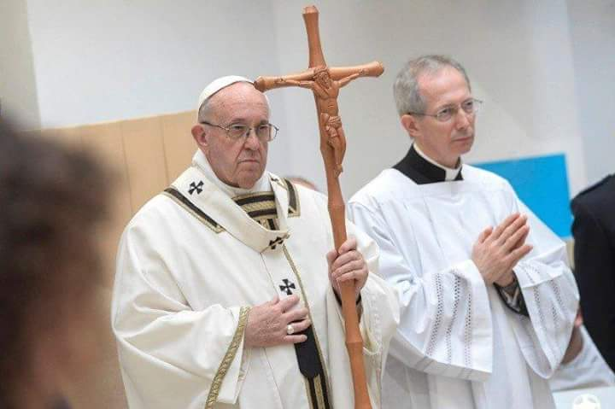
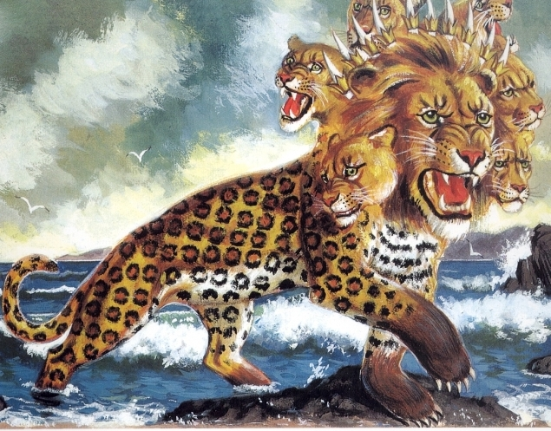
The Mark in Rome’s Words…
“Of course the Catholic Church claims that the change was her act. It could not have been otherwise, as none in those days would have dreamed of doing anything, in matters spiritual, ecclesiastical and religious without her. This act is a mark of her ecclesiastical power and authority in religious matters”—Letter written by the Chancellor of Cardinal Gibbons, CF Thomas (November 11, 1895).
“Sunday is our mark of authority. . . The church is above the Bible and this transference of Sabbath observance is proof of that fact”—Catholic Record, September 1, 1923 (Ontario)

Slide 30
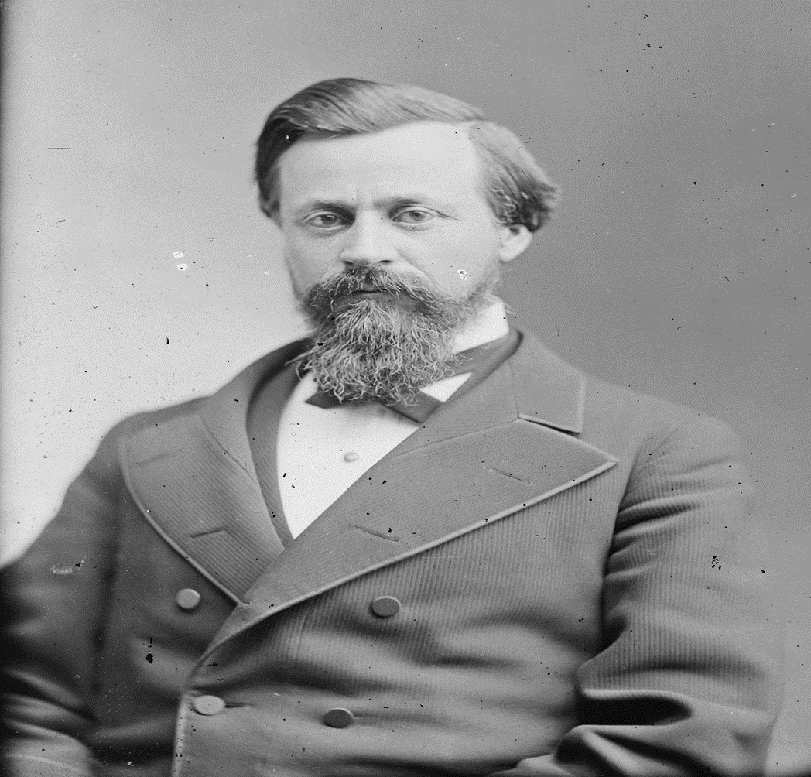
A “Sunday” Law???
“It is well known to most of our readers that United States Senator Henry W. Blair, from New Hampshire, introduced in the Fiftieth Congress, May 21, 1888, what has been commonly known as the " Blair Sunday-Rest bill," which was read twice, and referred to the Committee on Education and Labor. It was quite fully discussed pro and con. before the committee, with decided favors shown to those who favored the bill, by Mr. Blair, the author of the bill, who was also the chairman of the committee. Many millions of signatures to petitions for and against the bill came before Congress.” American Sentinel, Dec. 1889

Slide 31
Rome’s Challenge….
"It is not yet too late for Protestants to redeem themselves. Will they do it?... will they indeed take the written word only, the Scripture alone, as their sole authority and their sole standard? Or will they still hold the indefensible, self contradictory, and suicidal doctrine and practice of following the authority of the Catholic church and wear the SIGN of her authority? Will they keep the Sabbath of the Lord, the seventh day, according to Scripture? Or will they keep the Sunday according to the tradition of the Catholic church." (Canon and Tradition, page 31)

