Slide 1
It Will Happen!

Slide 2
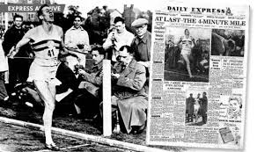
The Impossible 4 Minute Mile

Slide 3
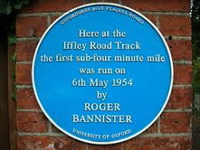
No one in Modern Times
No one , in modern times, had broken the 4 minute mile mark. It seemed IMPOSSIBLE! Until Roger Bannister did it!! He accomplished this feat on 6 May 1954 at Iffley Road track in Oxford, with Chris Chataway and Chris Brasher providing the pacing. When the announcer, Norris McWhirter, declared "The time was three...", the cheers of the crowd drowned out Bannister's exact time, which was 3 minutes and 59.4 seconds. He had attained this record with minimal training, while practicing as a junior doctor.

Slide 4
In This Time of Atonement
“Then shall he kill the goat of the sin offering, that is for the people, and bring his blood within the vail, and do with that blood as he did with the blood of the bullock, and sprinkle it upon the mercy seat, and before the mercy seat: And he shall make an atonement for the holy place, because of the uncleanness of the children of Israel, and because of their transgressions in all their sins: and so shall he do for the tabernacle of the congregation, that remaineth among them in the midst of their uncleanness. And there shall be no man in the tabernacle of the congregation when he goeth in to make an atonement in the holy place, until he come out, and have made an atonement for himself, and for his household, and for all the congregation of Israel. And he shall go out unto the altar that is before the LORD, and make an atonement for it; and shall take of the blood of the bullock, and of the blood of the goat, and put it upon the horns of the altar round about. And he shall sprinkle of the blood upon it with his finger seven times, and cleanse it, and hallow it from the uncleanness of the children of Israel.” Leviticus 16:15-19

Slide 5
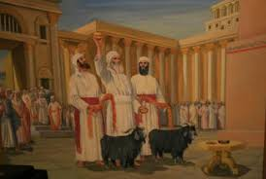
Once each year, on the Day of Atonement, the High Priest took care of the sin problem in the sanctuary. Once each year, he would cleanse the temple of all the accumulated sins of penitent Israel. This happened thru the blood of the Lord’s goat. He would enter into the Most Holy Place and sprinkle the blood on the mercy seat. Then, he would go out to the Holy Place, and make atonement for it, and then sprinkle blood on the horns of the altar of burnt offering. In doing thus, he had removed all the sins that had defiled the temple throughout the year.

Slide 6
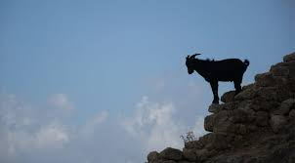
Placed on Azazel-the scapegoat
“And when he hath made an end of reconciling the holy place, and the tabernacle of the congregation, and the altar, he shall bring the live goat: And Aaron shall lay both his hands upon the head of the live goat, and confess over him all the iniquities of the children of Israel, and all their transgressions in all their sins, putting them upon the head of the goat, and shall send him away by the hand of a fit man into the wilderness: And the goat shall bear upon him all their iniquities unto a land not inhabited: and he shall let go the goat in the wilderness.” Lev. 16:20-22

Slide 7
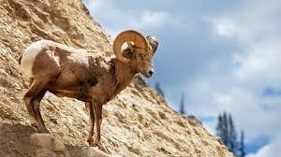
Atonement in the Sanctuary was Complete!
With the scapegoat gone, bearing upon himself the sins of penitent Israel, the sin problem in the temple was resolved. While the sanctuary was cleansed, something else had to be cleansed as well. The sanctuary of the Heart!!!

Slide 8
Cleansed before the Lord!
“And this shall be a statute for ever unto you: that in the seventh month, on the tenth day of the month, ye shall afflict your souls, and do no work at all, whether it be one of your own country, or a stranger that sojourneth among you: For on that day shall the priest make an atonement for you, to cleanse you, that ye may be clean from all your sins before the LORD. It shall be a sabbath of rest unto you, and ye shall afflict your souls, by a statute for ever.” Leviticus 16:29-31

Slide 9
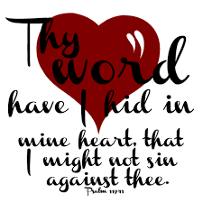
While the sin problem is being resolved in the temple, the sin problem must be dealt with in the sanctuary of every heart. For those who resolved the sin problem in their lives, they were at- one-ment with God. Those who clung to sin were removed from the camp along with the scapegoat. “And ye shall do no work in that same day: for it is a day of atonement, to make an atonement for you before the LORD your God. For whatsoever soul it be that shall not be afflicted in that same day, he shall be cut off from among his people. And whatsoever soul it be that doeth any work in that same day, the same soul will I destroy from among his people.” Leviticus 23:28-30

Slide 10
“The apostle sought to teach the believers how important it is to keep the mind from wandering to forbidden themes or from spending its energies on trifling subjects. Those who would not fall a prey to Satan's devices, must guard well the avenues of the soul; they must avoid reading, seeing, or hearing that which will suggest impure thoughts. The mind must not be left to dwell at random upon every subject that the enemy of souls may suggest. The heart must be faithfully sentineled, or evils without will awaken evils within, and the soul will wander in darkness. “Gird up the loins of your mind,” Peter wrote, “be sober, and hope to the end for the grace that is to be brought unto you at the revelation of Jesus Christ; ... not fashioning yourselves according to the former lusts in your ignorance: but as He which hath called you is holy, so be ye holy in all manner of conversation; because it is written, Be ye holy; for I am holy.” AA, pg. 518

Slide 11
Putting Away of Sin!
Says the prophet: "Who may abide the day of His coming? and who shall stand when He appeareth? for He is like a refiner's fire, and like fullers' soap: and He shall sit as a refiner and purifier of silver: and He shall purify the sons of Levi, and purge them as gold and silver, that they may offer unto the Lord an offering in righteousness." Malachi 3:2, 3. Those who are living upon the earth when the intercession of Christ shall cease in the sanctuary above are to stand in the sight of a holy God without a mediator. Their robes must be spotless, their characters must be purified from sin by the blood of sprinkling. Through the grace of God and their own diligent effort they must be conquerors in the battle with evil. While the investigative judgment is going forward in heaven, while the sins of penitent believers are being removed from the sanctuary, there is to be a special work of purification, of putting away of sin, among God's people upon earth. This work is more clearly presented in the messages of Revelation 14.” Great Controversy, pg. 425

Slide 12
This is Nothing New!
The Day of Atonement doesn’t mean that forgiveness can not be offered since 1844. Forgiveness for sin is still available. “If we confess our sins, he is faithful and just to forgive us our sins, and to cleanse us from all unrighteousness.” 1 John 1:9 “Who is a God like unto thee, that pardoneth iniquity, and passeth by the transgression of the remnant of his heritage? he retaineth not his anger for ever, because he delighteth in mercy. He will turn again, he will have compassion upon us; he will subdue our iniquities; and thou wilt cast all their sins into the depths of the sea.” Micah 7:18,19

Slide 13
It is more than Forgiveness!
The Day of Atonement cleanses the temple from sin and God wants to cleanse the soul temple from sin as well. It isn’t about sinning and repenting, it is about representing to the universe that God’s requirement for obedience to His law is fair and just and POSSIBLE through faith in His power! “Having therefore these promises, dearly beloved, let us cleanse ourselves from all filthiness of the flesh and spirit, perfecting holiness in the fear of God.” 2 Corinthians 7:1

Slide 14
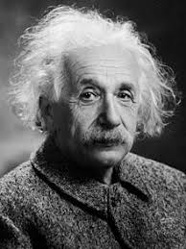
Theory of Relativity
. Albert Einstein, German: 14 March 1879 – 18 April 1955) was a German-born theoretical physicist[5] who developed the theory of relativity, one of the two pillars of modern physics (alongside quantum mechanics). His work is also known for its influence on the philosophy of science. He is best known to the general public for his mass–energy equivalence formula E = mc2, which has been dubbed "the world's most famous equation". He received the 1921 Nobel Prize in Physics "for his services to theoretical physics, and especially for his discovery of the law of the photoelectric effect",[10] a pivotal step in the development of quantum theory.

Slide 15
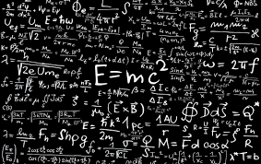
Albert Einstein formulated the equation of the theory of special relativity. In 1905, Einstein’s theory existed, symbols on paper, but in inherent in these symbols was the power to move mountains and produce light equal to the sun. Taken to a place that Einstein opposed, this theory would make possible the annihilation of the human race. It took some 40 long years for Einstein’s premise to become a vital creation.

Slide 16
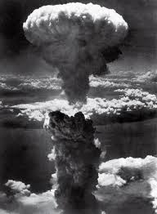
Einstein’s Theory Became Fact!!!

Slide 17
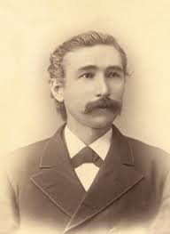
1848 Bible Conferences
In 1848, a series of Bible conferences were convened in the Northeastern United States. The attendees included the likes of James and Ellen White, Joseph Bates, J. N. Andrews. Hiram Edson, and Pierce. Some 40 years later, in 1888, an awesome theory, called righteousness by faith, was shared with SDAdventism through Jones and Wagoneer. Their theories were so powerful, Ellen white said the latter rain was falling. But would the theory be carried out?????

Slide 18
Most Precious Message!
“The Lord in His great mercy sent a most precious message to His people through Elders Waggoner and Jones. This message was to bring more prominently before the world the uplifted Saviour, the sacrifice for the sins of the whole world. It presented justification through faith in the Surety; it invited the people to receive the righteousness of Christ, which is made manifest in obedience to all the commandments of God. Many had lost sight of Jesus. They needed to have their eyes directed to His divine person, His merits, and His changeless love for the human family. All power is given into His hands, that He may dispense rich gifts unto men, imparting the priceless gift of His own righteousness to the helpless human agent. This is the message that God commanded to be given to the world. It is the third angel's message, which is to be proclaimed with a loud voice, and attended with the outpouring of His Spirit in a large measure.” TM, pgs. 91,92

Slide 19
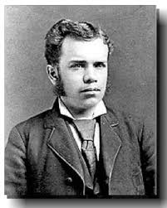
The A- Bomb and the 144,000
Einstein’s theory lived in 1945. Before that, it was only on paper. Today, the message of righteousness by faith, still is a theory. God still waits for a people to allow Christ to enable them to overcome sin and complete the atonement in their lives. Sadly, for Jones and Wagoneer, they preached a mighty message on paper, but it never consumed their veins. The 144,000 will live, they will show the world that God is fair and that His law can be obeyed thru faith in the power of Christ. Let us be among those who vindicate the character of God!!!

Slide 20
Well??????????? Our Decision?????
“Now, while our great High Priest is making the atonement for us, we should seek to become perfect in Christ. Not even by a thought could our Saviour be brought to yield to the power of temptation. Satan finds in human hearts some point where he can gain a foothold; some sinful desire is cherished, by means of which his temptations assert their power. But Christ declared of Himself: “The prince of this world cometh, and hath nothing in Me.” John 14:30. Satan could find nothing in the Son of God that would enable him to gain the victory. He had kept His Father's commandments, and there was no sin in Him that Satan could use to his advantage. This is the condition in which those must be found who shall stand in the time of trouble. It is in this life that we are to separate sin from us, through faith in the atoning blood of Christ. Our precious Saviour invites us to join ourselves to Him, to unite our weakness to His strength, our ignorance to His wisdom, our unworthiness to His merits. God's providence is the school in which we are to learn the meekness and lowliness of Jesus. The Lord is ever setting before us, not the way we would choose, which seems easier and pleasanter to us, but the true aims of life. It rests with us to co-operate with the agencies which Heaven employs in the work of conforming our characters to the divine model. None can neglect or defer this work but at the most fearful peril to their souls.” GC, pg. 623

