Slide 1
Amazing Grace, pt. 5
‘Woman of Privilege’

Slide 2
She Had it Made!
She had everything! She came from a fine family. She lacked for nothing. She was beautiful outwardly and had some beautiful inward traits as well. She was engaging, friendly, generous, and a keen analyzer of things.

Slide 3
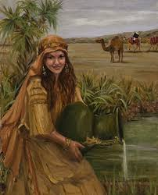
Her Story Begins….
It was at the local watering hole where we are introduced to our character today. She brought her pitcher to the local well to get water. While there, a man, heretofore, unknown to her, approached and requested her assistance. Her answer would determine the rest of her life!

Slide 4
Rebekkah
“And it came to pass, before he had done speaking, that, behold, Rebekah came out, who was born to Bethuel, son of Milcah, the wife of Nahor, Abraham's brother, with her pitcher upon her shoulder. And the damsel was very fair to look upon, a virgin, neither had any man known her: and she went down to the well, and filled her pitcher, and came up. And the servant ran to meet her, and said, Let me, I pray thee, drink a little water of thy pitcher. And she said, Drink, my lord: and she hasted, and let down her pitcher upon her hand, and gave him drink. And when she had done giving him drink, she said, I will draw water for thy camels also, until they have done drinking. And she hasted, and emptied her pitcher into the trough, and ran again unto the well to draw water, and drew for all his camels.” Gen. 24:15-20

Slide 5
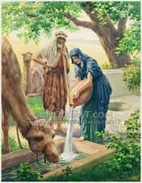
Answer to Prayer
“Among the women who were gathered at the well, the courteous manners of one attracted his attention. As she came from the well, the stranger went to meet her, asking for some water from the pitcher upon her shoulder. The request received a kindly answer, with an offer to draw water for the camels also, a service which it was customary even for the daughters of princes to perform for their fathers' flocks and herds. Thus the desired sign was given. The maiden "was very fair to look upon," and her ready courtesy gave evidence of a kind heart and an active, energetic nature.” PP, pgs. 172,173

Slide 6
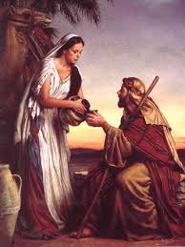
Young Lady of Action
“And her brother and her mother said, Let the damsel abide with us a few days, at the least ten; after that she shall go. And he said unto them, Hinder me not, seeing the LORD hath prospered my way; send me away that I may go to my master. And they said, We will call the damsel, and enquire at her mouth. And they called Rebekah, and said unto her, Wilt thou go with this man? And she said, I will go.” Gen. 24:55-58

Slide 7
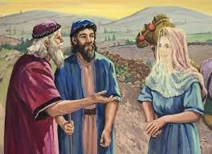
Fairy Tale Wedding
“And Rebekah lifted up her eyes, and when she saw Isaac, she lighted off the camel. For she had said unto the servant, What man is this that walketh in the field to meet us? And the servant had said, It is my master: therefore she took a vail, and covered herself. And the servant told Isaac all things that he had done. And Isaac brought her into his mother Sarah's tent, and took Rebekah, and she became his wife; and he loved her: and Isaac was comforted after his mother's death.” Gen. 24:64-67 “And Isaac was forty years old when he took Rebekah to wife, the daughter of Bethuel the Syrian of Padanaram, the sister to Laban the Syrian.” Gen. 25:20 Rebekah was around 15-20, half his age!!

Slide 8
The Trouble Begins!
“And Isaac intreated the LORD for his wife, because she was barren: and the LORD was intreated of him, and Rebekah his wife conceived. And the children struggled together within her; and she said, If it be so, why am I thus? And she went to enquire of the LORD. And the LORD said unto her, Two nations are in thy womb, and two manner of people shall be separated from thy bowels; and the one people shall be stronger than the other people; and the elder shall serve the younger. And when her days to be delivered were fulfilled, behold, there were twins in her womb. And the first came out red, all over like an hairy garment; and they called his name Esau. And after that came his brother out, and his hand took hold on Esau's heel; and his name was called Jacob: and Isaac was threescore years old when she bare them.” Genesis 25:21-26 “And Isaac loved Esau, because he did eat of his venison: but Rebekah loved Jacob.” Gen. 25: 28

Slide 9
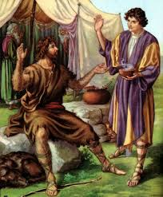
Esau and Jacob
“He gloried in the unrestrained freedom of his wild, roving life. Rebekah remembered the words of the angel, and she read with clearer insight than did her husband the character of their sons. She was convinced that the heritage of divine promise was intended for Jacob. She repeated to Isaac the angel's words; but the father's affections were centered upon the elder son, and he was unshaken in his purpose.” PP, pg. 178

Slide 10
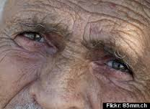
Isaac Still Couldn’t See it!
“Then Jacob gave Esau bread and pottage of lentils; and he did eat and drink, and rose up, and went his way: thus Esau despised his birthright.” Gen. 25:34 “³⁴And Esau was forty years old when he took to wife Judith the daughter of Beeri the Hittite, and Bashemath the daughter of Elon the Hittite: Which were a grief of mind unto Isaac and to Rebekah.” Gen. 26:34,35

Slide 11
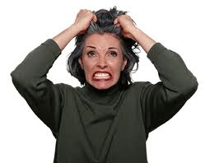
Rebekah Fit to be Tied
Rebekah was fit to be tied.
1. The angel told her.
2. Esau was irreverent and had no desire for religious things.
3. Esau sold it to Jacob.
4. Esau forfeited the birthright by marrying outside the faith.
5. Rebekah could not get it thru her husband’s thick skull!!!
Sound familiar?

Slide 12
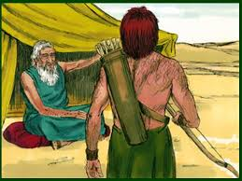
Isaac Makes Plans
“And it came to pass, that when Isaac was old, and his eyes were dim, so that he could not see, he called Esau his eldest son, and said unto him, My son: and he said unto him, Behold, here am I. And he said, Behold now, I am old, I know not the day of my death: Now therefore take, I pray thee, thy weapons, thy quiver and thy bow, and go out to the field, and take me some venison; And make me savoury meat, such as I love, and bring it to me, that I may eat; that my soul may bless thee before I die. And Rebekah heard when Isaac spake to Esau his son.” Gen. 27:1-5

Slide 13
What Should she do?
1. Her fondest and cherished dream for Jacob, her beloved son, was slipping thru her fingers.
2. Her husband was making the dumbest decision of his life.
3. She could kill him, but that would be too direct!!
4. She had tried everything else; what could she do?

Slide 14
Stratagem-Distrusted God!
“And Rebekah spake unto Jacob her son, saying, Behold, I heard thy father speak unto Esau thy brother, saying, Bring me venison, and make me savoury meat, that I may eat, and bless thee before the LORD before my death. Now therefore, my son, obey my voice according to that which I command thee. Go now to the flock, and fetch me from thence two good kids of the goats; and I will make them savoury meat for thy father, such as he loveth: And thou shalt bring it to thy father, that he may eat, and that he may bless thee before his death. And Jacob said to Rebekah his mother, Behold, Esau my brother is a hairy man, and I am a smooth man: My father peradventure will feel me, and I shall seem to him as a deceiver; and I shall bring a curse upon me, and not a blessing. And his mother said unto him, Upon me be thy curse, my son: only obey my voice, and go fetch me them.” Gen. 27:6-13

Slide 15
God’s Way-God’s Time
“She told Jacob what had taken place, urging the necessity of immediate action to prevent the bestowal of the blessing, finally and irrevocably, upon Esau. And she assured her son that if he would follow her directions, he might obtain it as God had promised. Jacob did not readily consent to the plan that she proposed. The thought of deceiving his father caused him great distress. He felt that such a sin would bring a curse rather than a blessing. But his scruples were overborne, and he proceeded to carry out his mother's suggestions. It was not his intention to utter a direct falsehood, but once in the presence of his father he seemed to have gone too far to retreat, and he obtained by fraud the coveted blessing.
Jacob and Rebekah succeeded in their purpose, but they gained only trouble and sorrow by their deception. God had declared that Jacob should receive the birthright, and His word would have been fulfilled in His own time had they waited in faith for Him to work for them. But like many who now profess to be children of God, they were unwilling to leave the matter in His hands.” PP, pg .180

Slide 16
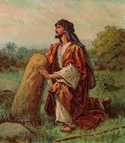
The Consequences
“Rebekah bitterly repented the wrong counsel she had given her son; it was the means of separating him from her, and she never saw his face again.” PP, pg. 180
We bring consequences on ourselves. Rebekah deserved this. Her last years, without Jacob near, were indeed bitter ones.

Slide 17
Were it not for the tender compassion of the Lord, it could have driven Rebekah to insanity or suicide. How many aching moments must she have cried in secret to the Lord. The Lord supplied His amazing grace to keep her going thru her pain.

Slide 18
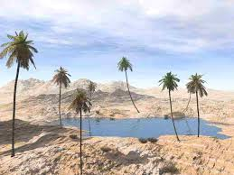
Desert into Springtime
“Casting all your care upon him; for he careth for you.” 1 Peter 5:7
“For the LORD shall comfort Zion: he will comfort all her waste places; and he will make her wilderness like Eden, and her desert like the garden of the LORD; joy and gladness shall be found therein, thanksgiving, and the voice of melody.” Isa. 51:3

Slide 19
The quiet moments, in which the devil seeks to tear us up, like Rebekah, were and only are bearable thru God’s amazing grace that recognizes our foolishness and sympathizes with our self inflicted grief. Praise God for His Amazing Grace that saved Rebekah from herself!

