Slide 1
Ancient Adventism: Were You There?

Slide 2
Who Are They Really?
The Jews of the Bible, from their beginning were looking forward to the coming of the Messiah and that makes them Adventists. They also worshipped on the 7th day Sabbath. Thus, the Jews were 7th day Adventists. Let us notice the amazing parallels between them and us today!

Slide 3
Save the Organization/Kill the Truth!
“But some of them went their ways to the Pharisees, and told them what things Jesus had done. Then gathered the chief priests and the Pharisees a council, and said, What do we? for this man doeth many miracles. If we let him thus alone, all men will believe on him: and the Romans shall come and take away both our place and nation. And one of them, named Caiaphas, being the high priest that same year, said unto them, Ye know nothing at all, Nor consider that it is expedient for us, that one man should die for the people, and that the whole nation perish not. And this spake he not of himself: but being high priest that year, he prophesied that Jesus should die for that nation;” John 11:46-51

Slide 4
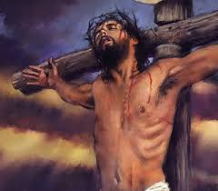
Kill the Messiah
John 14:6 “Thomas saith unto him, Lord, we know not whither thou goest; and how can we know the way? Jesus saith unto him, I am the way, the truth, and the life: no man cometh unto the Father, but by me.” In order to save their organization and their job, they would kill the truth who was Christ!

Slide 5
Slaughter the Savior!
“Even if Jesus were innocent, urged the high priest, He must be put out of the way. He was troublesome, drawing the people to Himself, and lessening the authority of the rulers. He was only one; it was better that He should die than that the authority of the rulers should be weakened. If the people were to lose confidence in their rulers, the national power would be destroyed. Caiaphas urged that after this miracle the followers of Jesus would likely rise in revolt. The Romans will then come, he said, and will close our temple, and abolish our laws, destroying us as a nation. What is the life of this Galilean worth in comparison with the life of the nation? If He stands in the way of Israel's well-being, is it not doing God a service to remove Him? Better that one man perish than that the whole nation be destroyed.” DA, pg. 540

Slide 6
Fear of the Jews!
“These words spake his parents, because they feared the Jews: for the Jews had agreed already, that if any man did confess that he was Christ, he should be put out of the synagogue.” Jn. 9:22
“And after this Joseph of Arimathaea, being a disciple of Jesus, but secretly for fear of the Jews, besought Pilate that he might take away the body of Jesus: and Pilate gave him leave. He came therefore, and took the body of Jesus.” Jn. 19:38
“Then the same day at evening, being the first day of the week, when the doors were shut where the disciples were assembled for fear of the Jews, came Jesus and stood in the midst, and saith unto them, Peace be unto you.” Jn. 20:19

Slide 7
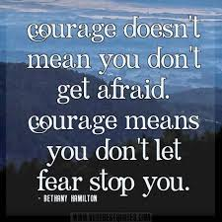
Fear!
“For God hath not given us the spirit of fear; but of power, and of love, and of a sound mind. Be not thou therefore ashamed of the testimony of our Lord, nor of me his prisoner: but be thou partaker of the afflictions of the gospel according to the power of God;” 2 Tim. 1:7,8

Slide 8
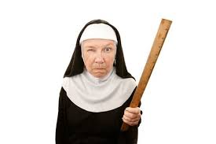
Obsessed by Outward Acts!
Then led they Jesus from Caiaphas unto the hall of judgment: and it was early; and they themselves went not into the judgment hall, lest they should be defiled; but that they might eat the Passover.” Jn. 18:28

Slide 9
WELL?
“The rabbis counted their righteousness a passport to heaven; but Jesus declared it to be insufficient and unworthy. External ceremonies and a theoretical knowledge of truth constituted Pharisaical righteousness. The greatest deception of the human mind in Christ's day was that a mere assent to the truth constitutes righteousness. In all human experience a theoretical knowledge of the truth has been proved to be insufficient for the saving of the soul. It does not bring forth the fruits of righteousness. A jealous regard for what is termed theological truth often accompanies a hatred of genuine truth as made manifest in life. The darkest chapters of history are burdened with the record of crimes committed by bigoted religionists…”

Slide 10
… They thought themselves the greatest religionists of the world, but their so-called orthodoxy led them to crucify the Lord of glory.
The same danger still exists. Many take it for granted that they are Christians, simply because they subscribe to certain theological tenets. But they have not brought the truth into practical life. They have not believed and loved it, therefore they have not received the power and grace that come through sanctification of the truth. Men may profess faith in the truth; but if it does not make them sincere, kind, patient, forbearing, heavenly-minded, it is a curse to its possessors, and through their influence it is a curse to the world.” DA, pgs. 309, 310

Slide 11
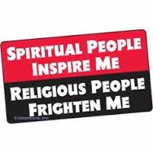
Sabbath Desecration!
“The Jews therefore, because it was the preparation, that the bodies should not remain upon the cross on the sabbath day, (for that sabbath day was an high day,) besought Pilate that their legs might be broken, and that they might be taken away.” Jn.19:31

Slide 12
Murder in our Heart!
“Instead of removing one jot of their force, He shows how far-reaching their principles are, and exposes the fatal mistake of the Jews in their outward show of obedience. He declares that by the evil thought or the lustful look the law of God is transgressed. One who becomes a party to the least injustice is breaking the law and degrading his own moral nature. Murder first exists in the mind. He who gives hatred a place in his heart is setting his feet in the path of the murderer, and his offerings are abhorrent to God.” DA, pg. 310

Slide 13
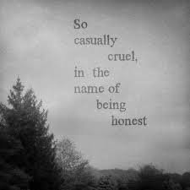
Slay People With Our tongues!
“Men may profess faith in the truth; but if it does not make them sincere, kind, patient, forbearing, heavenly-minded, it is a curse to its possessors, and through their influence it is a curse to the world.” DA, pg. 310

Slide 14
Sweep it Away!
“The people whom God had called to be the pillar and ground of the truth had become representatives of Satan. They were doing the work that he desired them to do, taking a course to misrepresent the character of God, and cause the world to look upon Him as a tyrant. The very priests who ministered in the temple had lost sight of the significance of the service they performed. They had ceased to look beyond the symbol to the thing signified. In presenting the sacrificial offerings they were as actors in a play. The ordinances which God Himself had appointed were made the means of blinding the mind and hardening the heart. God could do no more for man through these channels. The whole system must be swept away.” DA, pg. 36

Slide 15
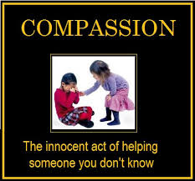
Condemned for Showing Compassion
“And he released unto them him that for sedition and murder was cast into prison, whom they had desired; but he delivered Jesus to their will. And as they led him away, they laid hold upon one Simon, a Cyrenian, coming out of the country, and on him they laid the cross, that he might bear it after Jesus.” LK. 23:25,26

Slide 16
We Were There!
“A vast multitude followed Jesus from the judgment hall to Calvary. The news of His condemnation had spread throughout Jerusalem, and people of all classes and all ranks flocked toward the place of crucifixion. The priests and rulers had been bound by a promise not to molest Christ's followers if He Himself were delivered to them, and the disciples and believers from the city and the surrounding region joined the throng that followed the Saviour.
As Jesus passed the gate of Pilate's court, the cross which had been prepared for Barabbas was laid upon His bruised and bleeding shoulders.” DA, pg. 741

Slide 17
Compassion
“His persecutors saw that it was impossible for Him to carry His burden farther. They were puzzled to find anyone who would bear the humiliating load. The Jews themselves could not do this, because the defilement would prevent them from keeping the Passover. None even of the mob that followed Him would stoop to bear the cross.
At this time a stranger, Simon a Cyrenian, coming in from the country, meets the throng. He hears the taunts and ribaldry of the crowd; he hears the words contemptuously repeated, Make way for the King of the Jews! He stops in astonishment at the scene; and as he expresses his compassion, they seize him and place the cross upon his shoulders.” DA, pg. 742

Slide 18
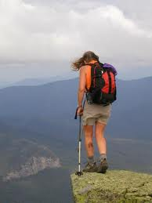
Claim and Action?!?
Simon’s sin was compassion! Since we are the professed people of God, living at the end of time, claiming to be following all of God’s commandments, how can we say we honor the last six commandments, which are love to man, when we don’t share the truth with others? The world is at the precipice; we are the only ones with a safety net; will we not share our net with others? May we be found guilty of compassion!!!!!

Slide 19
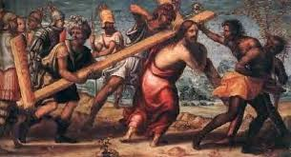
Guilty of Compassion
Could we be condemned in a court of law today for showing compassion? Or, is our religious experience all about outward acts? Are we sacrificing people’s reputations today; are we sacrificing the truth today in order to save ourselves from doing what is right? Are we a religious Adventist like Caiaphas or a heathen showing compassion like Simon?

