Slide 1
Against All Odds, pt. 5 ‘185,000 men’

Slide 2
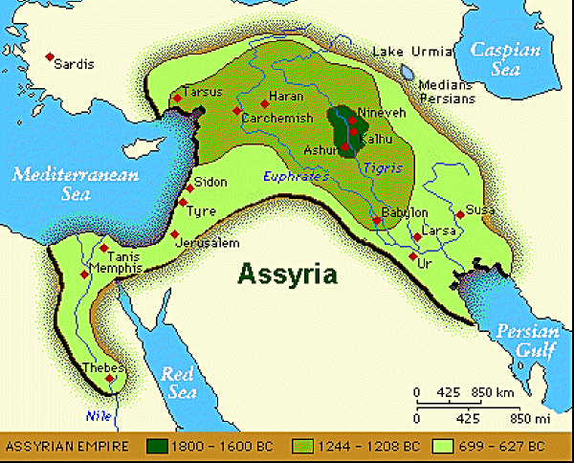
Crushed All Comers
He had crushed all comers in the Middle East. The Syrians were no match for him; the Babylonian hordes succumbed to his hands; the Phoenicians had fallen at his feet; the Egyptians were no match for his power, and the Ethiopians were as nothing in front of him. Even the Israelites of the Northern Kingdom had been carried away captive before his onslaught!!! Could anybody stop this mad man of the Middle East??

Slide 3
Who Was Strong Enough?
“Know ye not what I and my fathers have done unto all the people of other lands? were the gods of the nations of those lands any ways able to deliver their lands out of mine hand? Who was there among all the gods of those nations that my fathers utterly destroyed, that could deliver his people out of mine hand,…for no god of any nation or kingdom was able to deliver his people out of mine hand, and out of the hand of my fathers: how much less shall your God deliver you out of mine hand?” 2 Chronicles 32:12-14

Slide 4
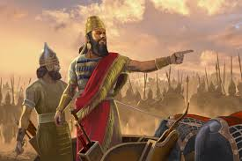
Sennacherib was the king of the Neo-Assyrian Empire from the death of his father Sargon II in 705 BC to his own death in 681 BC. The second king of the Sargonid dynasty, Sennacherib is one of the most famous Assyrian kings for the role he plays in the Hebrew Bible, which describes his campaign in the Levant. Other events of his reign include his destruction of the city of Babylon in 689 BC and his renovation and expansion of the last great Assyrian capital, Nineveh.

Slide 5
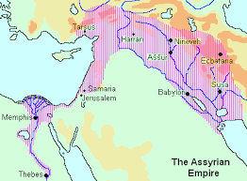
No one had opposed his advance throughout the Middle East and Sennacherib was confident that no one would. During the expansion of Assyria into a major empire, the Assyrians had conquered various neighboring kingdoms, either annexing them as Assyrian provinces or turning them into vassal states. Because the Assyrians venerated the long history and culture of Babylon, it was preserved as a full kingdom, either ruled by an appointed client king, or by the Assyrian king in a personal union. The relationship between Assyria and Babylonia was similar to the relationship between Greece and Rome in later centuries; much of Assyria's culture, texts and traditions had been imported from the south.

Slide 6
Judah and Hezekiah Were Next!!
Sennacherib's account of what happened at Jerusalem begins with "As for Hezekiah ... like a caged bird I shut up in Jerusalem his royal city. I barricaded him with outposts, and exit from the gate of his city I made taboo for him." Thus, Jerusalem was blockaded in some capacity, though the lack of massive military activities and appropriate equipment meant that it was probably not a full siege. According to the Biblical narrative, a senior Assyrian official with the title Rabshakeh stood in front of the city's walls and demanded its surrender, threatening that the Judeans would 'eat feces and drink urine' during the siege.” Wikipedia

Slide 7
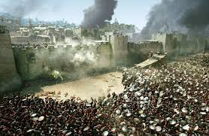
The Biblical Account
“Thus saith Sennacherib king of Assyria, Whereon do ye trust, that ye abide in the siege in Jerusalem? Doth not Hezekiah persuade you to give over yourselves to die by famine and by thirst, saying, The LORD our God shall deliver us out of the hand of the king of Assyria? Hath not the same Hezekiah taken away his high places and his altars, and commanded Judah and Jerusalem, saying, Ye shall worship before one altar, and burn incense upon it? Know ye not what I and my fathers have done unto all the people of other lands? were the gods of the nations of those lands any ways able to deliver their lands out of mine hand?” 2 Chronicles 32:10-13

Slide 8
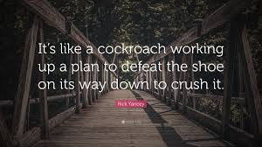
Crush you Like a Pea!
“The forces of Assyria, advancing from triumph to triumph, appeared in Judea. Confident of victory, the leaders divided their forces into two armies, one of which was to meet the Egyptian army to the southward, while the other was to besiege Jerusalem. Judah's only hope was now in God. All possible help from Egypt had been cut off, and no other nations were near to lend a friendly hand. The Assyrian officers, sure of the strength of their disciplined forces, arranged for a conference with the chief men of Judah, during which they insolently demanded the surrender of the city. This demand was accompanied by blasphemous reviling's against the God of the Hebrews. Because of the weakness and apostasy of Israel and Judah, the name of God was no longer feared among the nations, but had become a subject for continual reproach.” PK., pg. 352

Slide 9
Hezekiah’s Strategy
“The power of the oppressor was to be broken. Yet Hezekiah, in the earlier years of his reign, had continued to pay tribute to Assyria, in harmony with the agreement entered into by Ahaz. Meanwhile the king had taken “counsel with his princes and his mighty men,” and had done everything possible for the defense of his kingdom. He had made sure of a bountiful supply of water within the walls of Jerusalem, while without the city there should be a scarcity. “Also he strengthened himself, and built up all the wall that was broken, and raised it up to the towers, and another wall without, and repaired Millo in the city of David, and made darts and shields in abundance. And he set captains of war over the people.” 2 Chronicles 32:3, 5, 6. Nothing had been left undone that could be done in preparation for a siege. At the time of Hezekiah's accession to the throne of Judah, the Assyrians had already carried captive a large number of the children of Israel from the northern kingdom; and a few years after he had begun to reign, and while he was still strengthening the defenses of Jerusalem, the Assyrians besieged and captured Samaria and scattered the ten tribes among the many provinces of the Assyrian realm. The borders of Judah were only a few miles distant, with Jerusalem less than fifty miles away; and the rich spoils to be found within the temple would tempt the enemy to return.” PK., pgs. 350, 351

Slide 10
Hezekiah’s Bold Defense
“After these things, and the establishment thereof, Sennacherib king of Assyria came, and entered into Judah, and encamped against the fenced cities, and thought to win them for himself. And when Hezekiah saw that Sennacherib was come, and that he was purposed to fight against Jerusalem, He took counsel with his princes and his mighty men to stop the waters of the fountains which were without the city: and they did help him. So there was gathered much people together, who stopped all the fountains, and the brook that ran through the midst of the land, saying, Why should the kings of Assyria come, and find much water? Also he strengthened himself, and built up all the wall that was broken, and raised it up to the towers, and another wall without, and repaired Millo in the city of David, and made darts and shields in abundance. And he set captains of war over the people, and gathered them together to him in the street of the gate of the city, and spake comfortably to them, saying, Be strong and courageous, be not afraid nor dismayed for the king of Assyria, nor for all the multitude that is with him: for there be more with us than with him: With him is an arm of flesh; but with us is the LORD our God to help us, and to fight our battles. And the people rested themselves upon the words of Hezekiah king of Judah.” 2 Chronicles 32:1-8

Slide 11
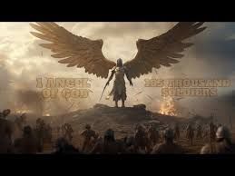
185,000 Men Go Down!
“Therefore thus saith the Lord concerning the king of Assyria, He shall not come into this city, nor shoot an arrow there, nor come before it with shield, nor cast a bank against it. By the way that he came, by the same shall he return, and shall not come into this city, saith the Lord. For I will defend this city, to save it, for Mine own sake, and for My servant David's sake.” Verses 29-34. That very night deliverance came. “The angel of the Lord went out, and smote in the camp of the Assyrians an hundred fourscore and five thousand.” Verse 35. “All the mighty men of valor, and the leaders and captains in the camp of the king of Assyria,” were slain. 2 Chronicles 32:21.
The God of the Hebrews had prevailed over the proud Assyrian. The honor of Jehovah was vindicated in the eyes of the surrounding nations. In Jerusalem the hearts of the people were filled with holy joy. Their earnest entreaties for deliverance had been mingled with confession of sin and with many tears. In their great need they had trusted wholly in the power of God to save, and He had not failed them.” PK., pg. 361

Slide 12
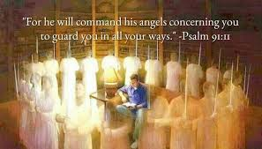
One with God is Supreme!
Elisha “Therefore sent he thither horses, and chariots, and a great host: and they came by night, and compassed the city about. And when the servant of the man of God was risen early, and gone forth, behold, an host compassed the city both with horses and chariots. And his servant said unto him, Alas, my master! how shall we do? And he answered, Fear not: for they that be with us are more than they that be with them. And Elisha prayed, and said, LORD, I pray thee, open his eyes, that he may see. And the LORD opened the eyes of the young man; and he saw: and, behold, the mountain was full of horses and chariots of fire round about Elisha.” 2 Kings 6:14-17

Slide 13
The Unseen
“Throughout the history of God's people great mountains of difficulty, apparently insurmountable, have loomed up before those who were trying to carry out the purposes of Heaven. Such obstacles are permitted by the Lord as a test of faith. When we are hedged about on every side, this is the time above all others to trust in God and in the power of His Spirit. The exercise of a living faith means an increase of spiritual strength and the development of an unfaltering trust. It is thus that the soul becomes a conquering power. Before the demand of faith, the obstacles placed by Satan across the pathway of the Christian will disappear; for the powers of heaven will come to his aid. “Nothing shall be impossible unto you.” Matthew 17:20.

Slide 14
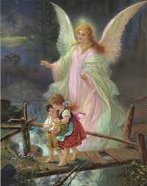
In the Coming Conflict
“And the ten horns which thou sawest are ten kings, which have received no kingdom as yet; but receive power as kings one hour with the beast. These have one mind, and shall give their power and strength unto the beast. These shall make war with the Lamb, and the Lamb shall overcome them: for he is Lord of lords, and King of kings: and they that are with him are called, and chosen, and faithful.” Rev. 17:12-14

